Slide 1
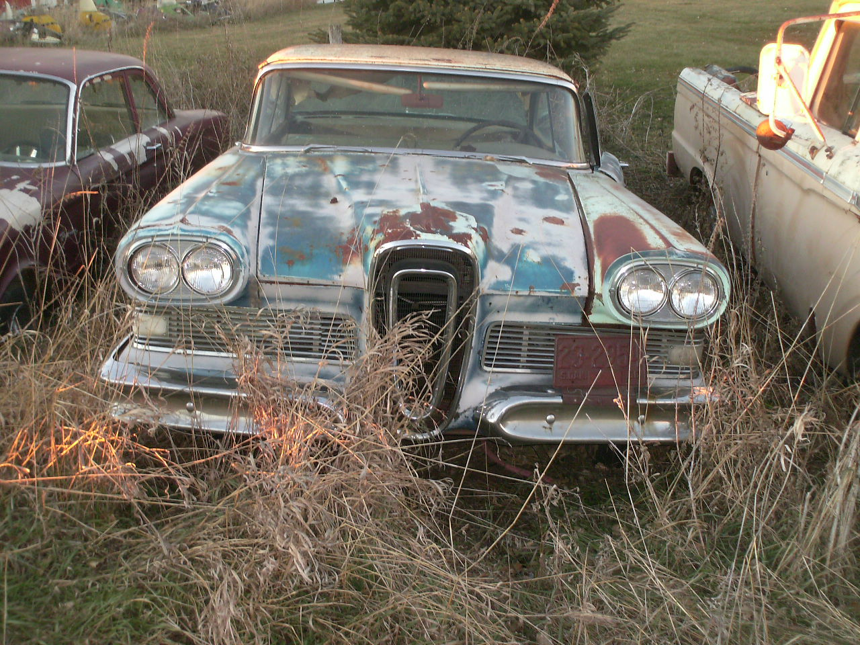

Slide 3
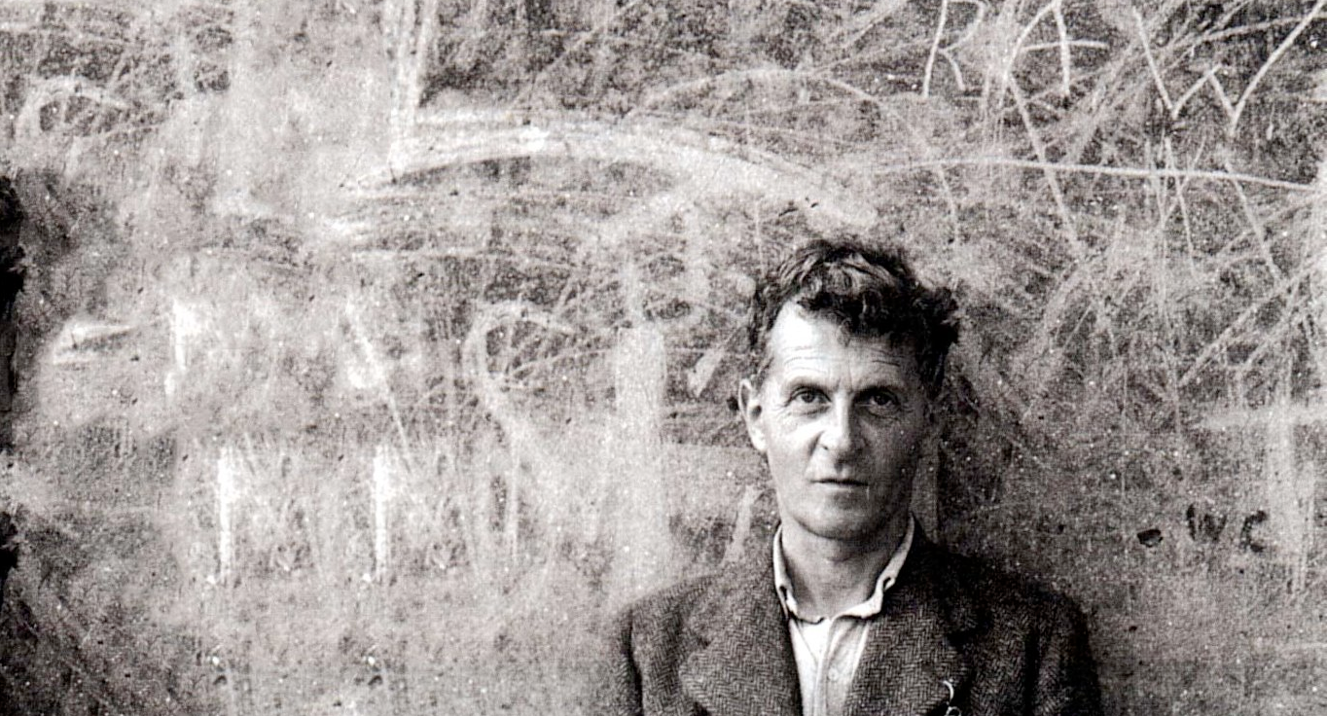
If people did not sometimes do silly things,
nothing intelligent would ever get done.
- Ludwig Wittgenstein

Slide 4
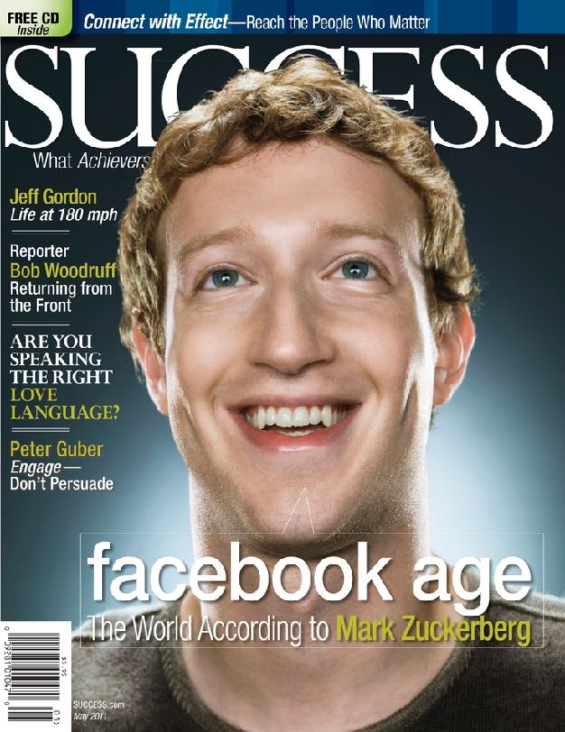
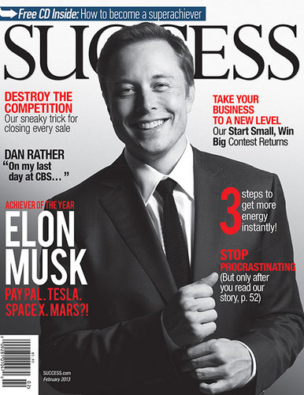
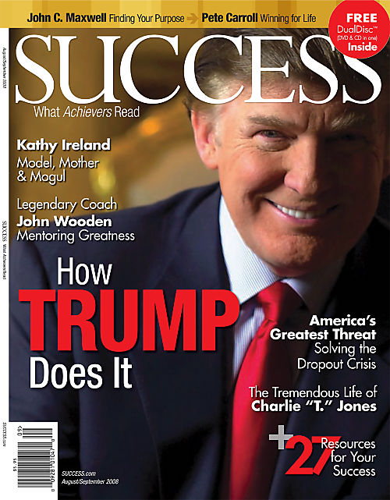

Slide 6
Learning is the only way to turn failure into success

Slide 7
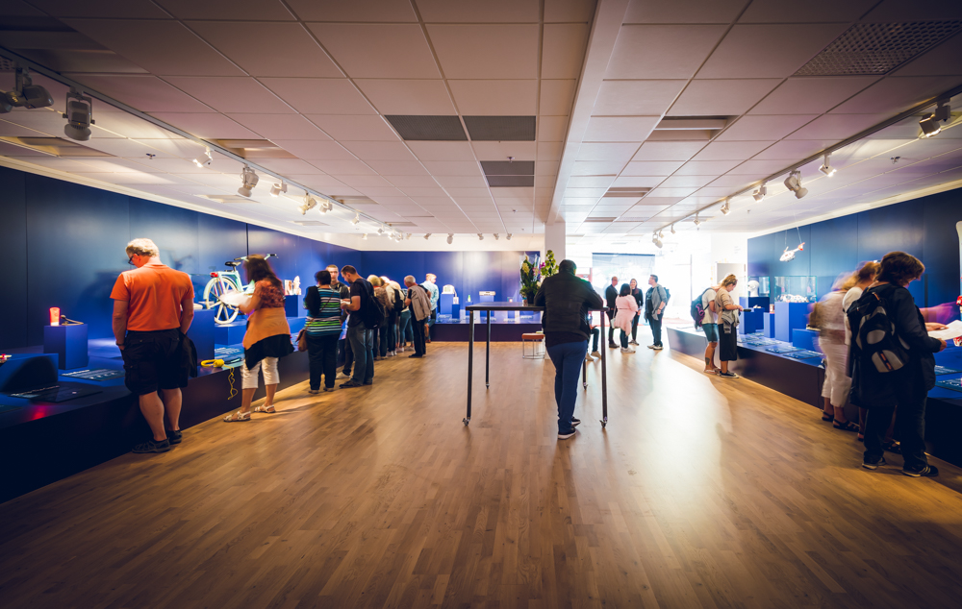
Helsingborg

Slide 8
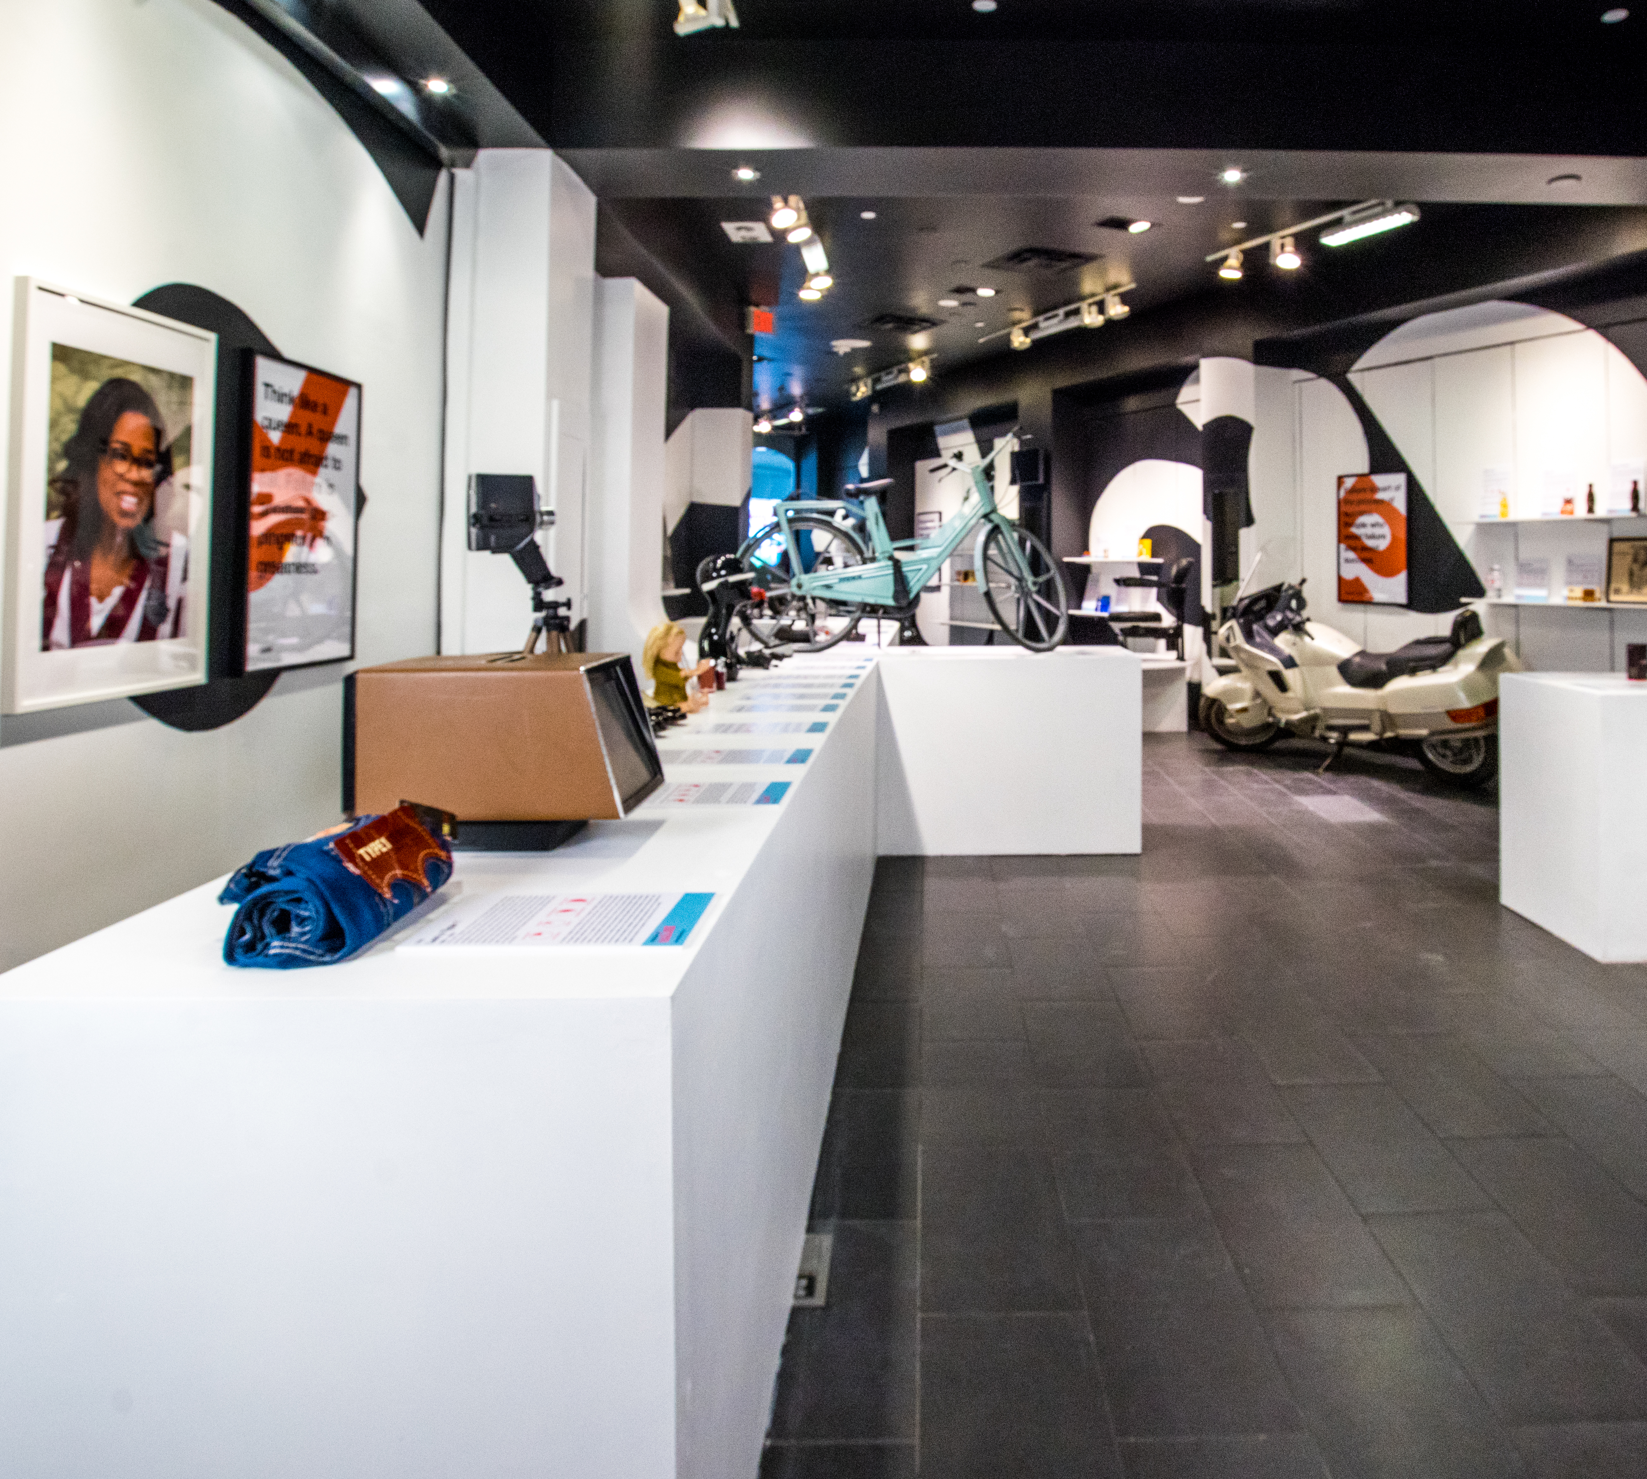
Hollywood
Los Angeles

Slide 9
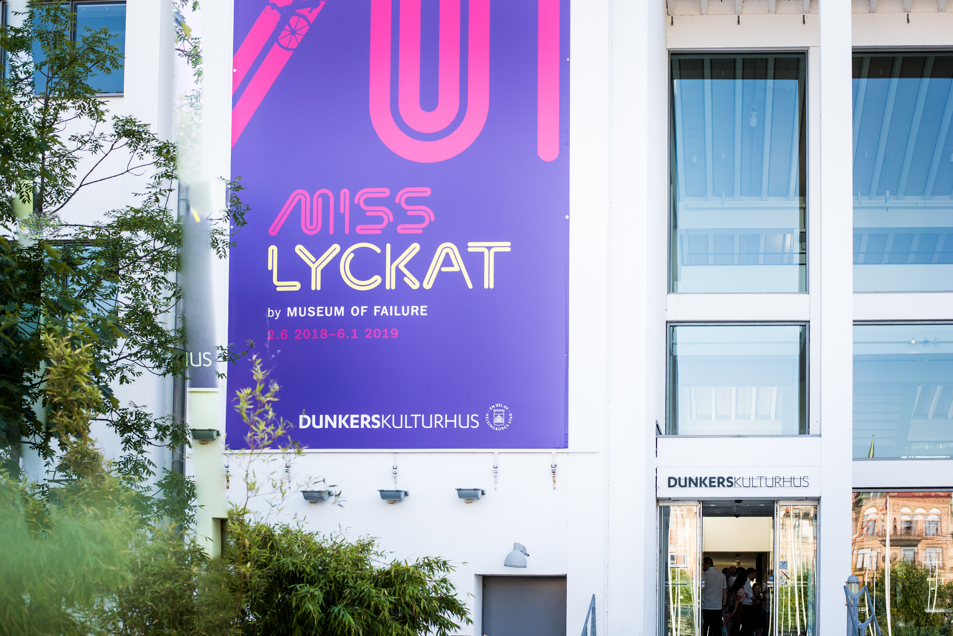

Slide 10
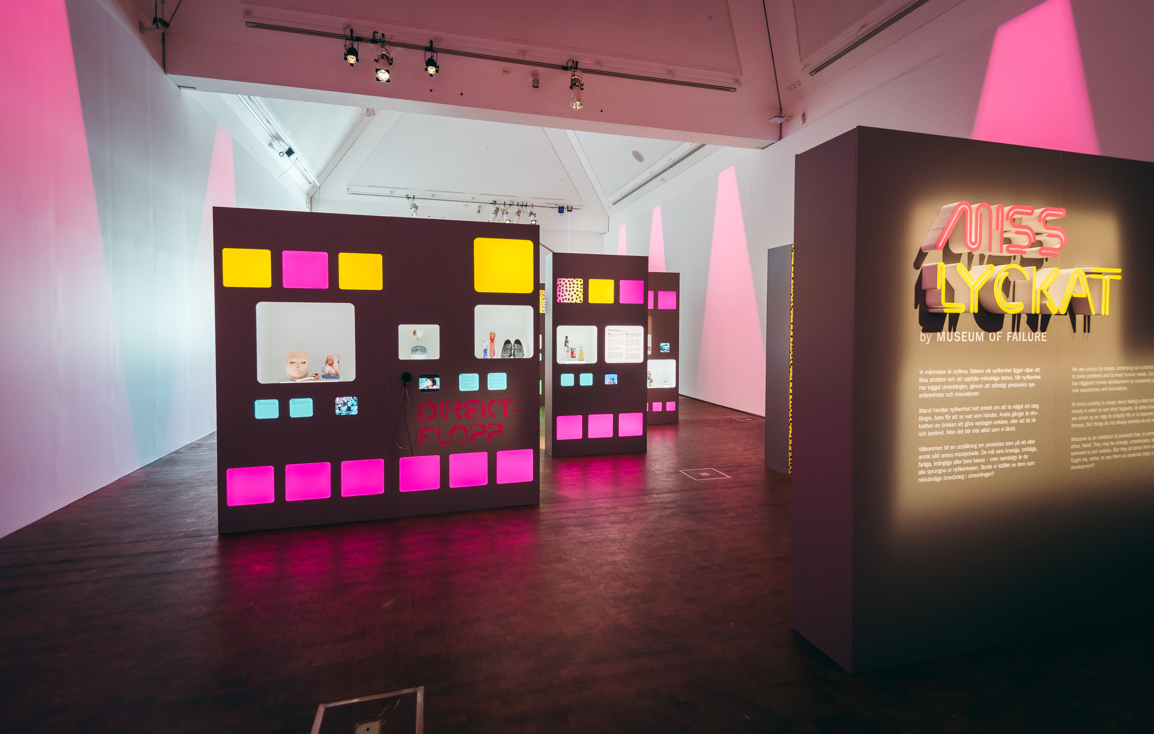

Slide 11
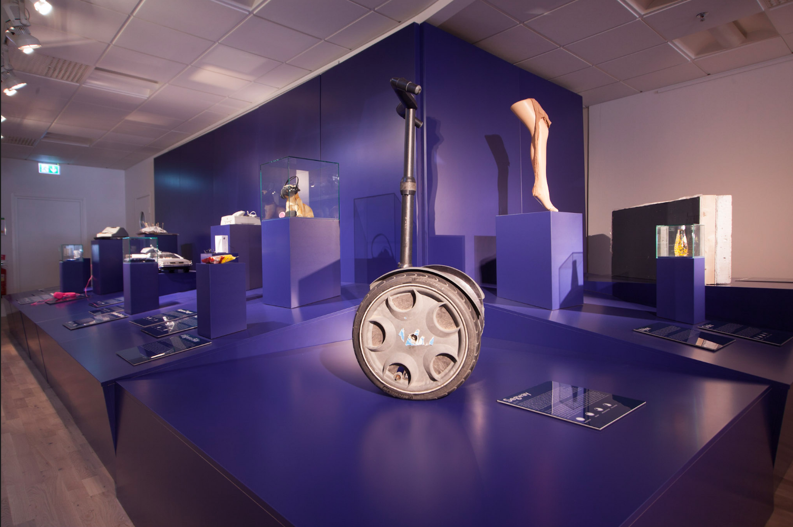
Failure is a deviation from expected and desired results

Slide 12
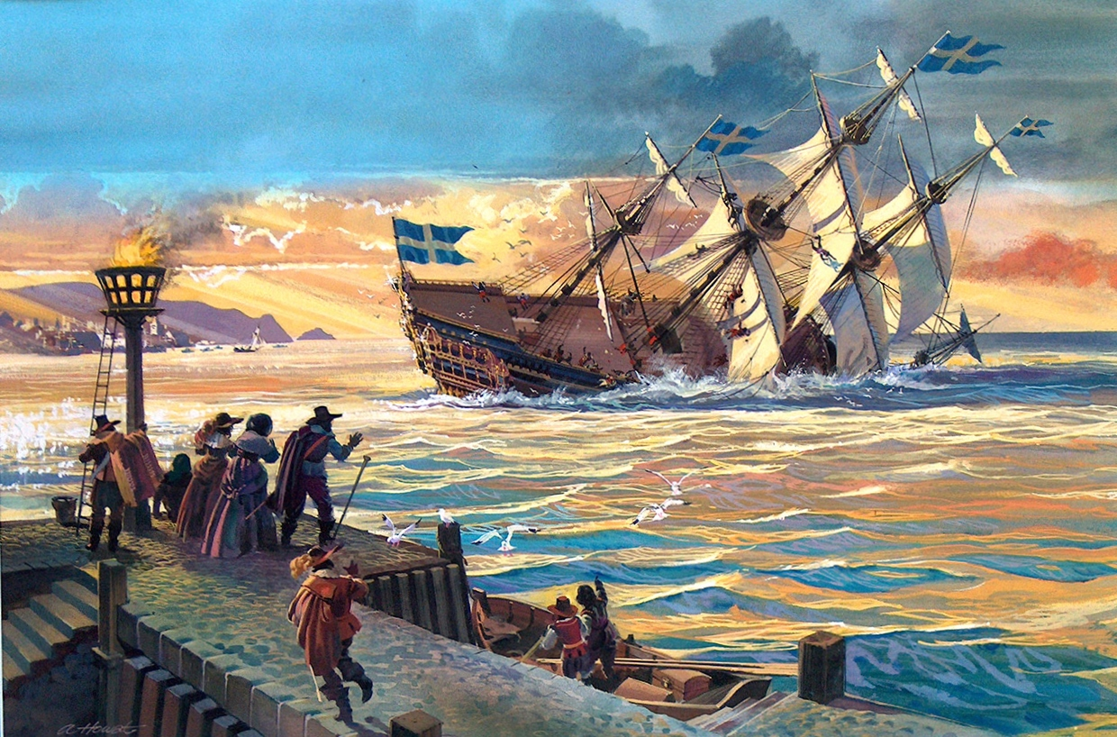
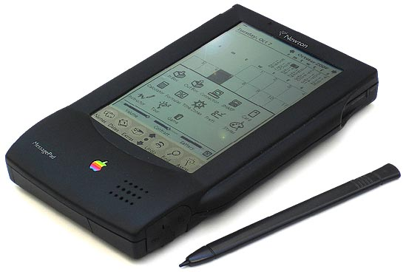
The Vasa
Stockholm 1628
Apple Newton
1993
Vasa ship
1628

Slide 13
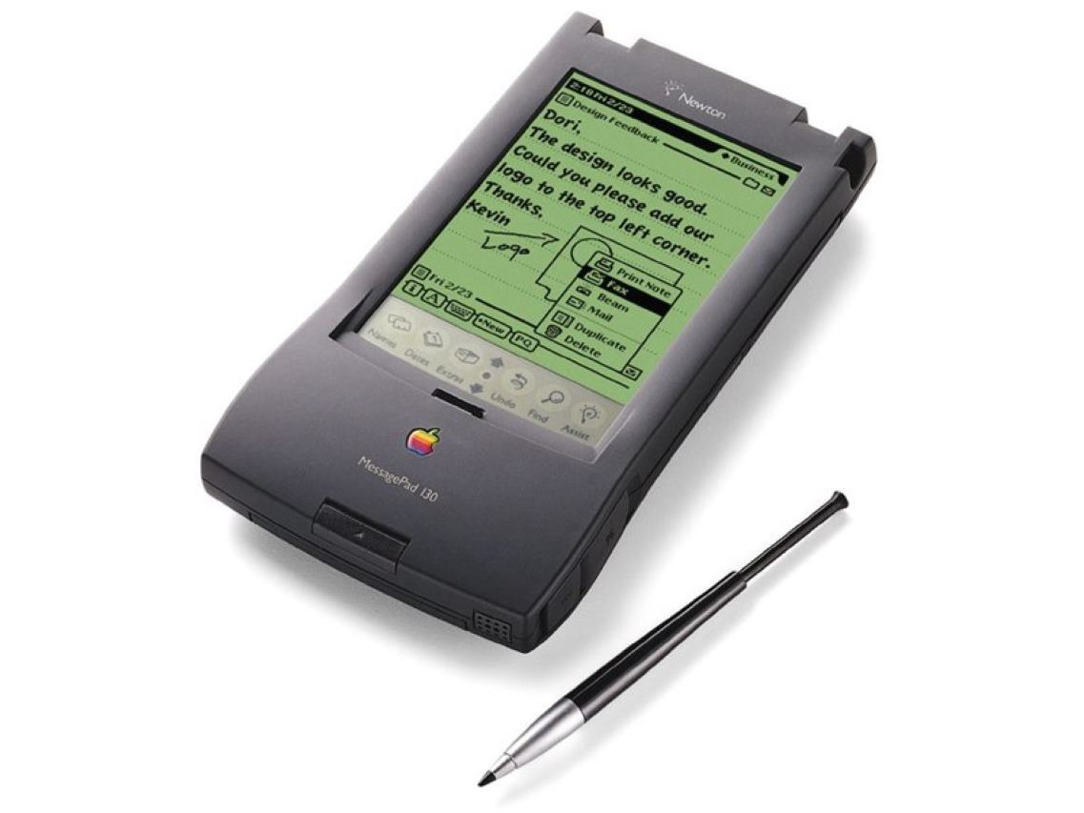
Apple Newton
1993

Slide 14
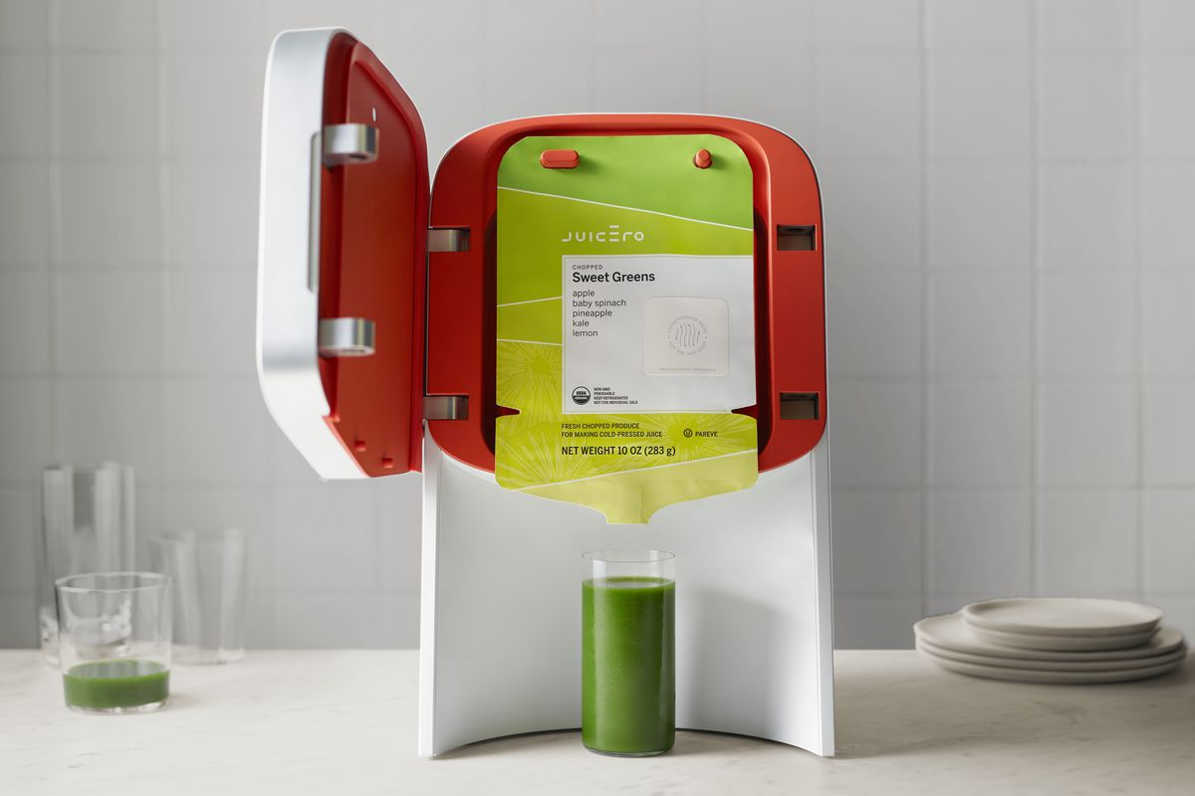
Juicero
2016-2017

Slide 15
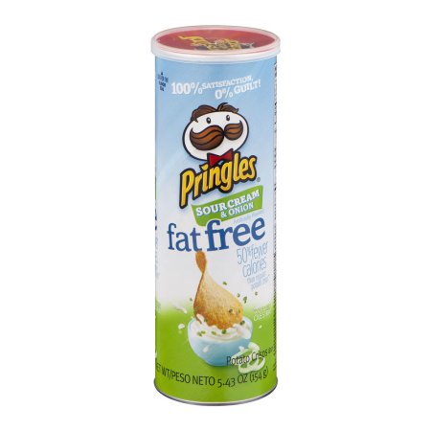
Olestra
1996

Slide 16
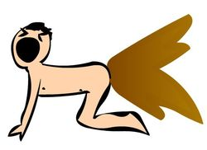
Olestra
1996

Slide 17
Failure. We’re hypocrites about it.
We’re afraid of it.
We avoid it.
We penalize it.

Slide 18
Failure University lesson 101
Difference between bad failures and good failures
nope
Preventable and predictable
yeah.. ok
Unavoidable due to complexity
Yes!
Intelligent failures at the frontier

Slide 19
Failure University lesson 201
Failure size
Small failures
identify, accept, learn, communicate
Large expensive
avoid

Slide 20
Psychological Safety
A team climate where it is safe to take interpersonal risks and be vulnerable in front of each other.
A sense of confidence that the team will not embarrass, reject or punish someone for speaking up.

Slide 21
Opening soon
Pop-ups
Toronto
Shanghai
Munich
Jeddah - Vienna - Amsterdam
Liverpool - Preston - Kortrijk London - Åndalsnes - Copenhagen

