Slide 1



Welcome to the Future of FinTech
Seminar 19th March 2018 – SSE & ESBRI

Slide 2
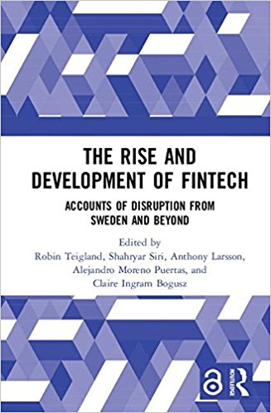



Sponsors
March 2018

Slide 3

Digital is the main reason
just over half the Fortune 500 companies
have disappeared since the year 2000.
-Pierre Nanterme, CEO Accenture, 2016
Yet..Digital disruption
has only just begun.
Notes:
When assessing the implications, consider the fact that that new digital business models are the principal reason why just over half of the names of companies on the Fortune 500 have disappeared since the year 2000. And yet, we are only at the beginning of what the World Economic Forum calls the “Fourth Industrial Revolution,” characterized not only by mass adoption of digital technologies but by innovations in everything from energy to biosciences.
Digital disruption is at the heart of all the conversations I have with CEOs today. And this is not surprising, as it presents the most significant threats and opportunities any of us have faced in business.
https://www.weforum.org/agenda/2016/01/digital-disruption-has-only-just-begun/

Slide 4
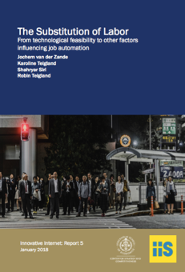
The commodification of banking
In 2000, the U.S. cash equities trading desk at Goldman Sachs’s New York headquarters employed 600 traders, buying and selling stock for large clients.
Today there are just 2 traders left.
http://www.nanalyze.com/2017/02/artificial-intelligence-investment-banking/

Slide 5
Exploitation
Improving existing value creation activities
Exploration
Developing new value creation activities
Adapted from March 1991
Notes:
(1) Enabling people to do things we already know how to do and (2)
creating collaborative environments that allow people to develop new ideas
and concepts to address unanticipated opportunities or challenges.
Productive learning focuses mostly on the individual and on helping
that individual to adopt a pattern of behavior that improves productivity.
Generative learning, by contrast, is a collaborative endeavor. Shared meaning
and insights are developed at the group level, and these insights drive
enterprise transformation to ensure growth and sustainability. Today, the
learning function is focused primarily on productive learning. As a result,
it appears that trainers are more likely to want to maintain the status quo,
rather than challenge it.
Learning is a far more complicated phenomenon than can ever be limited
to the classroom context. If we convey knowledge about tasks we already
know how to do, we call it productive learning . If we share knowledge about
tasks that are new and different, we call it generative learning . Productive
learning serves largely to maintain the status quo within an enterprise by
conveying what is already known, while generative learning involves not
only absorbing existing information but also creating new solutions to unanticipated
problems. Information age learning requires that individuals and
organizations change the way they think about and act on what is known
and what needs to be known in order to innovate, change, and win.

Slide 6
What is FinTech?
Innovative blending of finance and technology
to provide banking functions
traditionally offered by full-service banks,
e.g., deposits, withdrawals, transfers, payments, currency exchanges, investments,
in a more automated, transparent, efficient, customer friendly, and/or price competitive manner.
Notes:
This means that FinTech companies have been defined as those that are finding innovative ways to blend finance and technology within the business functions that are offered by a full-service bank. FinTech allows customers, both physical and legal entities, to receive similar service to the one traditionally provided by banks. Such services allow the users to deposit, withdraw, and transfer cash, pay invoices, exchange currencies, or perform investment activities. FinTech enterprises’ goal is to offer their customers solutions that are more automated, transparent, provide better user experience, are more efficient, offer a competitive price, and save time.

Slide 7
Long history of “FinTech” in Stockholm
2014, FinTech Funding in Stockholm Explodes
1959, Bankgirot founded
1990s, Sweden invests in Internet infrastructure, today country with 3rd highest Internet penetration
2010, Neonet $160M exit
2014, iZettle raises $55M
1985, Swedish financial and credit markets deregulated
2014, Klarna raises $125M in PE
1968, World’s first online ATM in Sweden
2003, First BankID issued in Sweden
2010, iZettle founded
1950 1960 1970 1980 1990 2000 2010
1967, First ATM installed in Sweden
1984, Optionsmäklarna (OM) opens in Stockholm, Sweden’s first stock option market, electronic trading introduced
1998, Merger between Stockholm’s Stock Exchange and OM Stockholm
2005, Klarna founded
2012, TriOptima, $160M exit
2007, NASDAQ acquires OMX Group
First wave of electronic trading software companies emerges
Unicorns such as Skype, King, Spotify and Mojang founded
http://www.slideshare.net/eteigland/stockholm-49722748
Notes:
Robin
NFT ventures
How did stockholm take global leadership
Efficiency, highest mobile banking and internet banking presence in world
Large heritage of innvoation and globalization, H&M, Nordea, IKEA, Ericsson,
No US and UK banks in Sweden – in private, they destroy innovation in system. So good that not here
The most efficient mcdonalds in world due to high cost of labor – so become more efficient
Transformation process in banking – how carry on?
Box companies specific companies taking a sweet spot that they have identified,
Tomorrow – customer – many interfaces to customer, who has strongest connection to customer – box companie that specialized and they will become international players, nordic startups will be large european players right, and then infrastructure
Who will deliver this process –
Experience
Delivered before – entrepreneurs experienced from 90s
Slightly older ents
Realistic plans, budgets, predictions,
Not 19 year old who establsihes online site to sell shoes globally – this is not the case
Not boo.com –
Mature entrepreneurs – old guys
Journey towards 1 bln euro company
How many companies can you invest in? 500 products offered in banking so 500 companies in niche areas.
Volume
Low cost base
what are we looking for?
Scalable business- european focus
Volume based
Niche position
Willingness to challenge and change
Concrete areas
Mortgage – margins are massive in this industry
Current account
Pensions and savings
Cross sale options
Cross-border

Slide 8
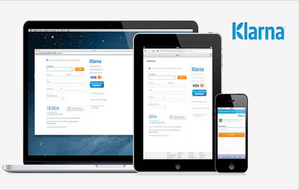
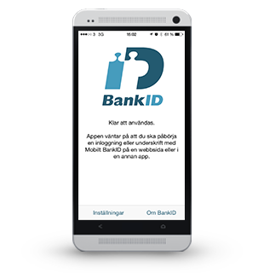
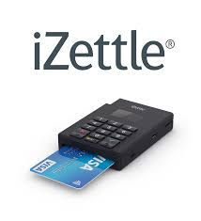

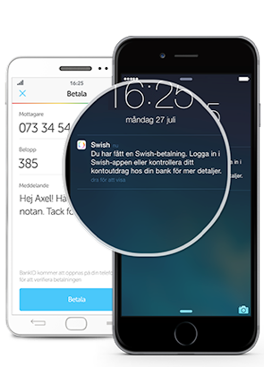
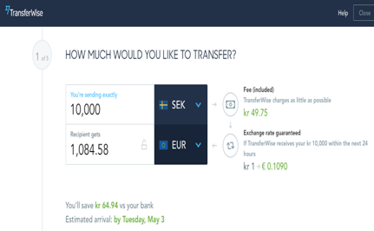


Slide 9

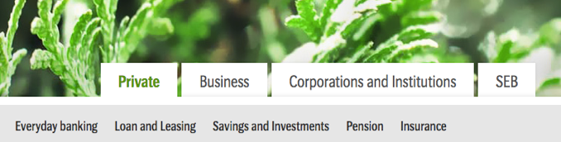













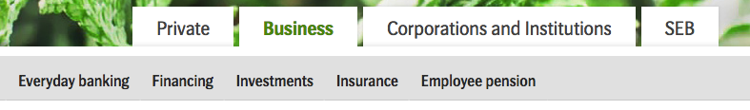








FinTechs moving in on traditional bank territory
Inspiration from CB Insights, SEB base webpage slightly modified to make more room

Slide 10
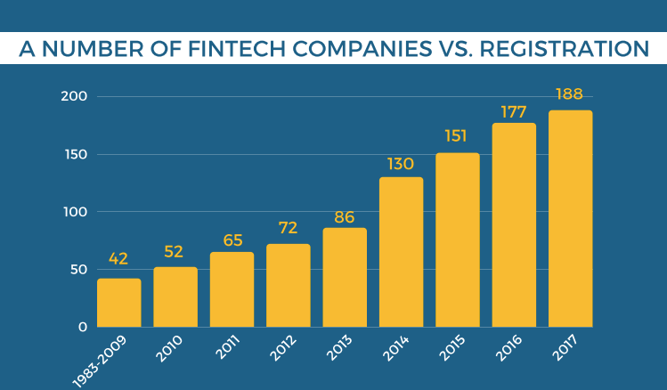
Steady growth in Greater Stockholm Region
Gromek et al., 2018
https://www.hhs.se/contentassets/0602629cbe1e4d7ca1e2a30948a48a61/stockholmfintechreport2018v2.3.pdf

Slide 11
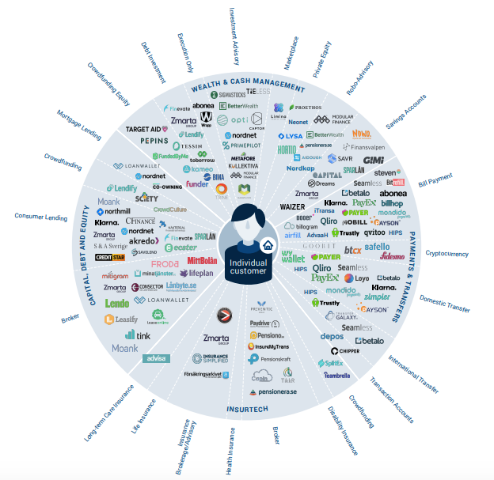
Stockholm FinTech
Gromek et al., 2018
https://www.hhs.se/contentassets/0602629cbe1e4d7ca1e2a30948a48a61/stockholmfintechreport2018v2.3.pdf

Slide 12
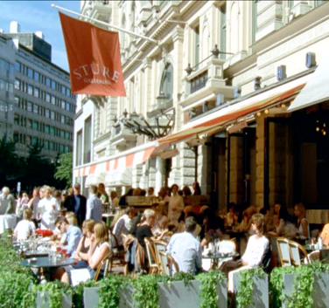
Strong “pay-it-forward” culture
“Stockholm has accumulated a high degree of entrepreneurial experience that continues to be fed back into the ecosystem.”
- Stockholm entrepreneur
“I really think that there is something special here in Stockholm that I haven’t seen anywhere in the world. I came here with no networks and less than six months later, I have an extensive network in the Stockholm startup community.”
- Hong Kong entrepreneur
Notes:
https://www.slideshare.net/eteigland/chasing-the-tale-of-the-unicorn-executive-summary
https://www.slideshare.net/eteigland/chasing-the-tale-of-the-unicorn-a-study-of-stockholms-misty-meadows

Slide 13
Exploitation
Improving existing value creation activities
Exploration
Developing new value creation activities
Adapted from March 1991
Notes:
(1) Enabling people to do things we already know how to do and (2)
creating collaborative environments that allow people to develop new ideas
and concepts to address unanticipated opportunities or challenges.
Productive learning focuses mostly on the individual and on helping
that individual to adopt a pattern of behavior that improves productivity.
Generative learning, by contrast, is a collaborative endeavor. Shared meaning
and insights are developed at the group level, and these insights drive
enterprise transformation to ensure growth and sustainability. Today, the
learning function is focused primarily on productive learning. As a result,
it appears that trainers are more likely to want to maintain the status quo,
rather than challenge it.
Learning is a far more complicated phenomenon than can ever be limited
to the classroom context. If we convey knowledge about tasks we already
know how to do, we call it productive learning . If we share knowledge about
tasks that are new and different, we call it generative learning . Productive
learning serves largely to maintain the status quo within an enterprise by
conveying what is already known, while generative learning involves not
only absorbing existing information but also creating new solutions to unanticipated
problems. Information age learning requires that individuals and
organizations change the way they think about and act on what is known
and what needs to be known in order to innovate, change, and win.

Slide 14
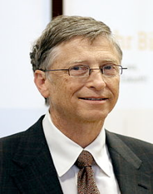
Banking is essential,
but banks are not.
Bill Gates

Slide 15

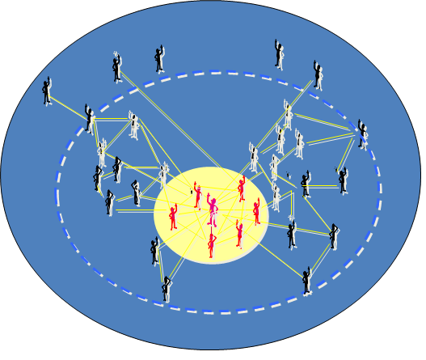
E.g., Central Bank
~ Long-standing financial institutions and regulations
Emergent Collective
VS
Institutions
E.g., Bitcoin Community
~ Self-organizing community of strangers across globe connected through Internet
Teigland, Yetis, Larsson 2013

Slide 16

Saying that Bitcoin is a currency
is like saying that the internet is email.
Currency is just the first app!
- Andreas Antonopolous
http://startusingbitcoin.com/blog/1-what-is-bitcoin/

Slide 17


Digitalizing distributed ownership with
no central actor other than a computer network?
Notes:
Digitalizing trust with
no central actor
other than
a computer network ?

Slide 18
Forces transforming the industry
Regulations
Cognition
Norms
External and
Internal Actors

Slide 19
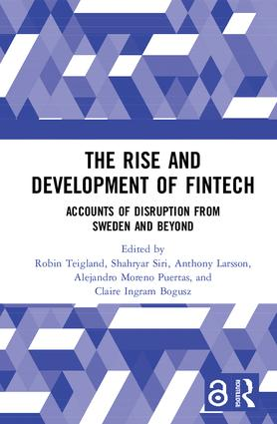
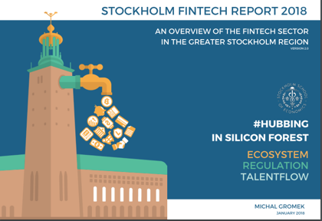
For further reading
https://www.amazon.com/Rise-Development-FinTech-Accounts-Disruption/dp/0815378505
https://www.hhs.se/contentassets/0602629cbe1e4d7ca1e2a30948a48a61/stockholmfintechreport2018v2.3.pdf

Slide 20






If you love knowledge,
set it free…
Robin Teigland
robin.teigland@hhs.se
www.robinteigland.com
www.slideshare.net/eteigland
@robin.teigland
If you like this presentation and would like to contribute to our research, we accept bitcoins: 1HthhUB62EzqEyKaAKvF1LGTabcdp4HsU.
Thank you!!!!!

Slide 21

Let’s talk about TRUST
The Rise and Development of FinTech
MatsLewan.se

Slide 22
Trust—‘firm belief in the reliability, truth, or ability of someone or something.’
The Rise and Development of FinTech
MatsLewan.se

Slide 23
predictability
The Rise and Development of FinTech
MatsLewan.se

Slide 24
“Predictability built the trust that allowed people to synchronize their actions in mutually productive ways”
(Stevenson, Moldoveanu, HBR)
The Rise and Development of FinTech
MatsLewan.se

Slide 25
Trust—‘possibility to predict a (desirable) outcome from interactions with someone or something.’
The Rise and Development of FinTech
MatsLewan.se

Slide 26
markers
The Rise and Development of FinTech
MatsLewan.se

Slide 27
social
The Rise and Development of FinTech
MatsLewan.se

Slide 28
two kinds of trust
The Rise and Development of FinTech
MatsLewan.se

Slide 29
trust is two-way
The Rise and Development of FinTech
MatsLewan.se

Slide 30
digital trust—blockchain
automated credit ratings
The Rise and Development of FinTech
MatsLewan.se

Slide 31
culture
Nigeria
Qatar
China
Turkey
Mexico
Spain
cognitive trust
affective trust
Poland
U.K.
Australia
Norway
Canada
US
The Culture Map (Meyer, 2015)
The Rise and Development of FinTech
MatsLewan.se

Slide 32
the ‘trustnet’
The Rise and Development of FinTech
MatsLewan.se

Slide 33
thanks
The Rise and Development of FinTech
MatsLewan.se

Slide 34

Coffee break

Slide 35
Digital Traces, Ethics and Insight:
Data-driven Services in Fintech
Claire Ingram Bogusz
Stockholm School Of Economics

Slide 36
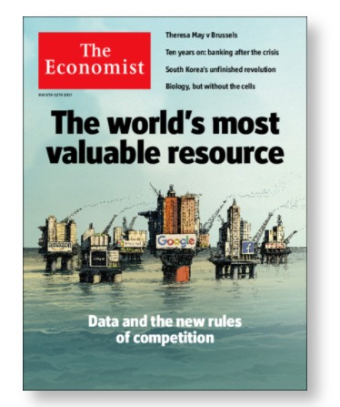
Notes:
The more data Tesla gathers from its self-driving cars, the better it can make them at driving themselves—part of the reason the firm, which sold only 25,000 cars in the first quarter, is now worth more than GM, which sold 2.3m. Vast pools of data can thus act as protective moats.
In 2016 Amazon, Alphabet and Microsoft together racked up nearly $32bn in capital expenditure and capital leases, up by 22% from the previous year, according to the Wall Street Journal.

Slide 37
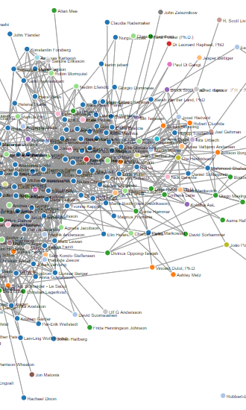
Digital traces in Fintech
Make existing services more efficient
Create new services
Access (or create?) new markets

Slide 38
 | Description and examples of firms | Examples
Credit Scoring and Direct Lending | AI used to create more accurate credit scores by non-traditional actors, facilitating peer-to-peer lending. | Upstart, Avant, Zest Finance.
Regulatory, Compliance and Fraud Detection | AI used to detect patterns that amount to fraud, as well as test for regulatory compliance. | Trifacta, Digital Reasoning, Data Robot
Assistants/Personal Finance | AI used to detect patterns and allow customers to automate—or avoid—those patterns in future personal finance transactions. | Dreams, Qapital, Homebot.
Quantitative and Asset Management | AI used to create investment portfolios optimised based in patterns in individual user behaviour, and market movements. | Wealthfront, Clone Algo, Sentient.
Insurance | AI used in risk assessment for insurance purposes, creating group and individual profiles. | Risk Genius, Shift Technology, Lemonade.
Table 2: Use of Artificial Intelligence in FinTech, adapted from CB Insights (2017)

Slide 39
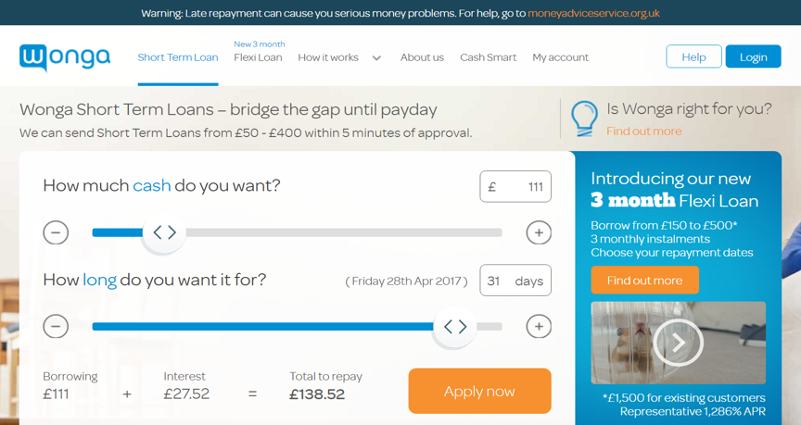
“The loan amounts users are initially presented with currently tend to be either £111 or £265, although I have also achieved figures of £350 and £361. In my informal survey, those using Apple products (a Safari browser, or say an iPhone or an iPad) seemed to be most consistently offered £265. Although tests with some obscure browsers suggest that it is likely that it is less that you are ‘uprated’ by using Apple products, than you are ‘down rated’ by using less niche browsers like Firefox and Internet explorer.” (Deville 2013)
“The firm has found that people who immediately shove the slider up to the maximum amount on offer, currently £400 for 30 days for a first-time applicant for a personal loan, are more likely than others to default.” (Pollock 2012)

Slide 40
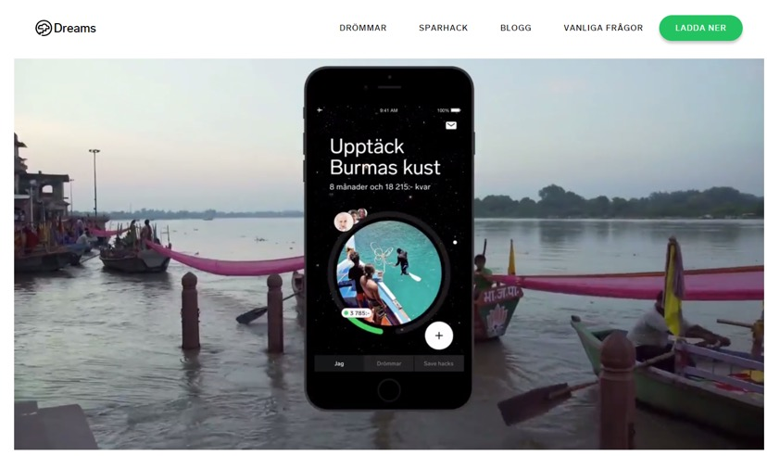

Slide 41
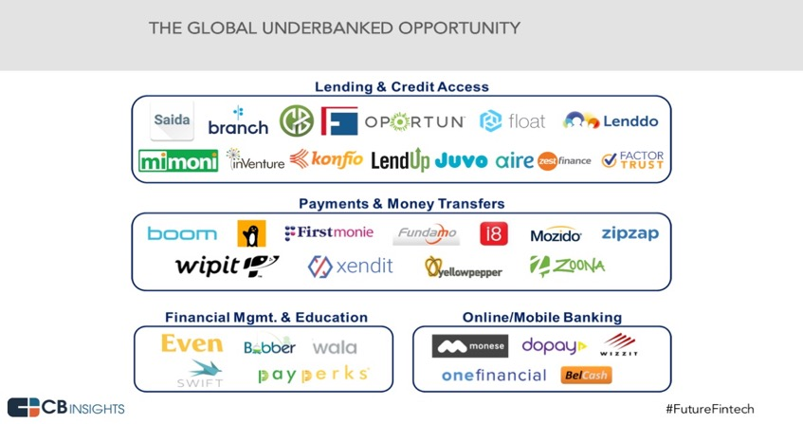

Slide 42
 | Deliberately left | Unintentionally left | Left by a third party
Data with content | Service data Disclosed data Entrusted data |  | Entrusted data Incidental data
Metadata |  | Entrusted data Behavioural data Derived data | Incidental data Derived data
Table 1: The characteristics and kinds of digital trace data, adapted from Schneier (2015)

Slide 43
implications
Consent
Ownership
Decontextualisation
Third party services

Slide 44
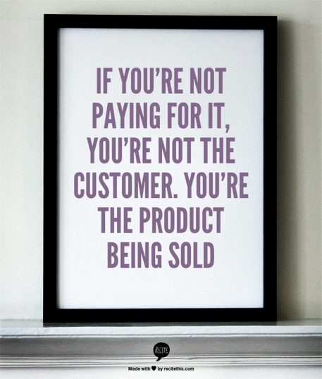

Slide 45
recommendations
Self-regulate
Be transparent / educate your customers
Need for clear rules around ownership
Public infrastructure?
Is data collection anti-competitive?
Trust?
Notes:
Governments could encourage the emergence of new services by opening up more of their own data vaults or managing crucial parts of the data economy as public infrastructure, as India does with its digital-identity system, Aadhaar.

Slide 46
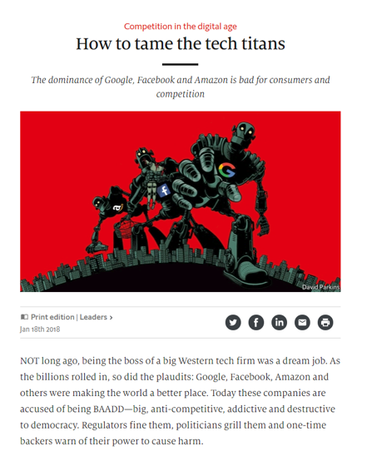

Slide 47
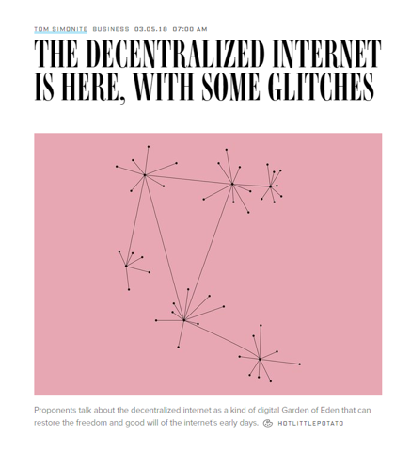

Slide 48


Dr. Claire Ingram Bogusz
Stockholm School of Economics
claire@clairebogusz.com
@Claire_EBI
slides.clairebogusz.com

Slide 49

Q&A

Slide 50

Concluding Remarks
- Shahryar Siri and Anthony Larsson

Slide 51
https://www.taylorfrancis.com/books/e/9781351183611

