Slide 1
Tufts University
(How) Can we do better?
Lessons from HIV-Aids
Amar Bhidé
www.bhide.net
August 2016

Slide 2
Today’s talk:
Nature and role of “massively multiplayer” innovation
HIV-Aids as a partial -- and exceptional – case in medicine
Barriers to multi-player medical innovation
What might be done?

Slide 5
Massively multiplayer innovation
Contra Cowan, Gordon, Phelps, inclusivity has improved innovation
Much more broad-based than during the 1st and 2nd industrial revolutions
Highly accretive and (contra Mazzucato) decentralized and bottoms up
Faster diffusion of ideas makes effective use critical
Effective use a function of venturesome consumption
Very poorly measured
Total Factor Productivity is an incorrigibly implausible proxy
Assumes away the very features that make the economy dynamic
Fails the smell test
Chronic inaccuracy does not exculpate
Some reasons for concern

Slide 6
Rolling back HIV-Aids: a multiplayer success
Tale of our times
Apes to humans in the 1920s
Outbreak in the early 1980s, pandemic by the mid-1990s
Dramatic drop in death rates, infections level off
Now a chronic condition, not a death sentence

Slide 7
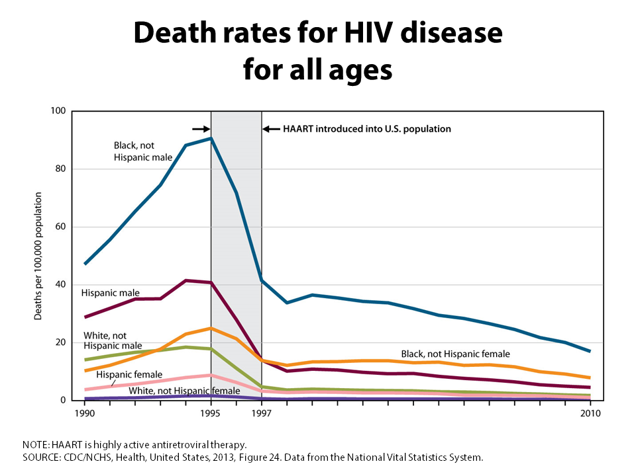
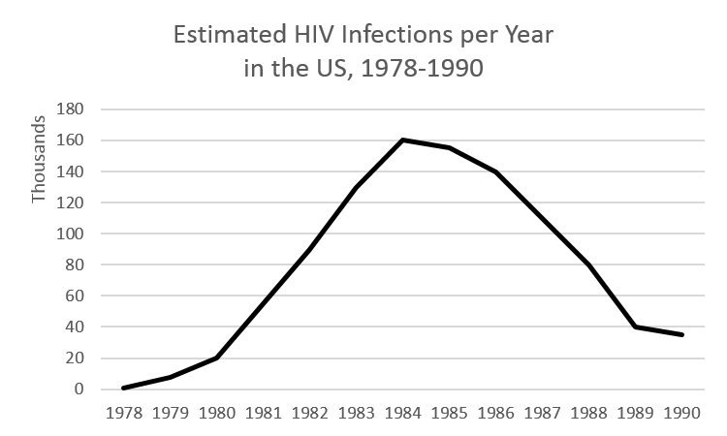
Rise and Fall

Slide 8
Correspondence with multi-player pattern
Multifarious cast
Evident from the outset
Interconnected advances in transmission control, testing and treatment
Accretive: incremental advances + novel discoveries
International collaboration and rivalry
Highly venturesome “consumer/activists”
Value where most used (but poorly captured in national accounts)
An important difference – no improvised entrepreneurs

Slide 9
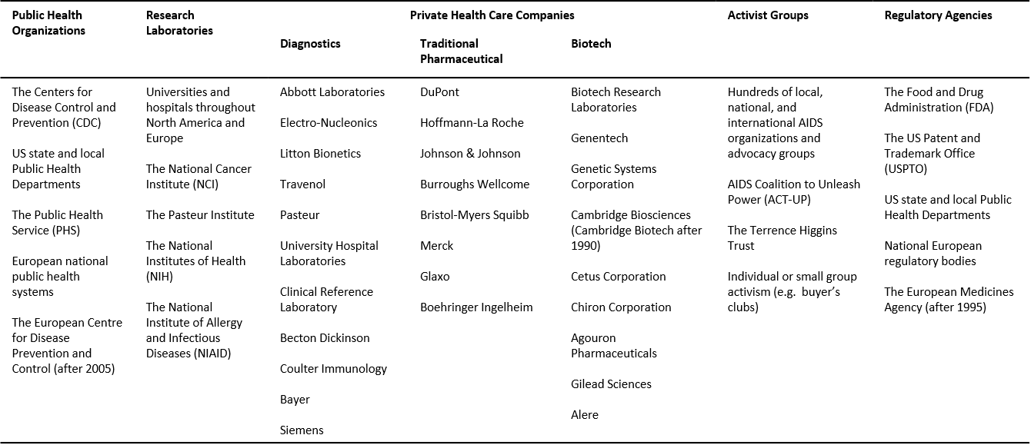
Multi-player pattern

Slide 10
Why is medical innovation usually not multiplayer
Age-old restrictions on who can practice
Practice limited to accredited, university trained physicians
Trade-offs from collectivized canon: cohesion and consistency vs. closed mindedness
Exclusion of “outsiders” from innovation
Contrast with other fields
Physician-patient relationship
Artisanal
Compliance vs venturesome consumption
Church and State
Traditional
FDA

Slide 11
How can medical innovation be made more multiplayer?
Some changes but arguably far from sufficient.
Possible reforms?
Relaxing credentialism
Limit regulators to safety
Anti-trust enforcement against hospitals
New IP regime to promote continuous innovation

