Slide 1
The New Normal of Innovation A European Perspective
Prof. Dr. Johann Füller
Stockholm, February 26th 2016
HYVE AG
CEO
Schellingstr. 45
80799 München
johann.fueller@hyve.net
Professor for Innovation and Entrepreneurship
WKO Tirol Stiftungsprofessor
Department of Strategic Management, Marketing and Tourism
University of Innsbruck
johann.fueller@uibk.ac.at

Slide 2
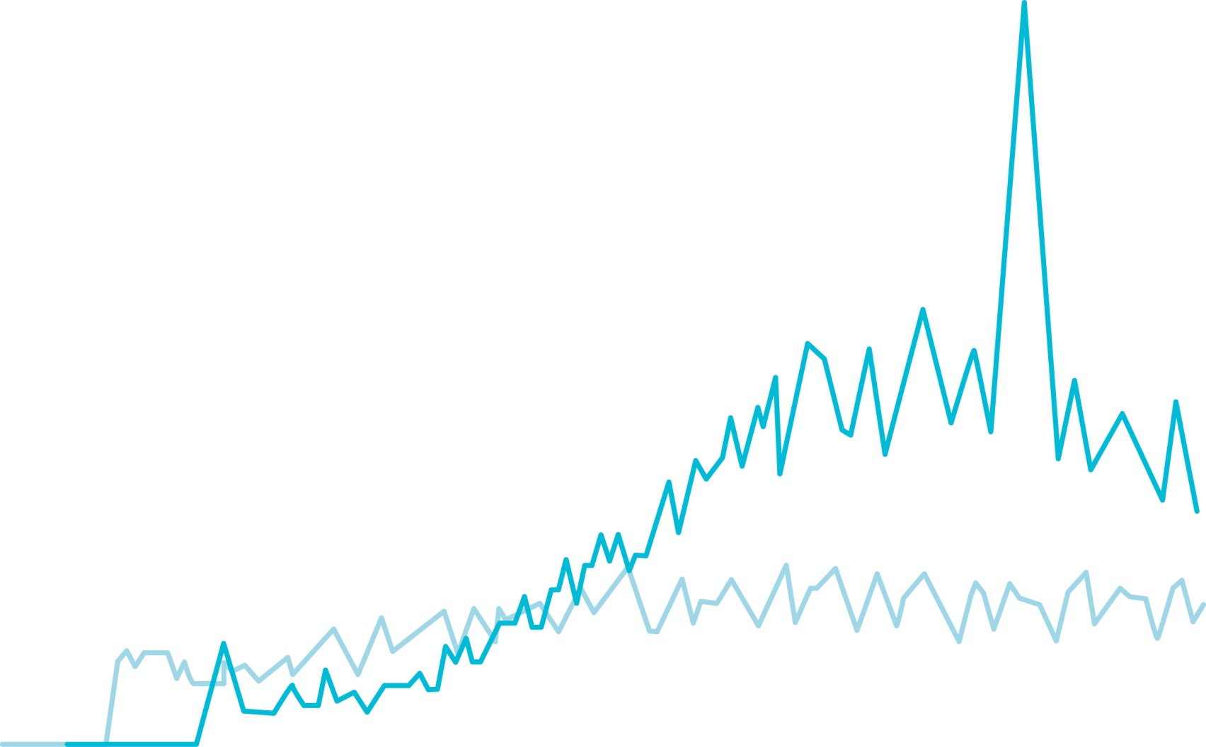
Interest in Open Innovation and Crowdsourcing Google Search Requests
2005
2007
2009
2011
2013
2015
Crowdsourcing
*Google Search Requests for.
Open Innovation

Slide 3
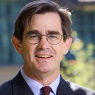
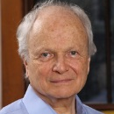
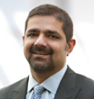
Development Stages of Open Innovation & Crowdsourcing
Project based
Piloting-phase
Single projects
Specific tasks
Gaining txperience
Exploratory
Don’t fall behind
Interest
Agenda Setting
Academics
Time of Pioneers
Workshops
2002
2006
2014

Slide 4
EXAMPLE
Project based
2006
2014

Slide 5
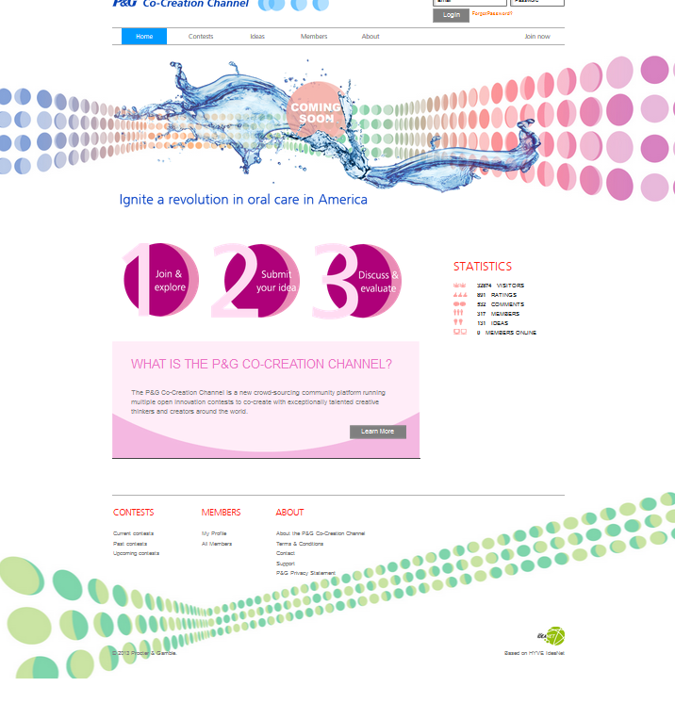
P&G Co-Creation Channel
Goal: Creation of a sustainable innovation community

Slide 6
729 members
179 ideas
1477 evaluations
91 492 visitors

Slide 7
Idea Cemetery (Getty Images)

Slide 8
Development Stages of Open Innovation & Crowdsourcing
New Normal of Innovation
Project based
Piloting-phase
Single projects
Specific tasks
Gaining txperience
Exploratory
Don’t fall behind
OI/Crowdsourcing as part of innovation management
Along the entire process
Different modes and forms
Sustainable OI/Crowdsourcing Channels/Labs
Innovation ecosystems
Interest
Agenda Setting
Academics
Time of Pioneers
Workshops
2002
2006
2014

Slide 9
EXAMPLE
New Normal of Innovation
2014

Slide 10
Vodafone Open Innovation Program
Vodafone Open Innovation Program
Innovation Contest
Product Development
Networking
Cross Industry Events
Ideas
Innovation Camp
Business Models
Prototypes
Product Development
Development Cluster
Innovative Products & Business Models

Slide 11
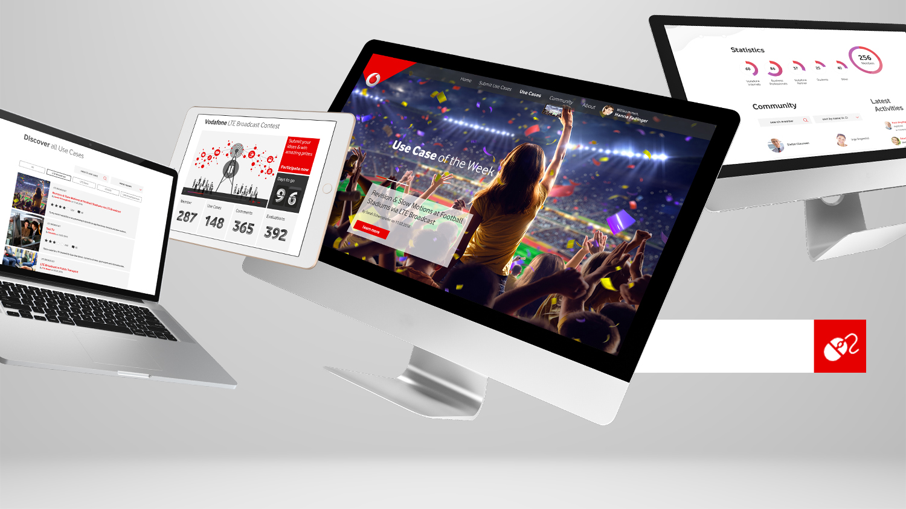
Open
Innovation Contest
Clickable Prototype
Projectsetup &
Planning
Existing Insights,
& Technologies
Global Open
Innovation Contest
Business Cases
& Expert Validation
Finalization

Slide 12
Innovation Camp
Innovation Camp
Development Cluster
Production Cluster
Innovation
Camp
Market
Feedback

Slide 13
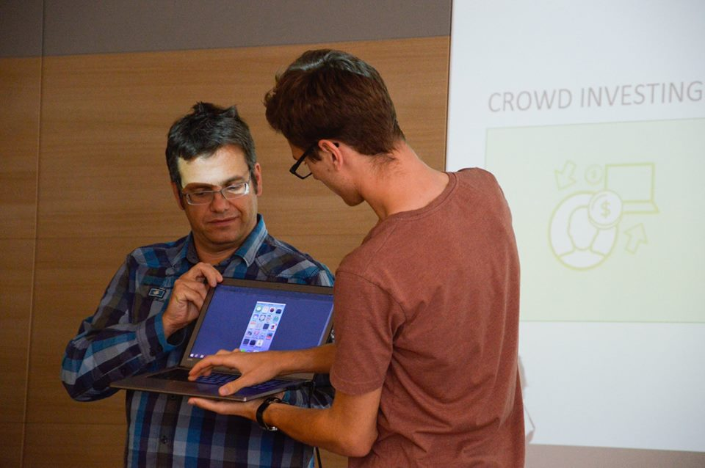
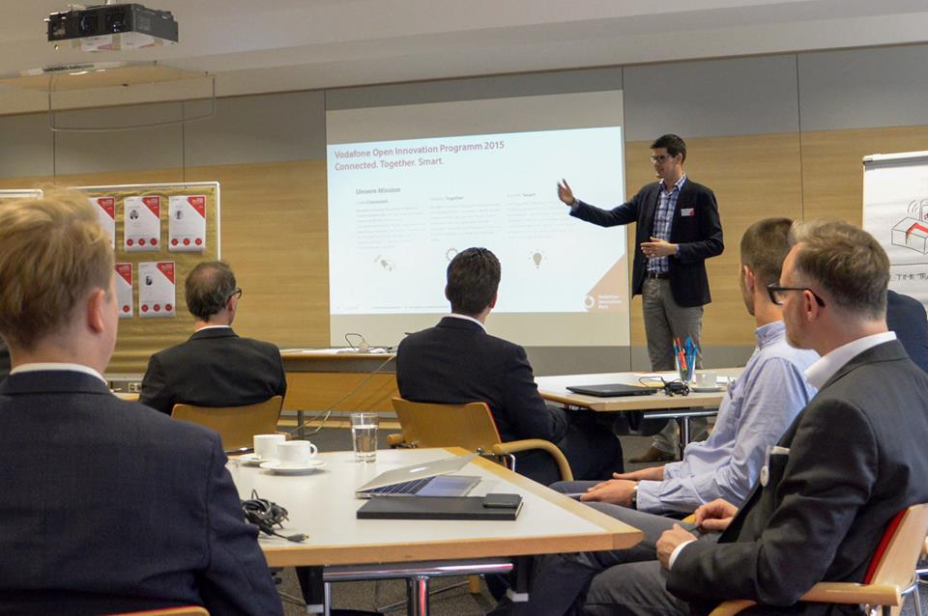
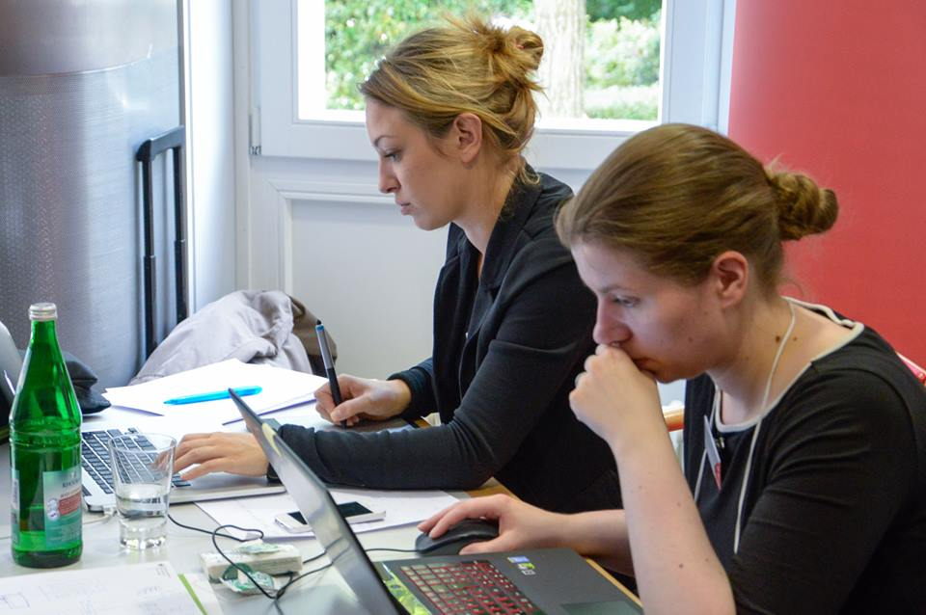
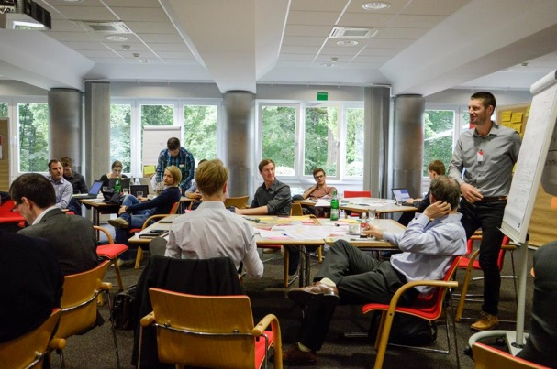
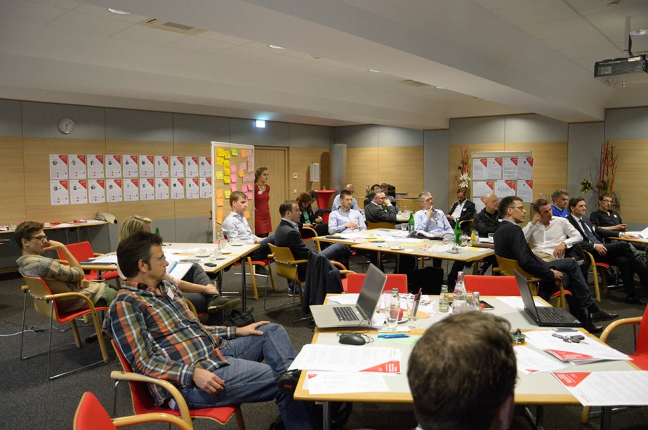
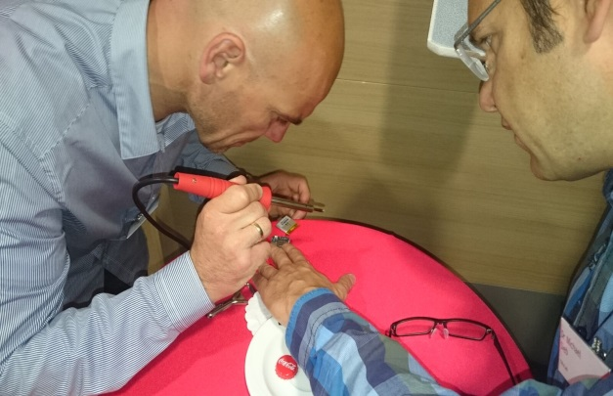
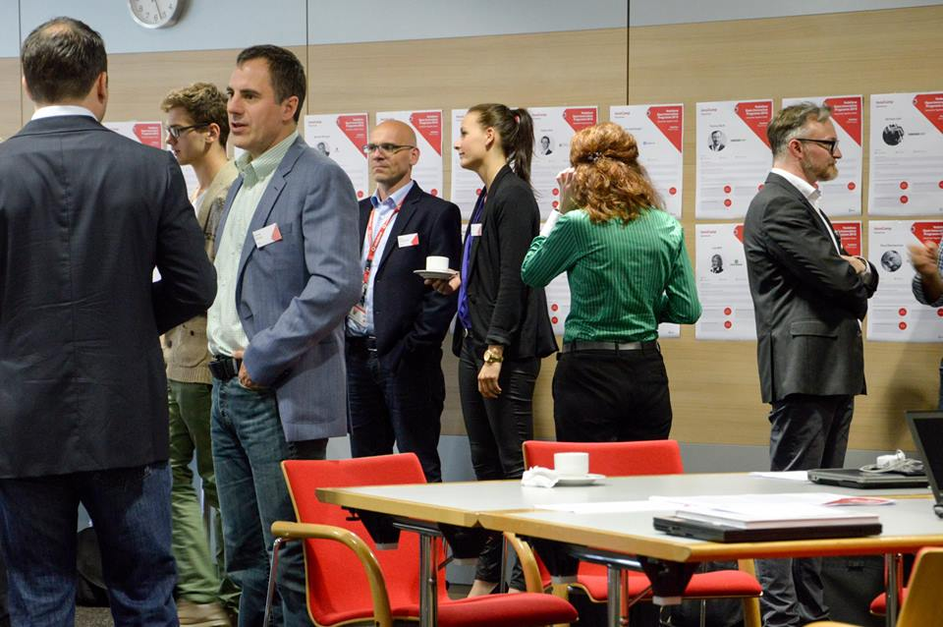
Innovation Camp

Slide 14
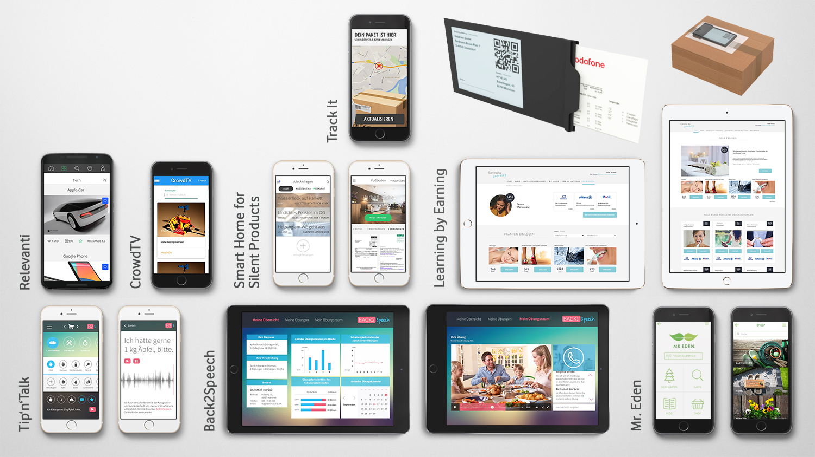
Open Innovation Program

Slide 15
Innovation Eco-System – Players
Know-How
Customers
Expert Crowd Communities
Startups
Labor
Competition
Users
Money
CORE
TEAM
Facilities
Universities & R&D Institutions
Suppliers
Access
Cross Industry
Employees

Slide 16
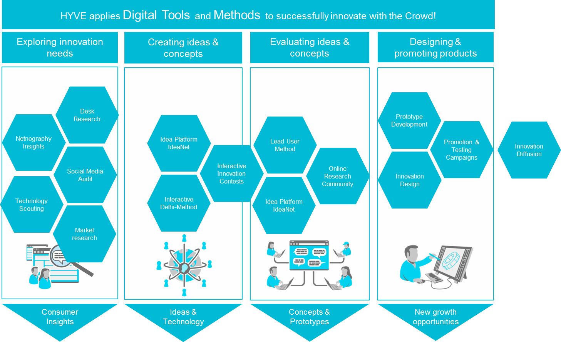
Innovation Eco-System – THINKING
Design Thinking
Lean Start Up
Open Innovation
User Centered
Experience based
Empathy
Start Up
Scrum & Agile
Iterative
Wisdom of the Crowd
Collaborative Communities
Inside out/ Outside Inn
Approach Tools and Methods

Slide 17
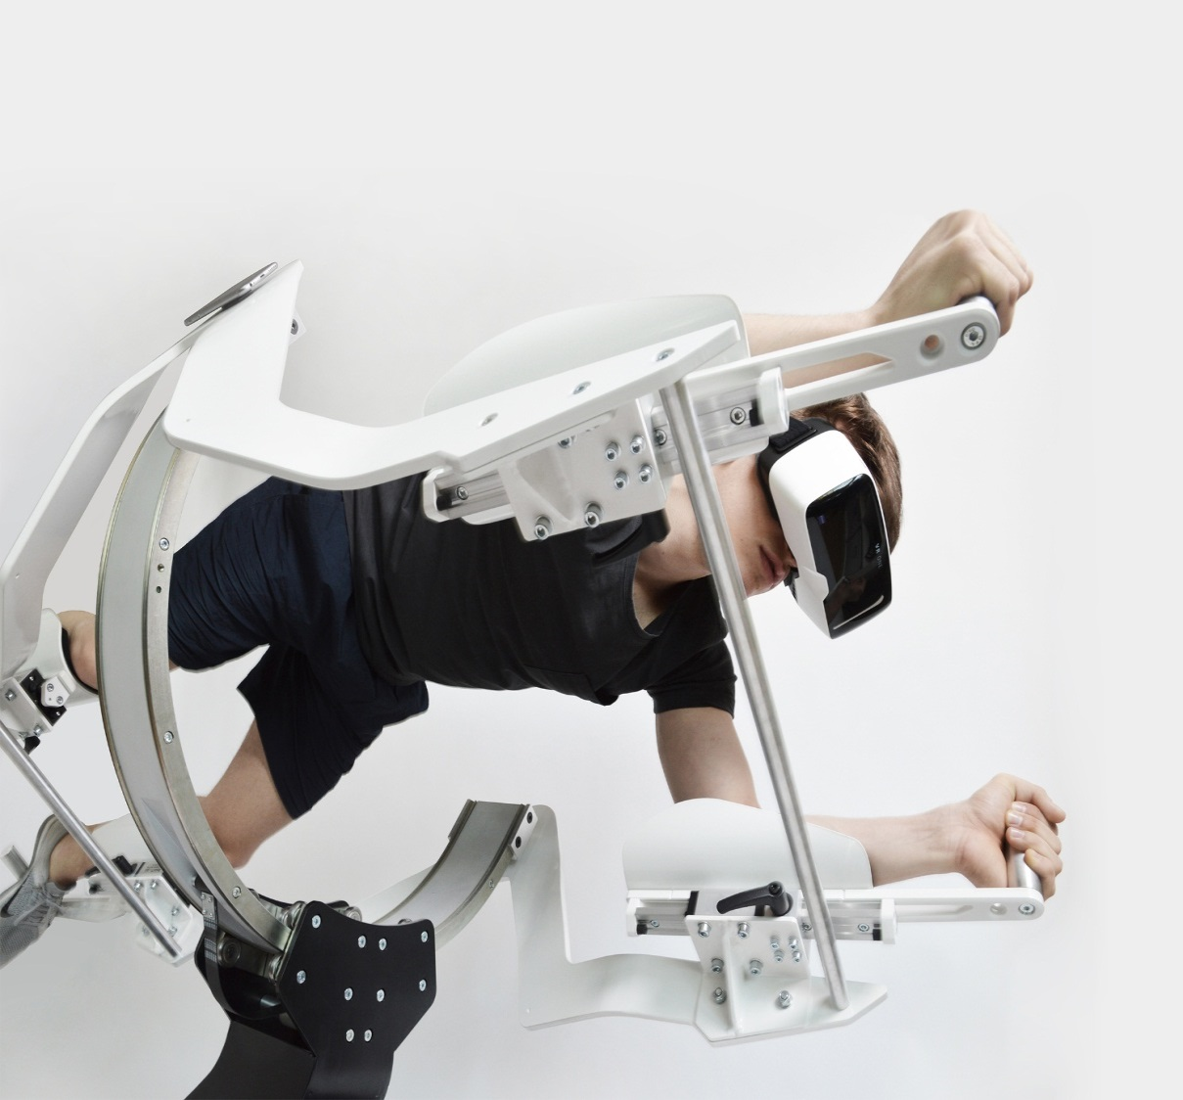
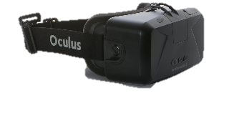
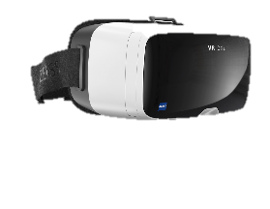
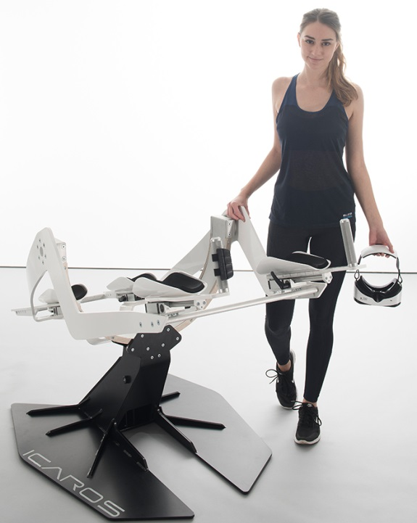
Active VR – The Solution
The ICAROS system allows gamers to steer through virtual worlds by balancing their body.
It consists of the ICAROS rig, controller, VR-headset and gaming app.
Controlling on the ICAROS exercises balance and reaction as well as different muscle groups - especially core-, chest-, and shoulder muscles.
The ICAROS controller is mounted to the handle bar of the device. It contains all necessary electronics to measure the users movements, sends the data the VR Headset and can be connected with any compatible HMD (head mounted display).
WORKS WITH VARIOUS HMDs
GAMING APP
CONTROLLER
Copyright ICAROS GmbH 2015

Slide 18
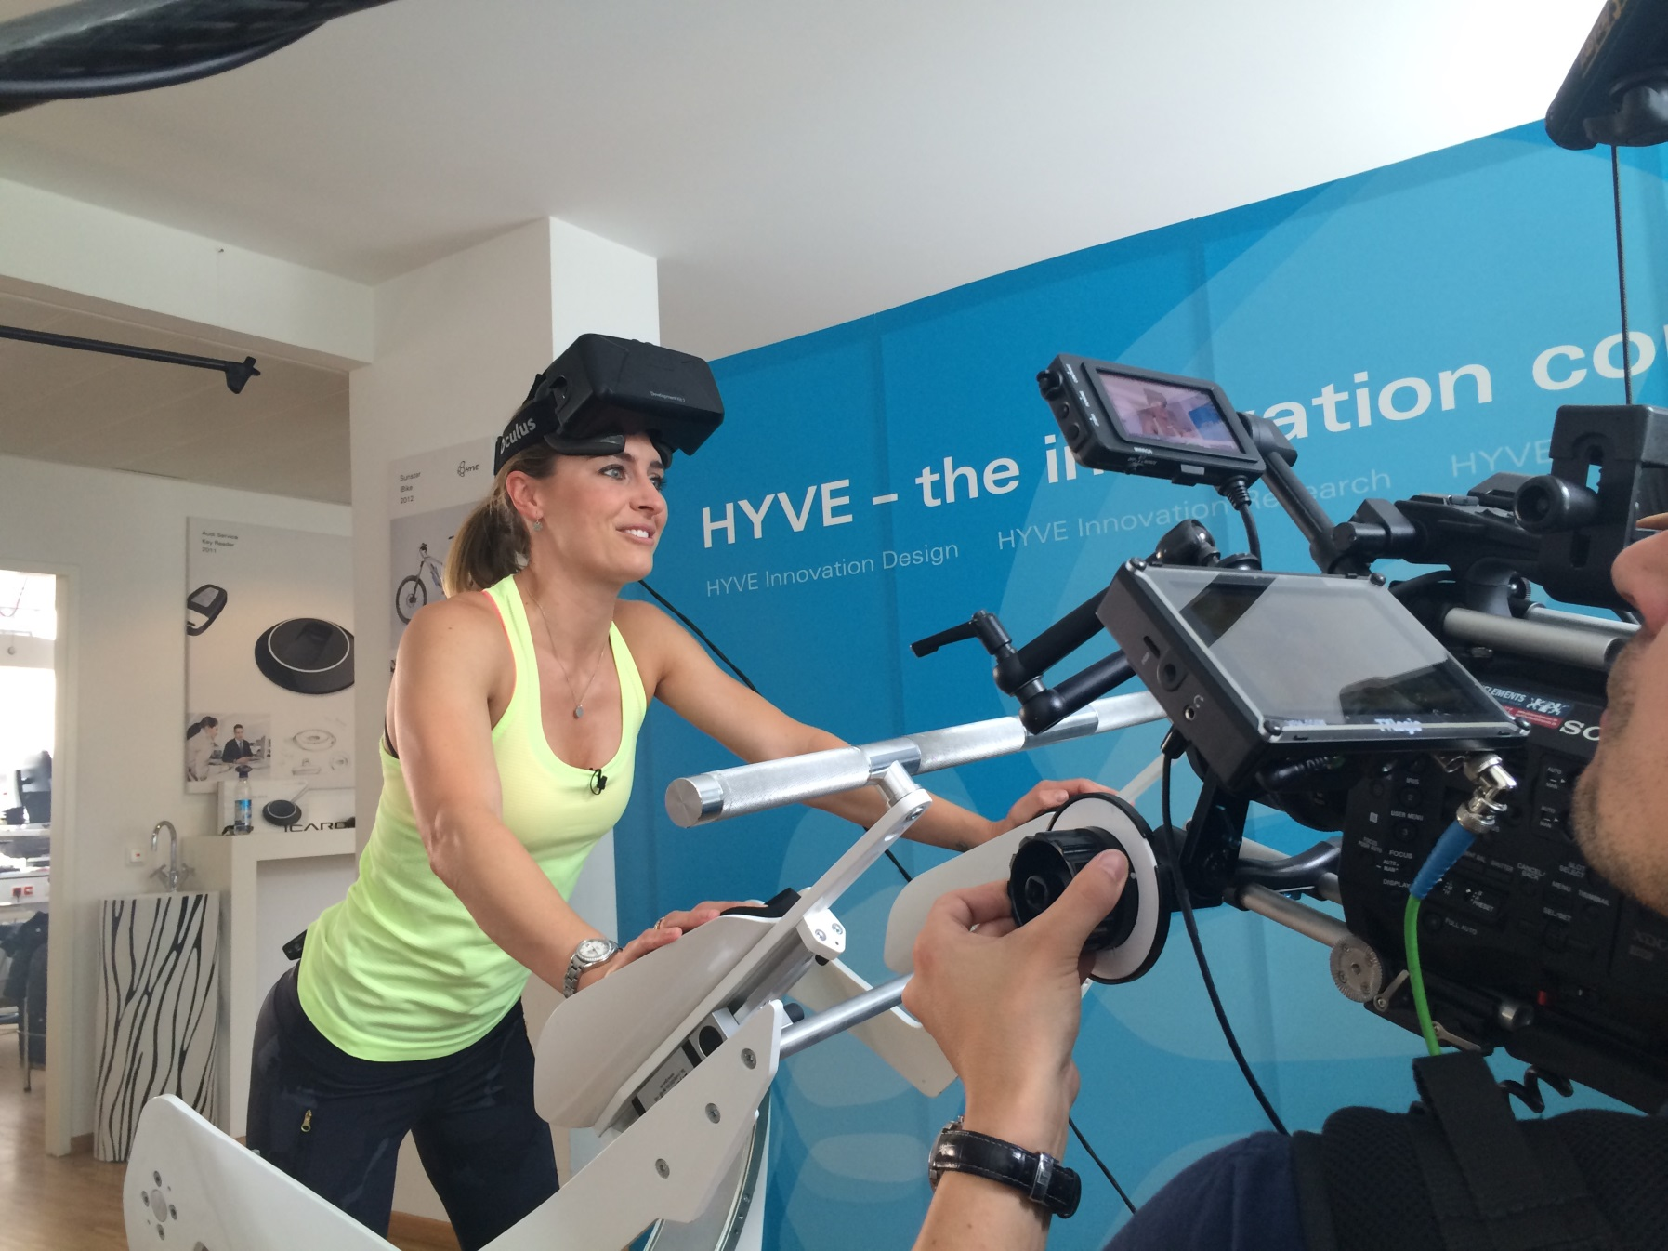

Slide 19
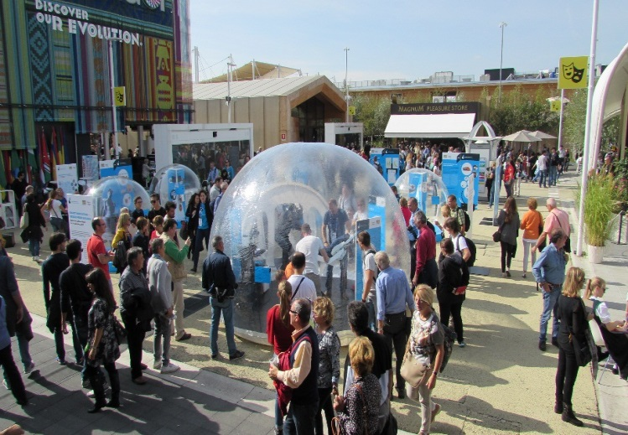
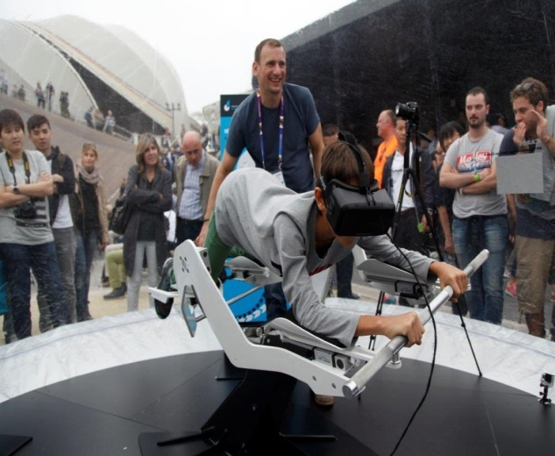
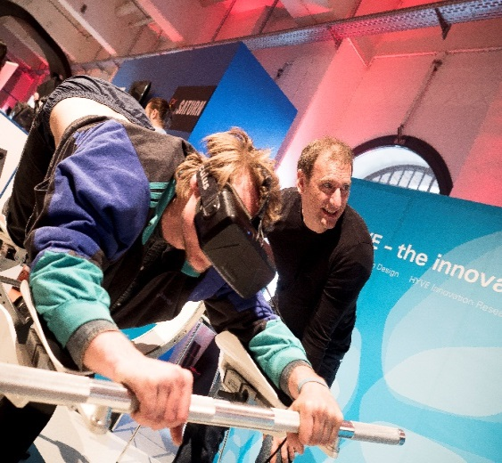
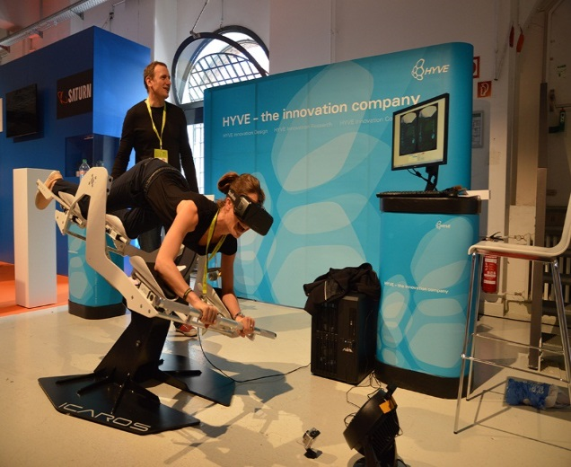
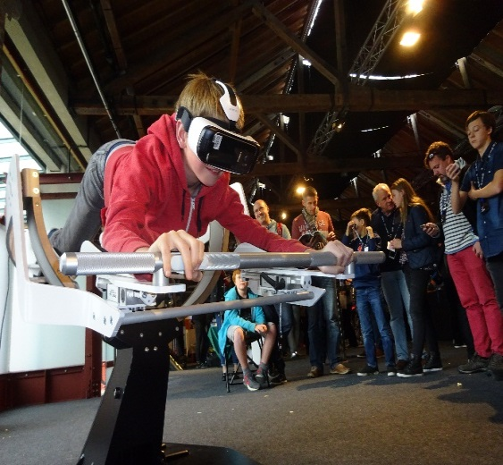
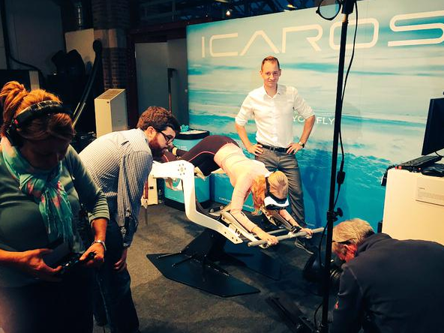
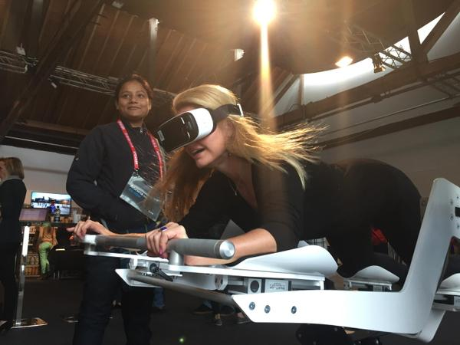
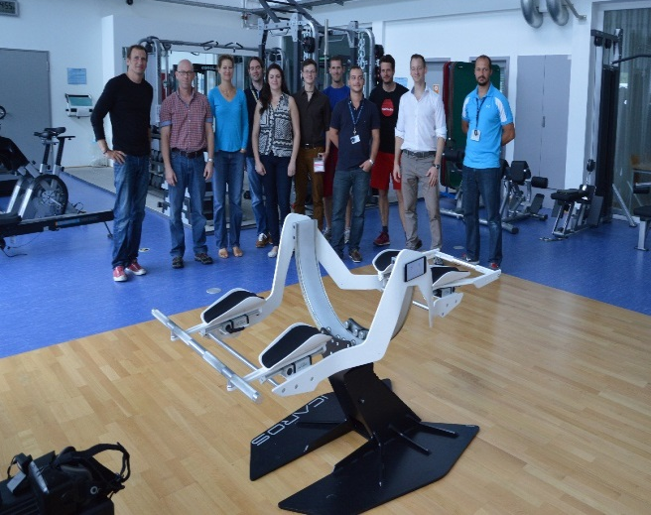
Impressions
EXPO, Milan 2015
EXPO, Milan 2015
Re:publica, Berlin 2015
Re:publica, Berlin 2015
WIRED Next Generation, London 2015
WIRED Conference, London 2015
WIRED Conference, London 2015
European Space Agency, Cologne 2015
Copyright ICAROS GmbH 2015

Slide 20
The New Normal of Innovation
Innovation Management
Start-Up*
Corporate*
Flexibility
Lean Start Up Thinking
Agility
Fast
Know How
Resources
Customer Base
Open Innovation & Crowdsourcing

