Slide 1
Hackers, Makers, and Crowdfunding: Lowering the Barriers to Entrepreneurship
Howard E. Aldrich
ESBRI Estrad
Stockholm, September 30, 2013

Slide 2
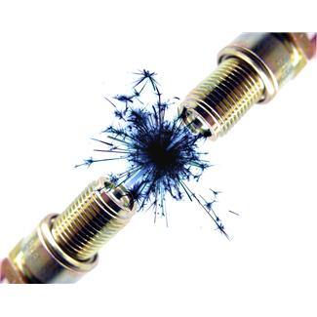
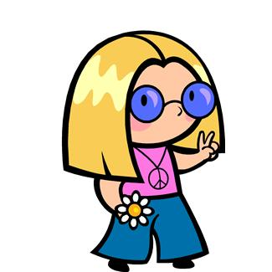
Two Global Trends
Technological revolution
Micro-everything
IT & Social Media
Enabling scaling down/up
Institutional entrepreneurship
Legacy of 1960’s
Localism & community
Facilitating collaboration & cooperation

Slide 3
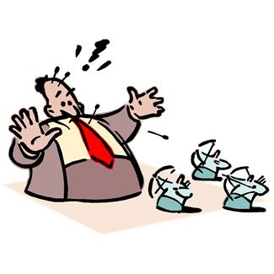
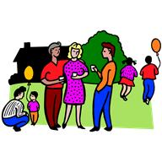
Social Innovation & New Institutions: “Hot Causes”
Rebelling against the “closed box”
Promoting local production & control
Doing things for yourself
Earning living from own creativity & labor
Notes:
Quote !: Shannon O’Hare: “We’ve been told by corporate America that we cannot fix the things we own… All we can do is buy their stuff & like it.”
Quote 2: from Jeffrey McGrew: “Honestly, I wonder if the cynical counter-response is partially from someone who's bitter at being stuck at a desk job. What's wrong with a bunch of new small business sprouting up all over America? Small business built this country, small business are the backbone of this country, and frankly, big business have little interest in a lot of local issues. Small businesses are all about local issues. If this movement launches a slew of new small businesses, I think it will indeed have an impact on our world, every bit as much as the Internet has.”

Slide 4
“If You Can Imagine It, You Can Make It”
User-Driven Innovation
Medical devices
Juvenile products
Extreme sports
Typesetting
Technology wants to be free!
Enabling technologies
Laser cutters
Computer Numerical Control (CNC) for machines
3D Printers
Notes:
Rise of tools that destroy the advantages of the old order`

Slide 5
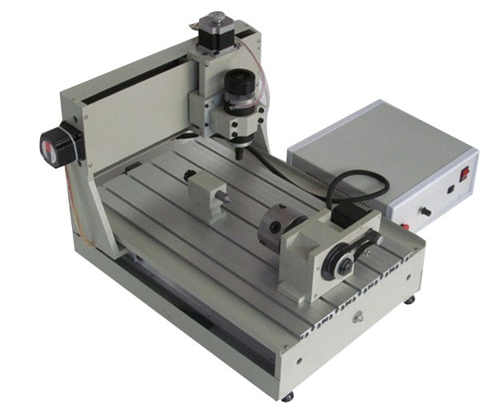
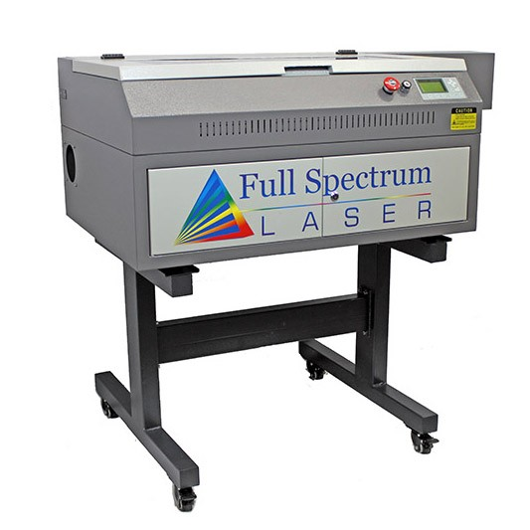
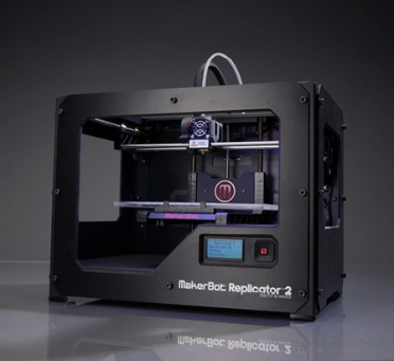
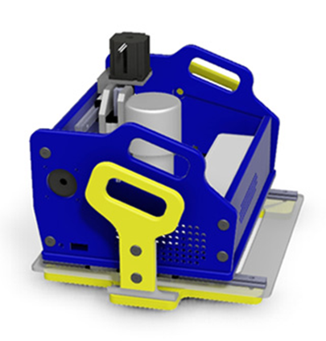
Some of The New Tools

Slide 6
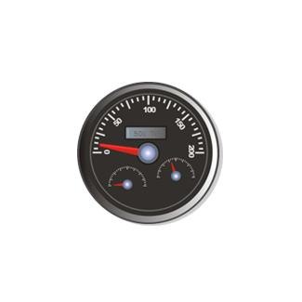
Where Do “Makers” Go to Gain Access to Tools?
Closed Access - $$ driven
Incubators
Accelerators
Open Access – Cooperative & Collaborative Spaces
Hackerspaces
Fab Labs (MIT-sponsored)
TechShop
1000’s globally

Slide 7
Hackerspaces in USA
Hoboken: MakerBar
SF: NoiseBridge
Oakland: LiberatingOurselvesLocally
Brooklyn: NYC Resistor
Philadelphia: The HackTory
Culver City: CrashSpace

Slide 9
Institutional Structures of Cooperation & Collaboration
Education (MOCCs)
Udacity
Singularity
Gatherings & Celebrations
Maker Faires
Media
Make magazine
Legal/regulatory
Creative Commons
Sharing & diffusion
Maker Shed
Brokers & bridges (crowd-sourced design & mfg)
Quirky
Thingiverse (Makerbot)
100K Garages
Cloudfab
Crowdspring

Slide 10
Example of Legal framework: @Creative Commons
“Creative Commons develops, supports, and stewards legal and technical infrastructure that maximizes digital creativity, sharing, and innovation.”
“Our vision is nothing less than realizing the full potential of the Internet — universal access to research and education, full participation in culture — to drive a new era of development, growth, and productivity.”

Slide 11
Small is the New Big “Punching Above Their Weight”
Marketing & Sales (“community”)
Etsy
Art Fire
Dawanda
Fulfillment & Shipping
Amazon.com
UPS
FedEx
Web Hosting & Outsourced Business Services (“the cloud”)
GoDaddy
Outright
SalesForce
Workday

Slide 12
Everyone an Investor? Democratizing Ownership
Non-equity crowd funding: “rewards”
Kickstarter
Indiegogo
Fundable (only biz)
FundedByMe
Non-equity crowd funding: debt/loans
Equity crowd funding
EquityNet
Fundable (only biz)
FundaGeek (for sale!)
FundedByMe
NEXT STEP: JOBS Act in the USA

Slide 13
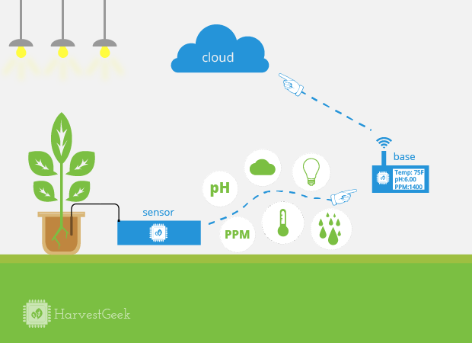
Example of social Innovation: HarvestBot (Harvest Geek’s Kickstarter Campaign)
Monitoring
a garden’s
vital signs

Slide 14
Issues Raised by Technological & Institutional Changes
Team composition: how much does it matter now?
Will pursuit of profits corrupt the “community” & collaborative spirit?
Can makers & fabbers remain “small”?
The “Matthew” & “Sesame Street” effects: what impact will these changes have on economic inequality?
Notes:
#3: Example of Brit Morin – started small but then raised millions.

Slide 15
