Slide 1
Always Looking for the “New” New Thing: Silicon Valley Again*
Martin Kenney
UC Davis
&
Berkeley Roundtable on the International Economy

Slide 2
Outline of Talk
California today
The ecosystem
The history of Silicon Valley
Policy issues
Considerations for the Nordic nations
Conclusions

Slide 3
California Today

Slide 4
Global Top 50 Universities*
CA: Stanford, UCB, CalTech, UCLA, UCSD, UCSF, UCSB, UCI, USC, UCD (10 total)
UK (5 total)
New York (4 total)
* Shanghai Jiaotong University AWRU 2012

Slide 5
California’s Share of U.S. and Global USPTO Patents Is Growing

Slide 6
Venture Capital Disbursements by
Region, 1980 - 2012
SoCal #3!
Source: VentureExpert 2011

Slide 7
Employment in Four Bay Area Counties, 1959-2001
?
© Source: Martin Kenney compilation from Census of Industry

Slide 8
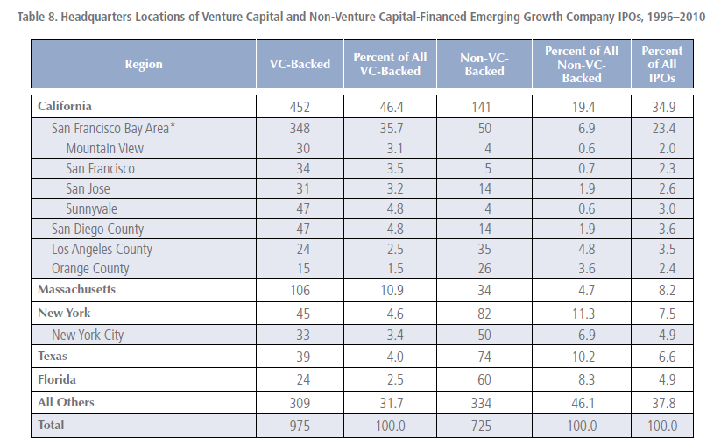
IPOs per State, N = 1,700

Slide 9
It is no exaggeration to say it is the Bay Area, Boston & San Diego, and the Rest

Slide 10
The Ecosystem

Slide 11
Dialectic and Coevolution of Culture, Economics, Technology and Social Networks
Capital gains/Venture Capital
Culture: ENTREPRENEURIAL
VIRTUOUS CIRCLE
Highly networked social order
Fast changing technologies
New new things
Culture, social structure, and economics are aligned
(c) Martin Kenney

Slide 12
An Ecosystem Specialized in Assisting Startups
Bankruptcy specialists
Venture capital
Law firms
Accountants
Specialized contract manufacturers
Investment bankers
Entrepreneurial Team
Commercial real estate
Marketing specialists
Banks
Consultants
Board of Directors members
Executive search
Lower entry barriers, speed the firm creation process, facilitate rapid growth, allow concentration on product development.
(c) Martin Kenney

Slide 13
Technology or Opportunity
Not too expensive to enter
Incumbents can’t understand or react because of their bus model
Redefines markets or captures next step in evolving market
10x improvement or
Change the way things are done
“Google it,” the PC, Internet, local area networks, smart phone
Create new platforms or standards
Cannibalize old technologies

Slide 14
The Culture
What is the “new new thing?”
Go for it/change the world
Gadget and engineering-oriented environment
Open networks -- everyone knows someone
Performance-based trust
Did and can you deliver?
Fast paced, high turnover

Slide 15
Capital Gains Drive Entire System

Slide 16
History of Silicon Valley

Slide 17
No Single Explanation
Technology (though my vote is here)
Universities
Venture capital
Defense Department spending
Culture
Social capital from networking
Co-evolution of individuals, firms, organizations, and institutions

Slide 18
Putting the Silicon in Silicon Valley

Slide 19
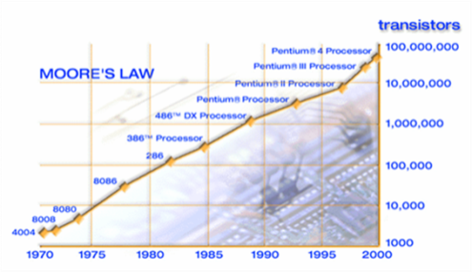
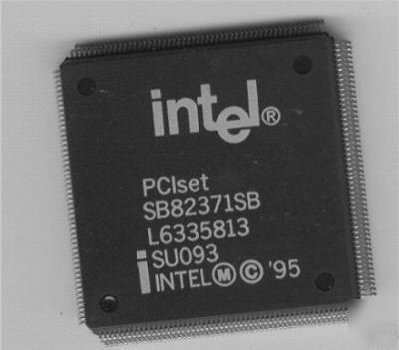
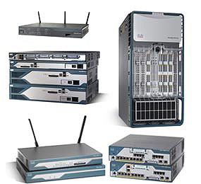
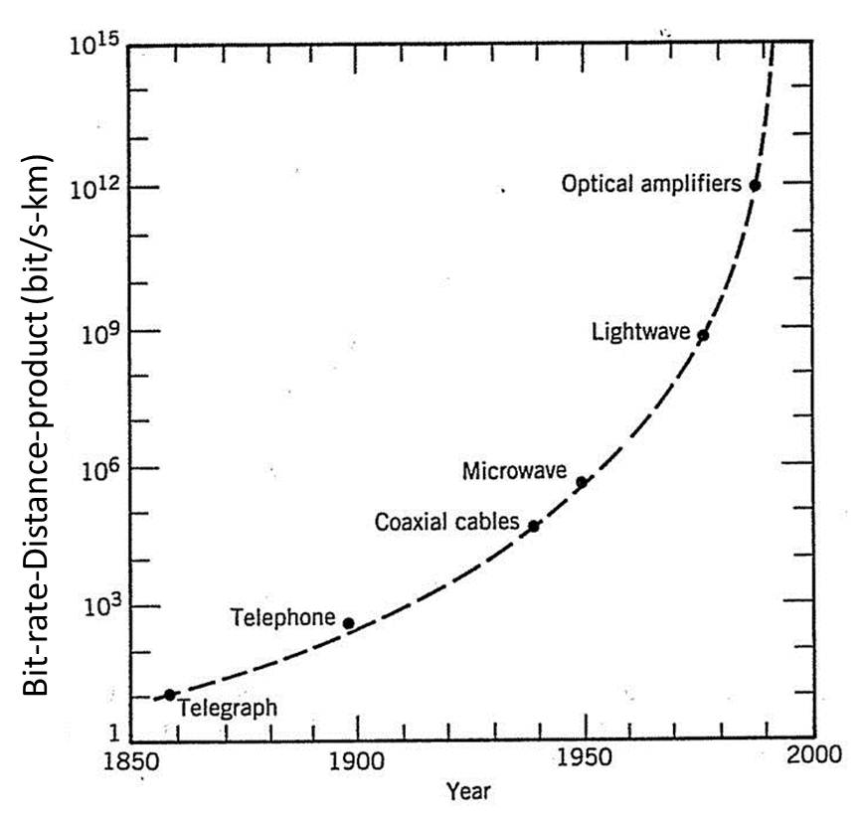
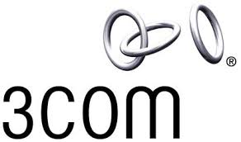
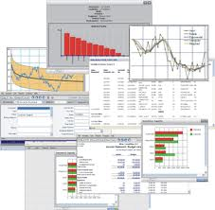
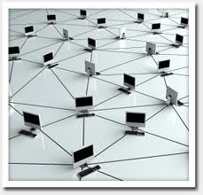
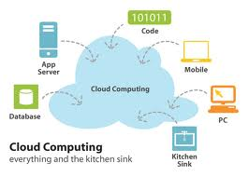
New New Thing
Chips
Computers etc.
Networking
Software
Internet

Slide 20
New New Thing
And, of course
Now getting old?
Next?

Slide 21
And Don’t Forget

Slide 22
Silicon Valley Leaders
World’s leading device maker -- Apple
World’s leading search company – Google
World’s leading social media site – Facebook
World’s leading chip maker – Intel
World’s leading networking equipment maker – Cisco
World’s second largest software co. -- Oracle

Slide 23
Policy Issues

Slide 24
Policy Issues
National Level:
Early days massive DoD purchasing
Early days difficult to enforce patent laws (now changed)
Standard setting e.g., TCP/IP
Massive and unremitting R&D expenditures (NIH, DoD, and NSF)
Merit-based evaluation
Immigration (U.S. universities select the world’s best)
Liquid and fairly transparent equity markets
Low capital gains tax & favorable stock option tax

Slide 25
Policy Issues
State Level:
Best public university system in the U.S. possibly the world
Inability to enforce non-compete agreements
Extremely liberal bankruptcy laws
Nice place to live -- socially liberal, strong environmental regulation
Long history of tolerance – lots of odd people

Slide 26
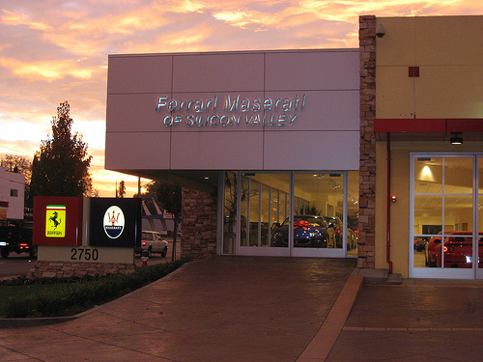
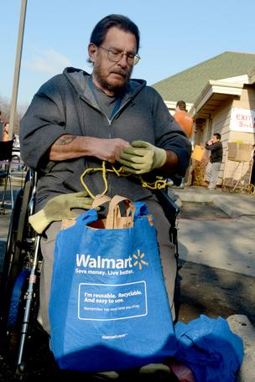
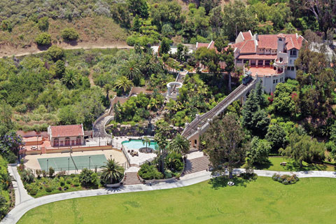
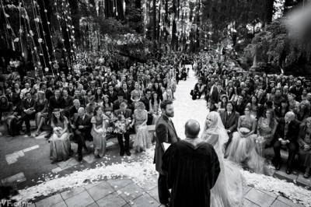
Fabulous Wealth, Grinding Poverty
San Jose City Worker Evicting Homeless
Facebook Sean Parker wedding
Big Sur $3 million in damages

Slide 27
Silicon Valley Future
Enormous amounts of capital available
Venture capital and angels
Great universities
Only rivaled by Boston
More globally connected than ever
Interesting new people keep coming
Optimistic as digitization continues to offer new opportunities: mobile, social media, and cloud

Slide 28
Considerations for Nordic Nations

Slide 29
Nordic Nations

Slide 30
Can Nordics Compete with Silicon Valley?
Sometimes Yes! but most of the time No!
Population – Bay Area -- 7 million, $535 billion – roughly Sweden in size!
University 2009 R&D budgets
UCSF $948, Stanford $704M, UCB $652
But it is possible to learn (PS we should learn from you)

Slide 31
Learnings
Invest in university research
Can immigrants get educated, stay and get great jobs?
Liberalize bankruptcy laws
Eliminate non-compete clauses in labor contracts
Concentrate on strengths

Slide 32
Nice Growth Firms
Many industries, but share following characteristics
Barriers to entry not too large
Use skilled, quality-oriented people
High value-added
Often started by an entrepreneur or a small team often are experienced personnel from a similar industry
Not likely to grow to enormous size or will scale in linear fashion
Not likely to grow large enough to offer stock to the public

Slide 33
What Kind of Industries?
Medical devices
Scientific instruments
Precision machinery
Design
Consultancies

Slide 34
Conclusions

Slide 35
Nordic Reality and Opportunities
Some top-flight scientists and universities, but not enough
Difficult to attract and retain top talent from abroad
Legal system changes on non-compete, bankruptcy and capital gains difficult and could have other consequences

Slide 36
Nordic High Tech Opportunities
Mobile software
Spying revelations show there is a global market for secure substitutes for U.S.
Software – not just mobile?
Internet
Cloud services
Health care
Clean tech?

Slide 37
Nice Growth Firm Benefits
Knowledge-based industries
High value-added
Employment effects often small individually but significant in aggregate
Can employ skilled craftspersons
Often built on high quality production
Producing quality products is a social good
Can be clustered or diverse

Slide 38
Conclusion
If you have the deals the money will come, e.g., China and Israel
How to encourage socially beneficial entrepreneurship
The goal is to encourage people to actualize their creativity

Slide 39
Questions?
mfkenney@ucdavis.edu

