Slide 1
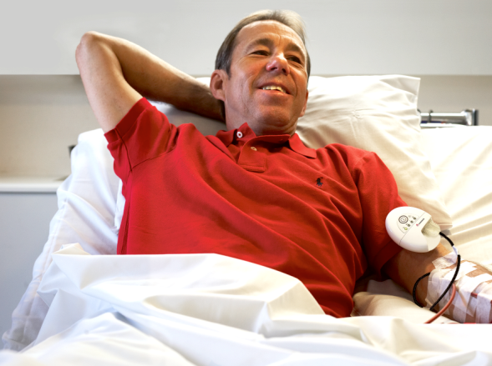

Slide 2
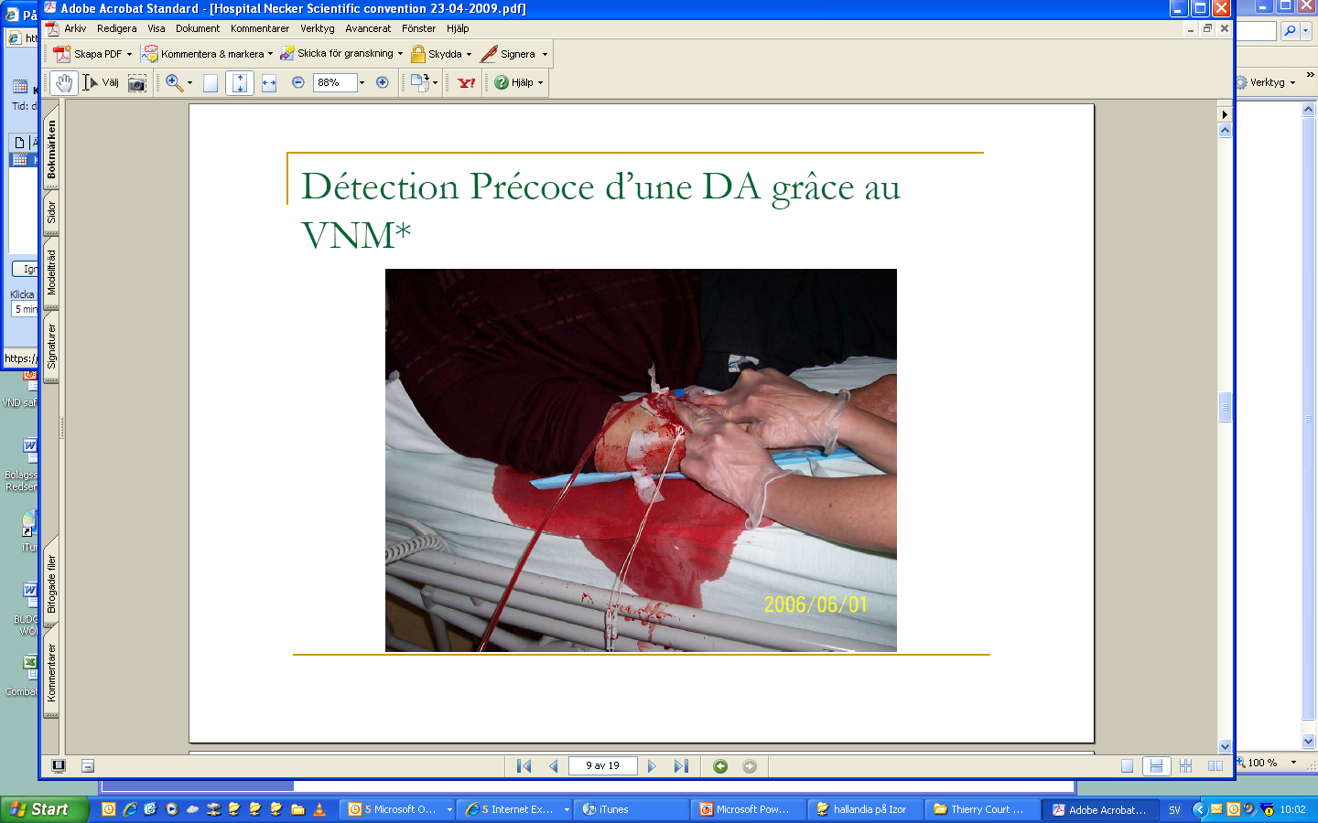
Needle dislodgement – The Issue
In the US alone, more than; 2 / 2 / 200
  2 patients die due to VND every week
  2 patients are seriously injured every day due to VND
  200 needles are dislodged every day
RPA estimates that 1 in 720 hemodialysis treatments performed in the US has a VND⁴
Haemodialysis nurses tells that they believe dislodgement related incidents are often not reported²
It is estimated that 136 patients die annually, in the US alone, due to venous needle dislodgement¹
VA clinics reports that 1 of 62500 treatments result in a serious bleeding and in worst case death ³
After a VND, the patient has a higher risk of mortality, due to infections⁵
Sandroni S. Catastrophic Hemorrhage from Venous needle dislodgement during hemodialysis. Journal of the American Society of Nephrology, volume 19, November 2008
Ny teknik, issue 33, 15th August 2007
Patients Safety Advisory; Veteran Health Administration Warning System; Published by VA Central Office; October 21, 2008
Renal physicians association, US, patient survey 2007
5) Gambro, France
Notes:
Global numbers are: 13 patients dies every week or 2 per day; 13 patients are seriously injured every day and 1300 needles dislodges every day

Slide 3
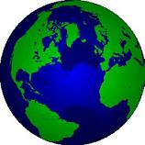



Market Potential
Patient population approximatly 2 mil ESRD patients
89% are treated with HemoDialysis (HD) 1.8 million
362 000 HD
271 500 HD
270 000 HD
900 000 HD
Aisa Paciffic
Latin America
&
Other
North America incl. Canada
EU, Africa & Middle East
270 million HD treatments annually

Slide 4
Where are our markets?
Market size
  Sweden – 3 500 patients
  UK – 20 000 patients
  Germany – 65 000 patients
  USA – 300 000 patients
Market structure
  Safety a concern?
  KOL
  Organization of customers
  Regulatory
  Legal
Accessibility
  Ways to market (Regulatory bodies, distributors/agents Interests grps)
  Speed of adoption
Notes:
Scotland – criminal court
KOL – America, Australia, svensken är verksam I USA

Slide 5
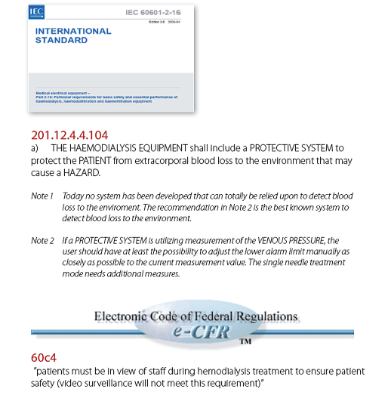
It’s a regulatory must!
Notes:
Might add DIN std

Slide 6
Redsense – reduces cost for the Health care system

Slide 7
Let’s roll
USA – direct sales
Germany – direct sales (but later)
UK – distributors (started w direct sales)
Europe – distributors
Asia – wait (different regulatory)
Australia – distributor (large on self HD)

Slide 8
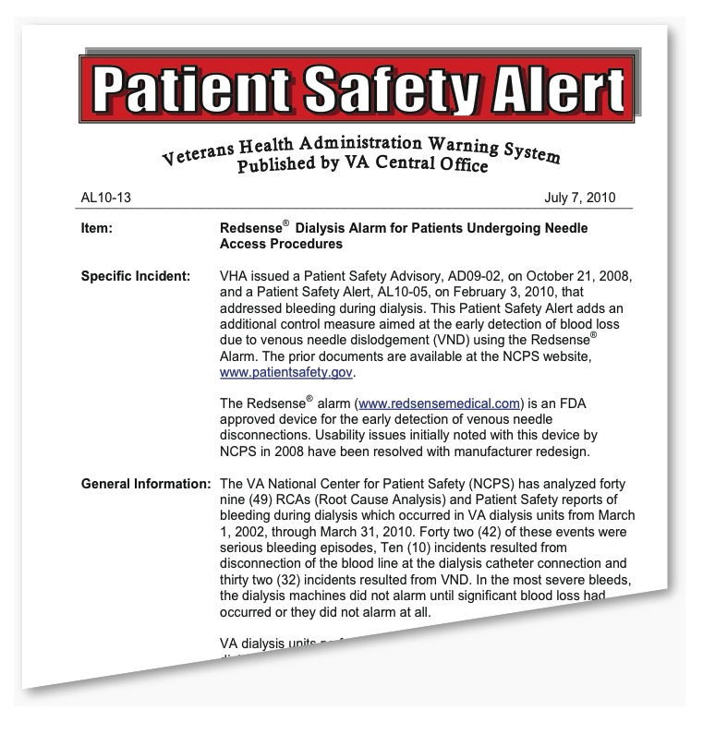
Customers
Samples of key customers:
USA gov. of Veterain Affairs
  First clinic started 2008
  All clinics mandatory from Nov. 9 ’10
  Appr. 20% adaptation
Scotland
  started using RS 2009
  Appr. 15 -18% adaptation
Cleveland clinics
  acute hospital,
  started 2010
  Art. Publ. Nov 2011
  Used by all AVF/Grafs
FMC-NA
  Nocturnal use
Notes:
The lead time for a customer is anything between 6 to 36 months
Other customers include:
Diaverum (management endores the use of Redsense for risk patients; they are currently doing a risk assessment on their clinics) – The Australian clinics uses RS
Kuratorum / Kfh: one clinic is using RS and have been using it sice 2010. next step is an introduction on three clinics
Phv: been listed as approved vender since 2010

Slide 9
Reflections
Do you need to be best in class?
Governmental bodies
  Läkemedelsverket
  FDA
  Veteran Affairs
Funds
  Business Angels
  VC
  Vinova, Almi
Notes:
Ystad

Slide 10
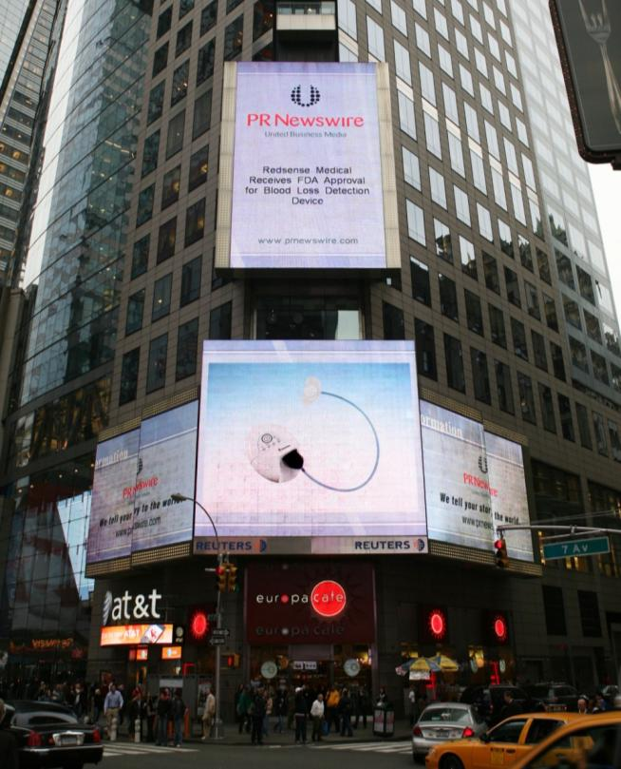
Tack!
Summery
Market acceptance
  CE March 2007
  FDA clearance clinic Oct 2007
  FDA clearance home May 2010
Redsense is being sold in 13 countries:
  Sweden, USA, Canada, Denmark, Finland, Germany, Holland, Belgium, France, Italy, Spain, Austria, Australia
Examples of clinics:
  Cleveland clinics, VA-hospitals, Glasgow (all of Scotland), NÄL, Skejby etc
Patrik.Byhmer@redsensemedical.com

Slide 11
Achievments
Regulatory
Awards
CE-mark Feb 2007
FDA 510k clearence Oct 2007
ISO 13485 clearance Nov 2008
FDA 510k clearance for HHD May 2010
FDA 510k clearance for 8 hour useage Feb 2011
Innovation company of the year
(Halmstad, Sweden region)
SKAPA finalist
(Most intresting start up in the region)
Emerging company of the year
(Frost & Sulliavan 2008)
Index award finalist
Member of the 33- list
(one of the 33 most promising young tehnology companies in Sweden)

Slide 12
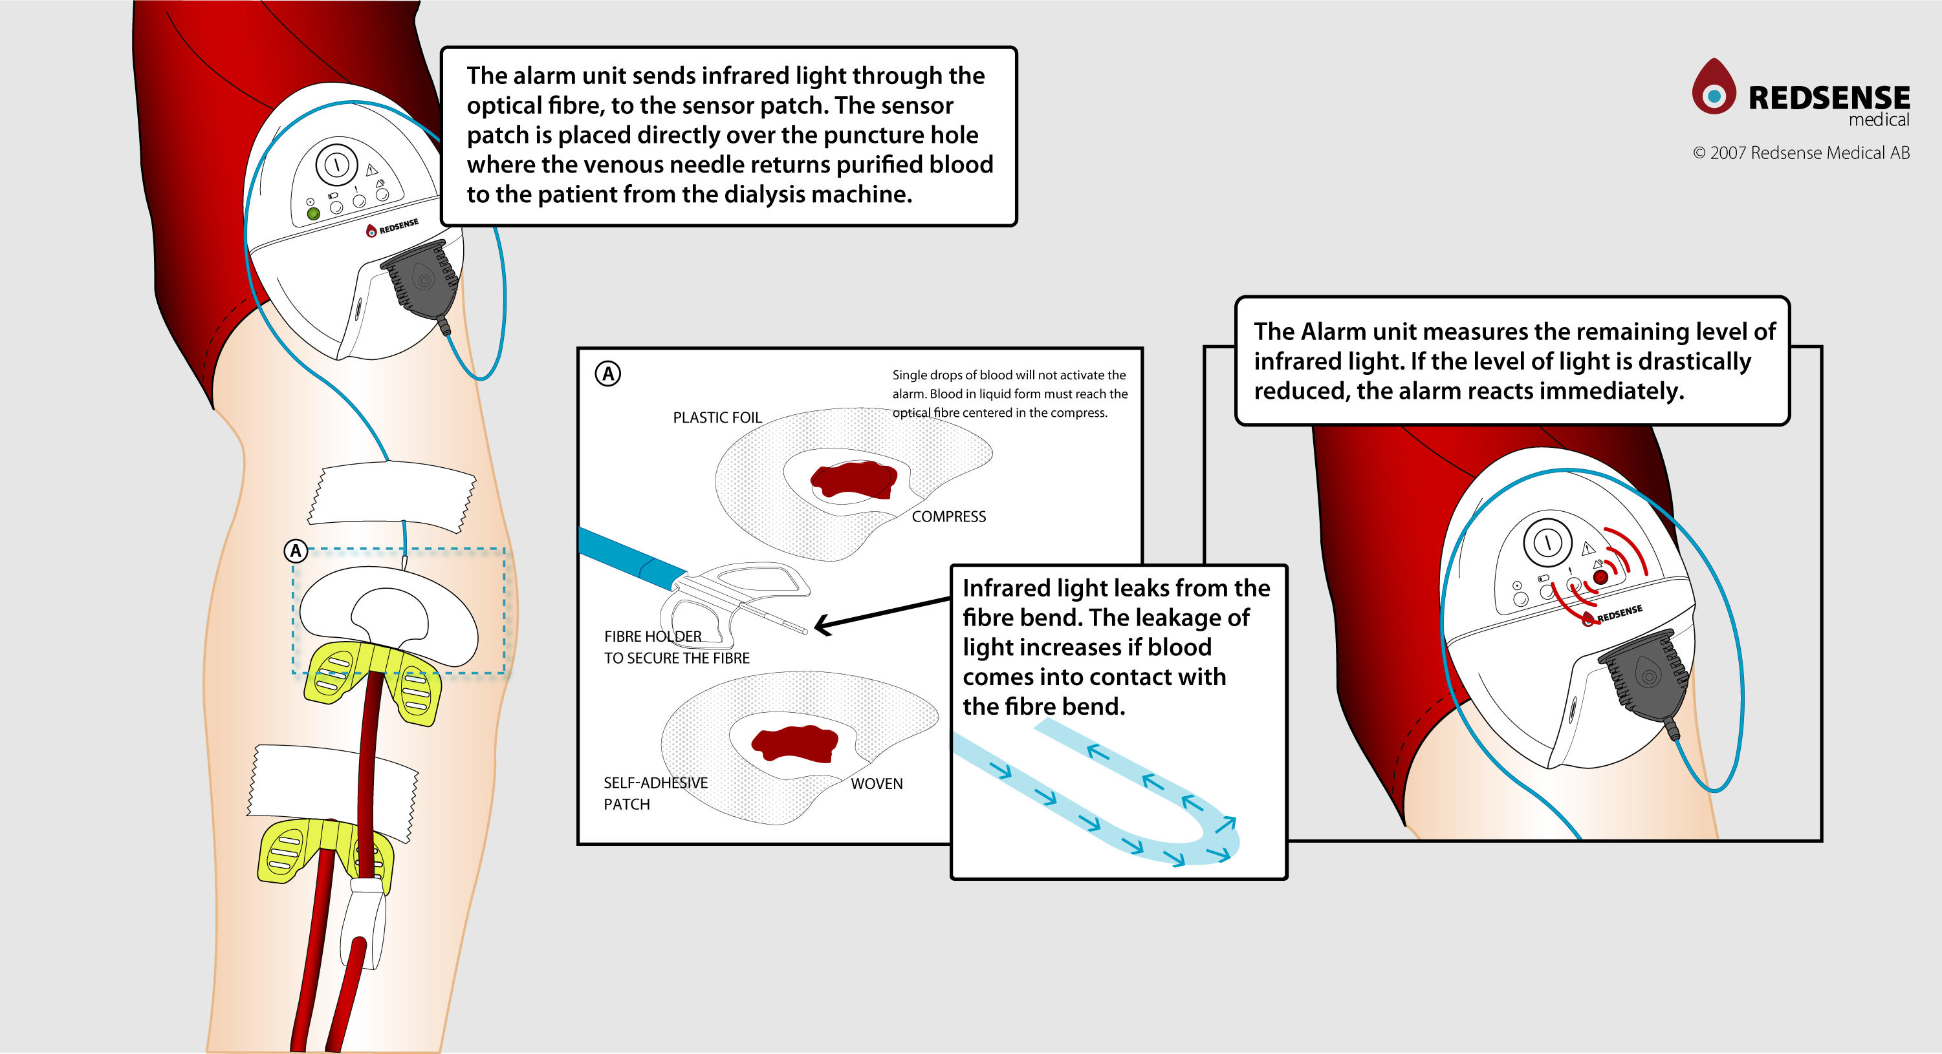
How the it works!

