Slide 1
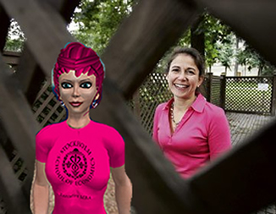
Leveraging Virtual Worlds for Real World Results
Dr. Robin Teigland, aka
Karinda Rhode in SL
Stockholm School of Economics
www.knowledgenetworking.org
www.slideshare.net/eteigland
Serdar Temiz
Royal Institute of Technology
Photo: Lundholm, Metro
September 2009
Notes:
Before we start there is a nice article on In world business models and second life.
http://dusanwriter.com/index.php/2009/07/13/in-world-business-models-and-second-life/
to get inspired:
http://www.youtube.com/watch?v=v2woYgbffXo&feature=player_embedded#t=360
resourses above havent been used in PPT. I will think after tomorrow.
----
slide1:
Virtual Worlds are convergence of social networking, online games and simulation
I would concentrate on
Stardoll since it is Swedish and:) it is the largest online community for girls who love fashion, shopping, decorating, creativity, and making new friends from around the world. Members create their own MeDoll avatar, go shopping, dress up, decorate their suite, express themselves creatively and socialize with each other
whyville.net
"Whyville is a virtual world where boys and girls from all over the real world come to chat, play, learn, and have fun together. You design your face, earn clams by playing games, hang out at the beach, and go to town events at the Greek Theater. You can start your own business, buy a car and give your friends a ride, or write for the town newspaper.!

Slide 2
Today’s discussion
Some facts and figures on virtual worlds
A look at virtual entrepreneurship
Some real life benefits of virtual worlds
Break
A look at some of my virtual world activities
A tour of Second Life

Slide 3
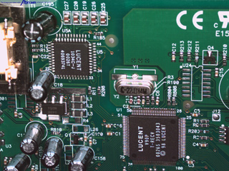
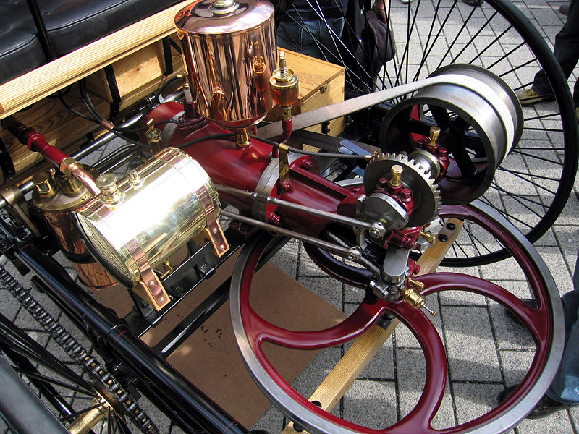
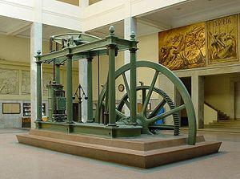
History tends to repeat itself…. Innovation, financial crisis, industrial revolution, …
Microelectronics
Internal combustion engine
Steam engine
Third
industrial
revolution?
Late 18th C
Late 19th C
Late 20th C
Schön 2008
Notes:
I always like to put things into perspective. The theme of today’s event is that of seeing opportunities in the midst of the financial crisis and I think that what is interesting and relevant here is that several economic historians had actually predicted the crisis that we are experiencing now. I don’t have time to go into all the details, but what we are seeing is a pattern repeating itself. As in the late 18th and 19th Centuries there was a technological innovation that led to a period first of transformation as the innovation began to be diffused, then a period of rationalization leading to an imbalance, and then to a financial crisis coming around 40 years after the innovation. However, in the past, these financial crises have then led to periods of great economic development – industrial revolutions, in which industry profitability has been restored through a redistribution of the value-added between capital and labor. But more importantly, these crises filtered out those organizations that could not adapt and change to stay competitive in the new industrial environment.
And one of the most important things that is of interest for today’s discussion is that in one of the factors facilitating these new phases of economic growth following the crisis has been that a generation of people that had never experienced life without the innovation starts to enter the workforce – thus they are not restricted by old ways of thinking.
experiencing now some economic historians claim to be due to the innovation of the microprocessor and microelectronics in the 1970s.
Similar to what we experienced with the innovation of the steam engine in the late 18th C and the internal combustion engine and electric motor in the late 19th C, there was a subsequent crisis about due to various forces converging. We saw that as these basic innovations were diffused, people stopped investing in the existing industrial structure and instead focused on investing in a new generation of competitive machinery, which then led to an industrial revolution in both cases as the innovations became embedded in society. At the same time, the crisis served to release the negative pressure that had been built up as well as to restore industry profitability through the redistribution of value-added between capital and labor.
Other notes
Notes from article - Schön, L, Economic Crises and Restructuring in History
A crisis is connected with changes in the long term or structural conditions built up during a rather long period of time and effects behavior for a long time to come
Transformation – changes in industrial structure – resources are reallocated between industries and diffusion of basic innovations with industry that provides new bases for such reallocation
Rationalization – concentration of resources to most productive units within the branches and measures to increase efficiency in different lines of production
Shifts between transformation and rationalization have occurred with considerable regularity in structural cycle of 40 years – 25 years on transformation, and 15 years on rationalization. Crises been part of this cycle as well
International crisis in 1840s –
How go from crisis to expansion quickly – went quite rapidly in 1930s for Sweden – but Sweden in opposite corner in 1970s
1850s – upswing of industrial and infrastructural investments was linked to breakthrough of mechanized factories in Sweden, modernization of steel processes and construction of railways
1930s and more marked after WWII late 1940s - expansion of electrification and diffusion of automobiles, processing of electrosteel to small motors in handicraft and household – combination with motorcar – new styles in living and consumption
Waves of investments around development of an infrastructure from basic innovation of preceding cycle
mid 1970s – microprocessor – knowledge and information in production of goods and services
It is not the basic innovation itself – but the diffusion of the innovation that counts!
When invented, then expensive to implement, have a narrow range of application –
Following generalization –
A structural crisis (that has been preceded by an early development of basic innovations) has put an end to old directions of investments mainly in rationalization of existing industrial structure and given rise to investments in ne and devt of new tech that after one decade (the length of the classical Juglar cycle of machinery investments) has created a new generation of economically competitive machinery
Reallocation of labor occurs approx 15-30 years after the structural crisis
Development of markets – distribution of value added between capital and labour is one mirror of these changes
Diffusion of innovations leads to expansion of markets and arrival of new competitors –
Structural crises – release negative pressure and restored profitability in industry – get rid of those who not competitive

Slide 4
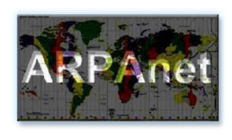
Towards 3D Internet
SENSORY
3D Internet
Thinking
Level of Interaction
Connected
Web 2.0 Thinking
Individual -
Web 1.0 Thinking
Facebook, Friendster, Yahoo, Blogger, Wikipedia, eBay, Typepad, LinkedIn. Amazon, MySpace, Textamerica, Delicious, HubPages
SecondLife, Active Worlds, There, SimsOnline, Club Penguin, World of Warcraft, 3D planets, ToonTown, Habbo, VSlide, Protosphere
Mosaic, Prodigy, Compuserve, AOL, Netscape
Time
Hamilton 2008
Notes:
This slide speaks to the ongoing evolution from the first web to the new web IBM and many other companies feel is developing.
Web 1.0 – What we now see was all about getting people on. This is has been described as ‘the democratization of access’ which set the stage for the web we are living within today.
Web 2.0 – Is all about participation, lead by new media savvy users and a growing number of social tools. This is has been described as ‘the democratization of participation’ a place where the playing field is being leveled for global collaboration, connection and participation. In this stage ‘people’ and the communities they are apart of take center stage. All ages, all skill levels and increasingly more sophisticated tool sets blend to raise the bar for knowledge and information sharing.
Web 3.0 – On the next horizon we see another phase or augmentation of the web. This is has been described as ‘the 3D internet’ and it describes a new media-rich , converged social platform that adds a new dimension the web worlds we have seen to date. This new world includes realistic collaboration spaces, virtual social worlds, the merging of many new media and our connection via a medium that will make you feel like you can transcend geography. We are in the very early days of discovery of this space across IBM and are discovering a variety of new opportunities and application for our business.
(- > launch slide15)

Slide 5
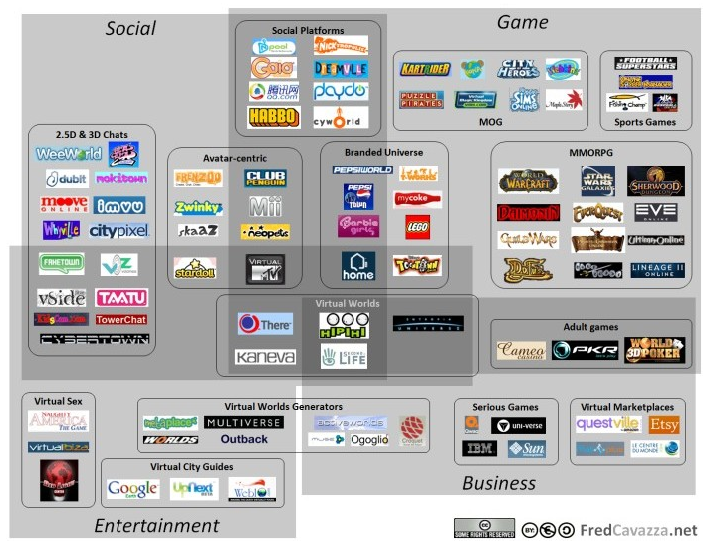
A growing universe of Virtual Worlds

Slide 6
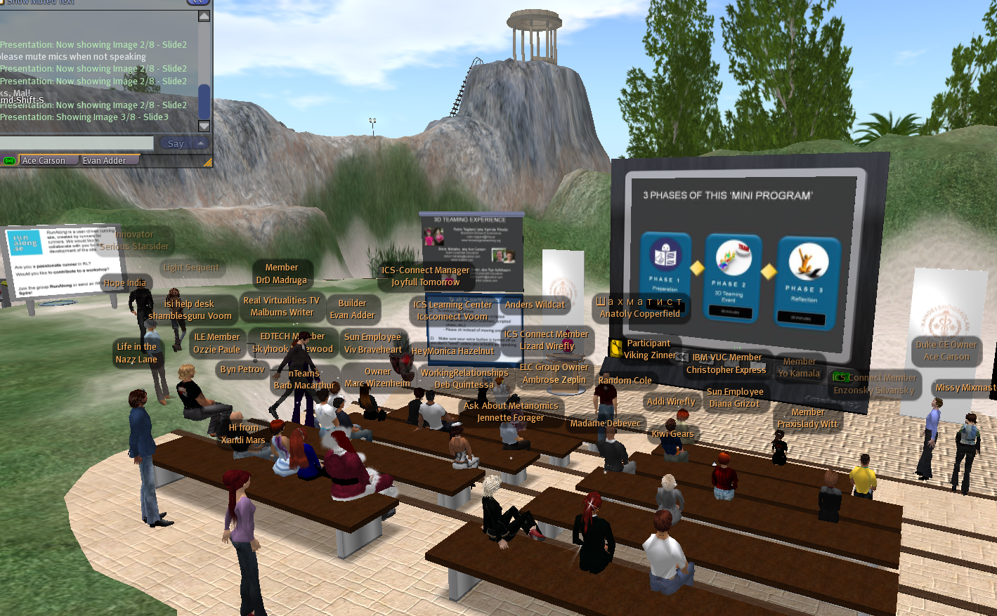
What are Virtual Worlds?
Persistent, computer-simulated, immersive environments
Shared space/co-presence with possibility for socialization and community
In some cases, ability to manipulate/create content
In some cases, virtual economy and currency
http://www.youtube.com/watch?v=0CijdlYOSPc
Notes:
Persistent, computer-simulated, immersive environments
ranging from 2D "cartoon" imagery to more immersive 3D environment
world exists regardless of whether users logged in
Users can manipulate and/or alter existing content or even create customized content
Shared space or co-presence
numerous users, or ‘avatars’, simultaneously participate, interact, and share experiences through gestures, text chat, and voice
Socialization/community
formation of in-world social groups such as teams, guilds, clubs, cliques, housemates, neighborhoods, etc the world allowed and encouraged

Slide 7
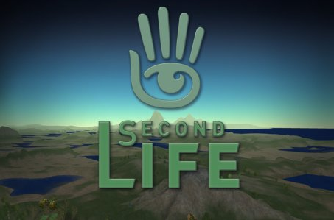
Virtual Worlds
Open-ended–built by residents
Social environment, affinity groups
Boundaries for access and building
Commerce, education, innovation, and…?
MMORPGs
Scripted narrative – created by game designers
Goals and objectives, ranking systems
Rules for gameplay, winners and losers
Entertainment only?

Slide 8
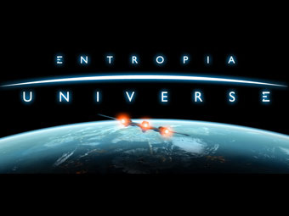
What financial crisis?
Increasing members
Increasing sales
Increasing companies
Wonderland

Slide 9
Why VWs ? Is there any market?
Today around 150 virtual worlds
Q1 2009: US$68 million invested in 13 virtual worlds-related companies
Q2 2009: Total number of accounts at 579 million, 39% increase from Q1 2009
End 2009 – US$ 2bln revenues from subscriptions, marketing, and microtransactions
Virtual Worlds News, KZERO
Notes:
Show Initiative, the leading virtual worlds and virtual goods trade media company, has announced findings from a comprehensive study of public transactions showing that investors put more than $68 million in 13 virtual worlds-related companies in Q1 2009.
ref:http://www.virtualworldsnews.com/2009/05/68m-invested-in-13-virtual-worldsrelated-companies-in-q1-2009.html
By the end of 2011, 80 percent of active Internet users (and Fortune 500 enterprises) will have a “second life”, but not necessarily in Second Life, according to Gartner, Inc.
http://www.gartner.com/it/page.jsp?id=503861
The number of people using virtual worlds is increasing at a rate of 15% every month and this growth does not appear to be stopping or slowing down anytime soon. (Hof, 2006d; Gartner, 2007 cited by Bray and Konsynski 2007)
According to their research, the Q2 2009 virtual worlds sector inhabitant count now stands at 579 million. This number represents a 38.6 percent increase over Q1, where inhabitant totals stood at 417 million. (KZero see the grap in next slide)
http://www.kzero.co.uk/blog/?page_id=2092

Slide 10
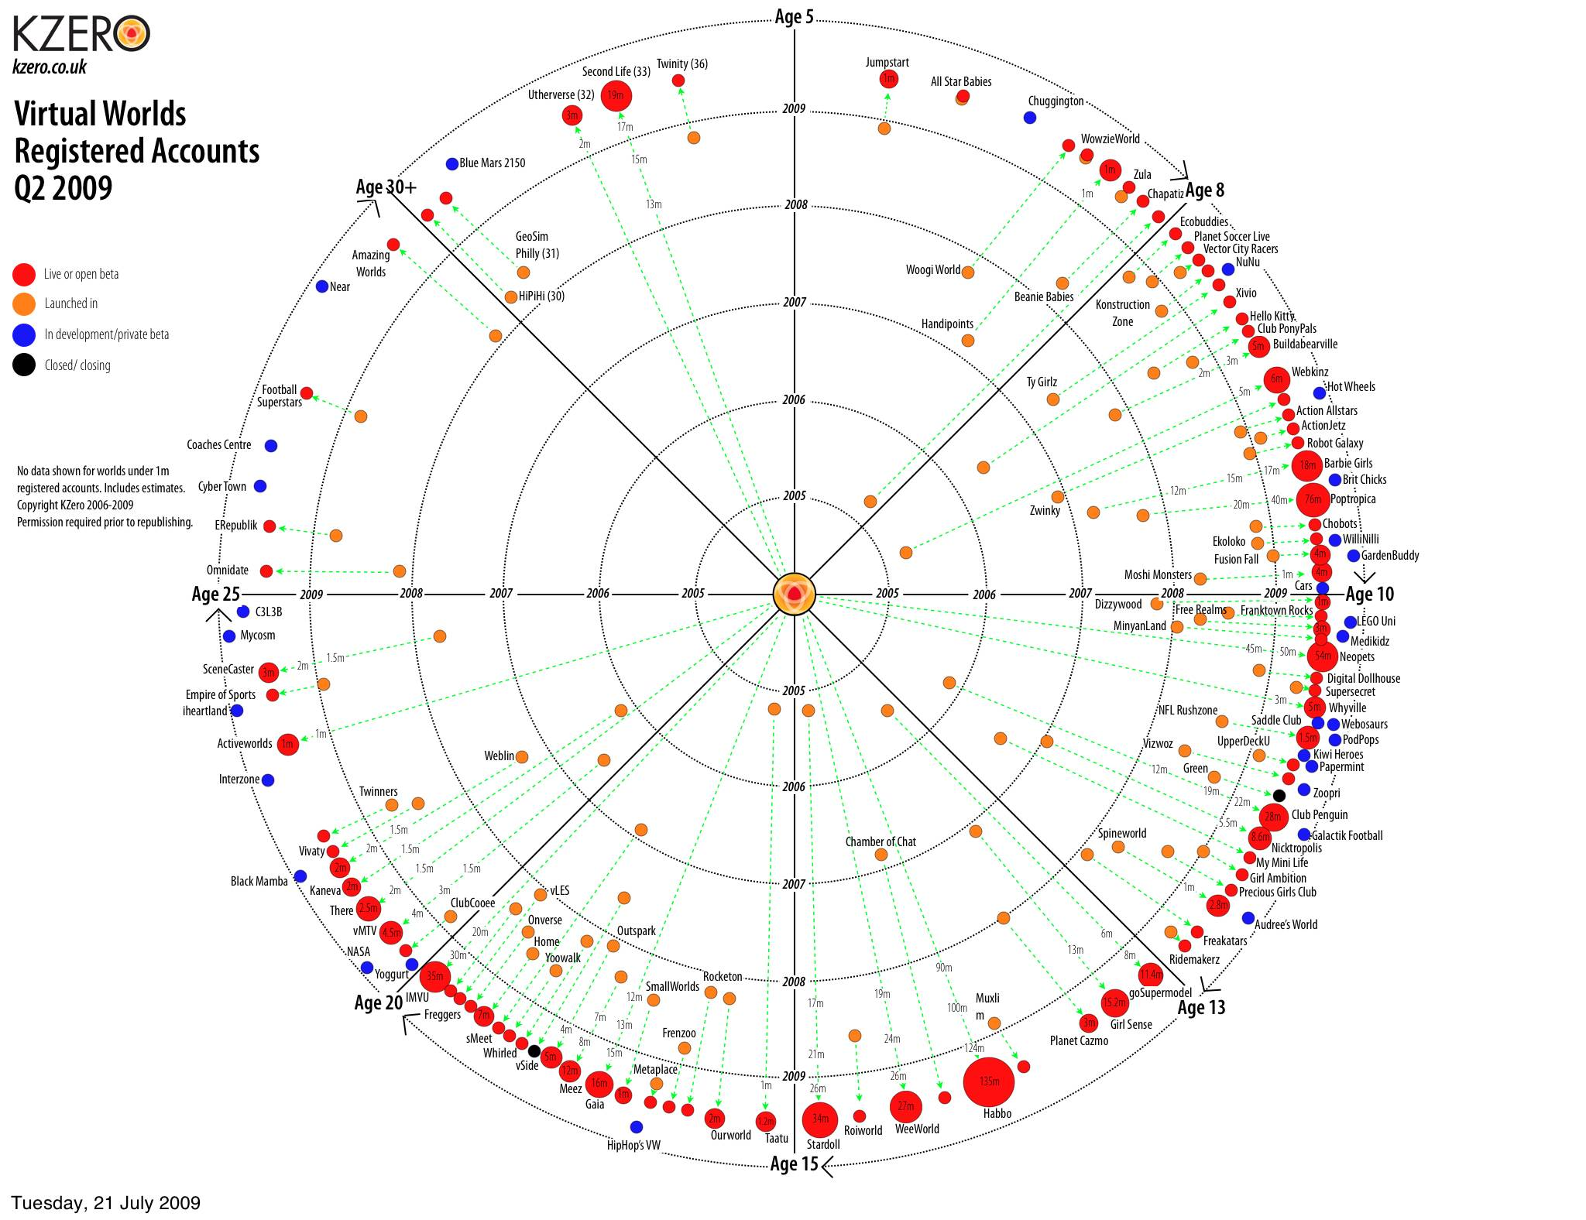
Around 150 virtual worlds
Q1 2009:
$68 mln invested in 13 virtual world companies
Notes:
http://www.kzero.co.uk/blog/?page_id=2092
All VW universe!! You can talk about the graph and some virtual worls for a short time.

Slide 11
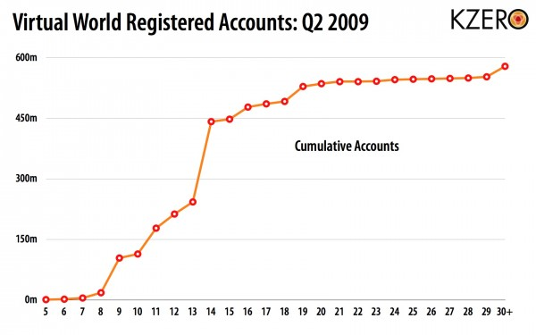
Number of Accounts-Age (Cumulative)
39% increase from Q1 2009
Notes:
The majority of activity, and associated monetization scramble, is happening in the 10-15 year old age group. Totaling 334 million registered accounts, over 57 percent of the entire segment, this age segment represents the largest potential for growth. Holding 19 percent of the entire segment is the 5-10 year old age group

Slide 12
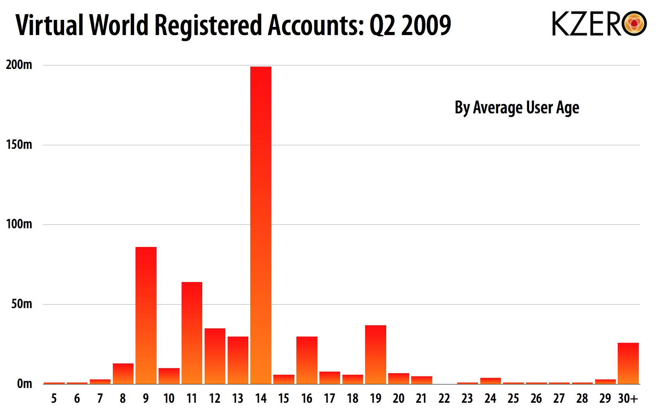
Notes:
Taking data-points of the average age of users within each world, and then allocating this data to all accounts, KZero affirms that predominant age in these worlds is 14. The majority of these VW inhabitants come from big players including Weeworld, Habbo, and Stardoll.

Slide 13
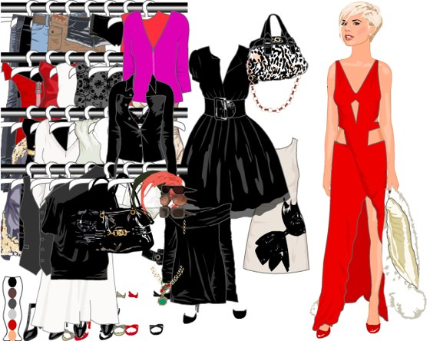
Two popular Kids & Tweens worlds
40 mln members
135 mln members
Notes:
Stardoll
It has its own celebrities. e.g Perez Hilton of Stardoll http://perezhiltonofstardoll.blogspot.com/
Members writes diaries, follow in-world magazines
To get clothes, to chat, to be a celebrity, to buy accommodation you need to do payment
I created a profile:
UserName: HejThisIsMe
Password:stardoll
if you have time, you can show it to the audience.
"Stardoll is a paper doll dress-up community site for everyone who enjoys fun, fashion and making friends. At Stardoll you can create your own doll or choose from our always growing collection of celebrity dolls and dress them up in our virtual fashions. Every celebrity doll has a wardrobe full of unique clothes and outfits, each month there are new and there are new dolls released every week."

Slide 14
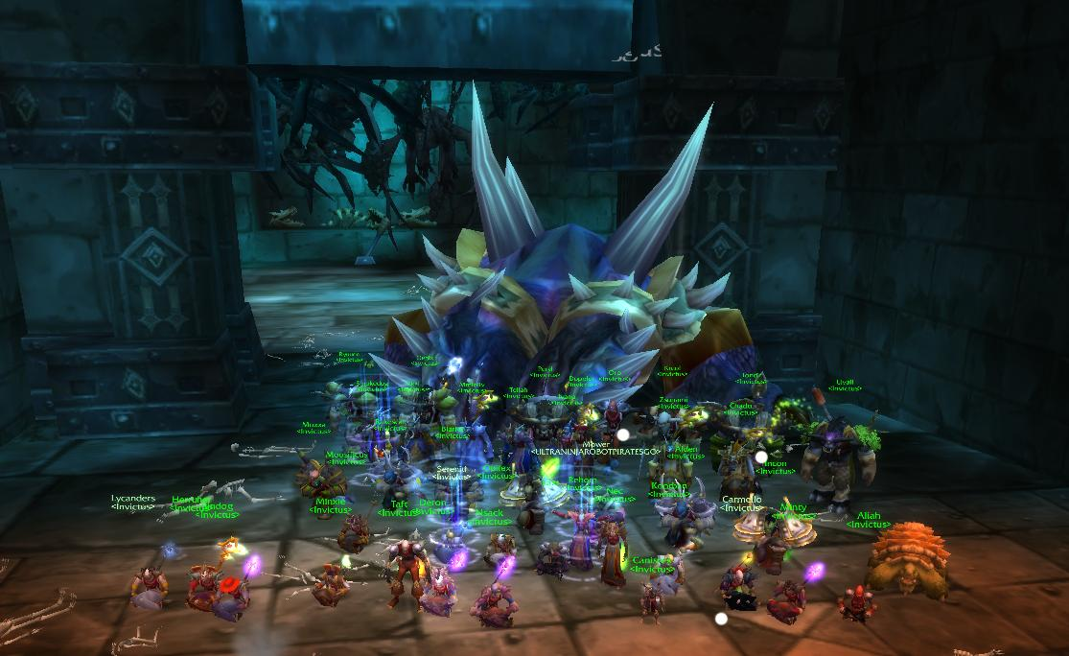
Building skills in virtual environments
My CV
Leading a virtual team of 30 individuals from across the globe
Creating and successfully executing strategies under pressure
Managing cross-cultural conflict without face-to-face communication

Slide 15
“Clearly if social activity migrates to synthetic worlds, economic activity will go there as well.” Castranova
http://www.youtube.com/watch?v=-ahqjBeknT0
Notes:
http://www.youtube.com/watch?v=-ahqjBeknT0

Slide 16
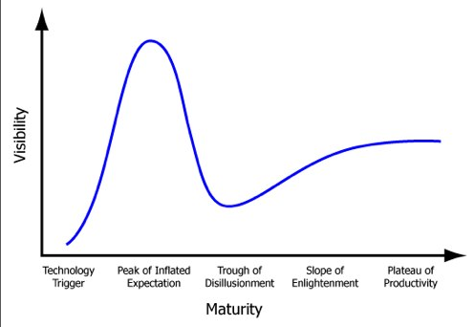
Gartner’s hype cycle
Notes:
What are the 5 phases of a Hype Cycle? 1. "Technology Trigger" The first phase of a Hype Cycle is the "technology trigger" or breakthrough, product launch or other event that generates significant press and interest. 2. "Peak of Inflated Expectations" In the next phase, a frenzy of publicity typically generates over-enthusiasm and unrealistic expectations. There may be some successful applications of a technology, but there are typically more failures. 3. "Trough of Disillusionment" Technologies enter the "trough of disillusionment" because they fail to meet expectations and quickly become unfashionable. Consequently, the press usually abandons the topic and the technology. 4. "Slope of Enlightenment" Although the press may have stopped covering the technology, some businesses continue through the "slope of enlightenment" and experiment to understand the benefits and practical application of the technology. 5. "Plateau of Productivity" A technology reaches the "plateau of productivity" as the benefits of it become widely demonstrated and accepted. The technology becomes increasingly stable and evolves in second and third generations. The final height of the plateau varies according to whether the technology is broadly applicable or benefits only a niche market.

Slide 17
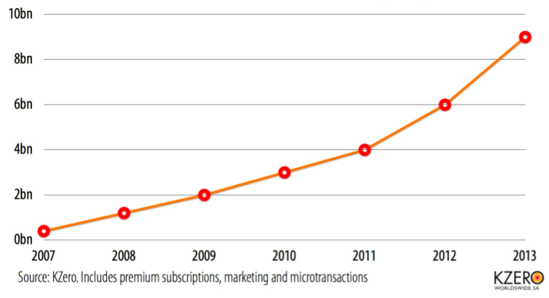
Virtual World revenues
USD 2bln in 2009
Notes:
http://www.kzero.co.uk/blog/?p=2845
I think the main point here is that the perceived value of virtual goods will change.
Right now there is an argument if virtual goods are real as they are only atoms. In the next few years this argument will become redundant and the value of virtual goods will explode

Slide 18
Microtransactions business model
Zynga:
- Majority revenues comes from 2% to 10% of users who pay $1 an hour to play premium games or buy virtual goods
- Annual sales of about USD 100 mln
Playdom:
- Estimated USD 50 mln in sales per year from virtual goods
Social Gaming Network:
- Estimated USD 50 mln sales mainly from virtual goods
Weeworld:
- Estimated 2008 revenue USD 10 mln+ mainly from virtual goods
Habbo:
- Estimated 2008 revenue USD 50 mln from virtual goods - 10% monthly players pay $10.30/month
http://www.businessweek.com/technology/content/apr2009/tc20090429_963394_page_2.htm
Notes:
http://www.businessweek.com/technology/content/apr2009/tc20090429_963394_page_2.htm
http://www.techcrunch.com/2009/03/30/habbo-pulled-in-74-million-in-real-revenues-last-year-from-virtual-goods-and-advertising/

Slide 19
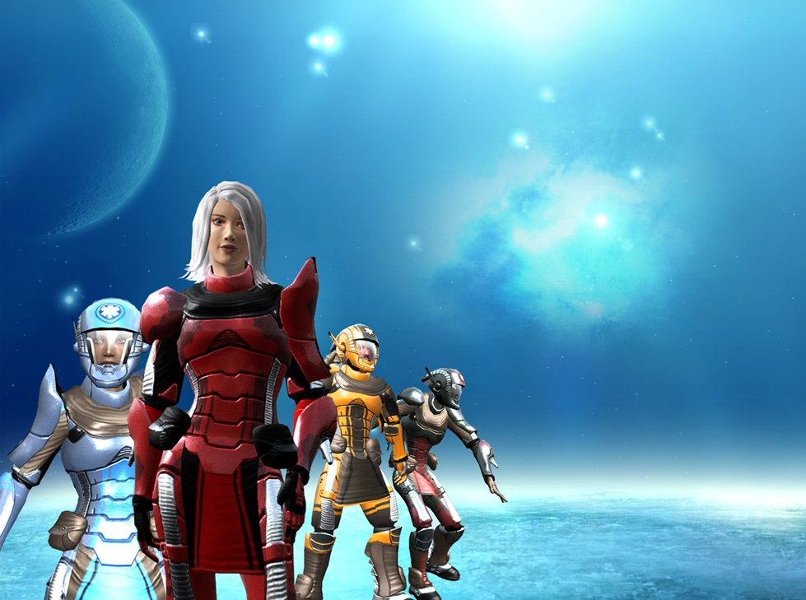
780,000 users
USD 420 mln turnover 2008

Slide 20
Entropia Universe by MindArk
Ability to develop skills and sell virtual goods
Island sold for USD 26,500 in 2004
Asteroid space resort sold for USD 100,000 in 2005
Clothes Against Violence – limited edition virtual jackets sold for more than same model of real world jackets
Virtual universe with real cash economy
Fixed exchange rate to US Dollar, 1 USD = 10 PED
Five banks auctioned for USD 404,000 in 2007
Real life bank license granted by Swedish Government to MindArk Bank in March 2009
A business model like the real world
Raw materials and skills required to build / create
Goods deteriorate and need to be replenished
Notes:
Function – e-commerce function – inte bara virtuell, men riktig handel –sälja kläder – real life kläder – tok in ett företag – lite London företag – on edge för detta- clothes against violence – street – urban betonade –kula jackor – vi lanserar virtuella kopior av varje – men bara 100 av varje maximum!!!! 3d modeler av dem som man kan köpa I real life - real kläder tar aldrig slut –men virtuella tar slut – begränsat . Virtuelall pris högre än det verkliga – inte hos kinesarare, kunde inte förstår det..
Objects with a set lifespan have a repurchase value which falls in relation to wear. Unique objects can have a market value, which is fixed via auctions, which exceeds the repurchase value. Assets that do not wear out, such as land or property, have no repurchase value.

Slide 21
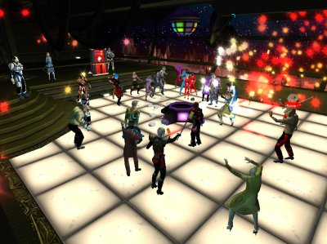
Jon “Neverdie” Jacobs in Entropia
USD 100,000 for asteroid space resort
USD 90,000 for bank license
http://www.youtube.com/watch?v=Mg4TwOqVprw&feature=related
Notes:
A USD Millioner in Entropia Universe.
Night Club Owner at Entropia Universe: Club NEVERDIE
Hepaid US$90,000 to get Banking Licence in Entropia (2007)
Owner of NEVERDIE Mega Championship Stadium--virtual arena for sports events and life concerts.
Interview with him. http://www.youtube.com/watch?v=LaZsWMrBeXo (3mins)

Slide 22
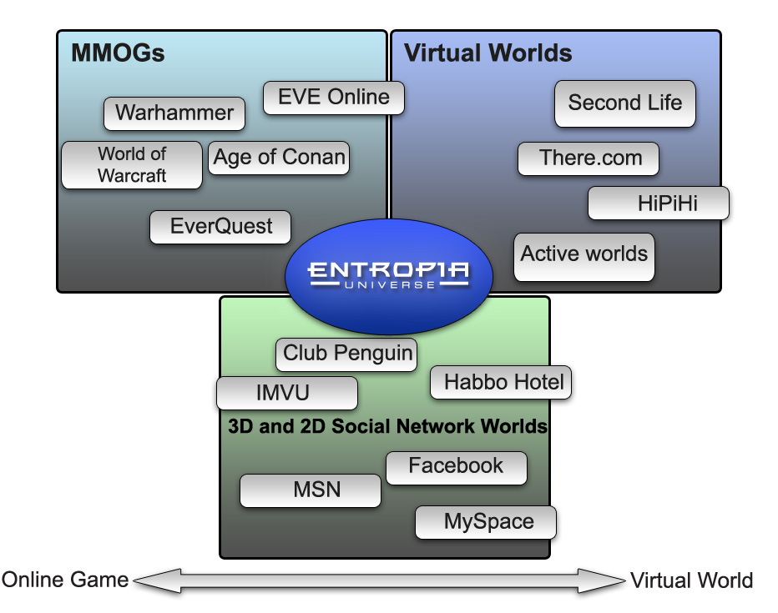
Entropia uniquely positioned

Slide 23
Virtual currency and a virtual economy
1.4 million residents logged in/60 day period
70,500 logged on Sunday, Sept 20
Average age=32, 43% female, 55% non-US
270 Linden dollars ≅ USD 1
350,000 hours of use per day
87,500 hours devt time/day
$1.6 bln worth of free work / year
68,000 people making profit
Joe Miller, Linden Lab, 2009
Notes:
Second Life reported that there were 1.4 million residents or avatars logging in during the previous 60 days and more than 1100 individuals earning more than USD 1,000 in profit monthly through their online activities.[1]
[1] Second Life, http://www.secondlife.com/whatis/economy_stats.php

Slide 24
What do these virtual entrepreneurs sell?
Number of individuals
Total of
593
Monthly USD profit
Real estate & land rentals
Simulation & training environments, games
Clothing, accessories, skins, animations
Art, design, furniture
SL, Sep 2009
Notes:
http://www.wired.com/gaming/virtualworlds/news/2006/02/70153
Second life website
Increase from 492 in July 2008

Slide 25
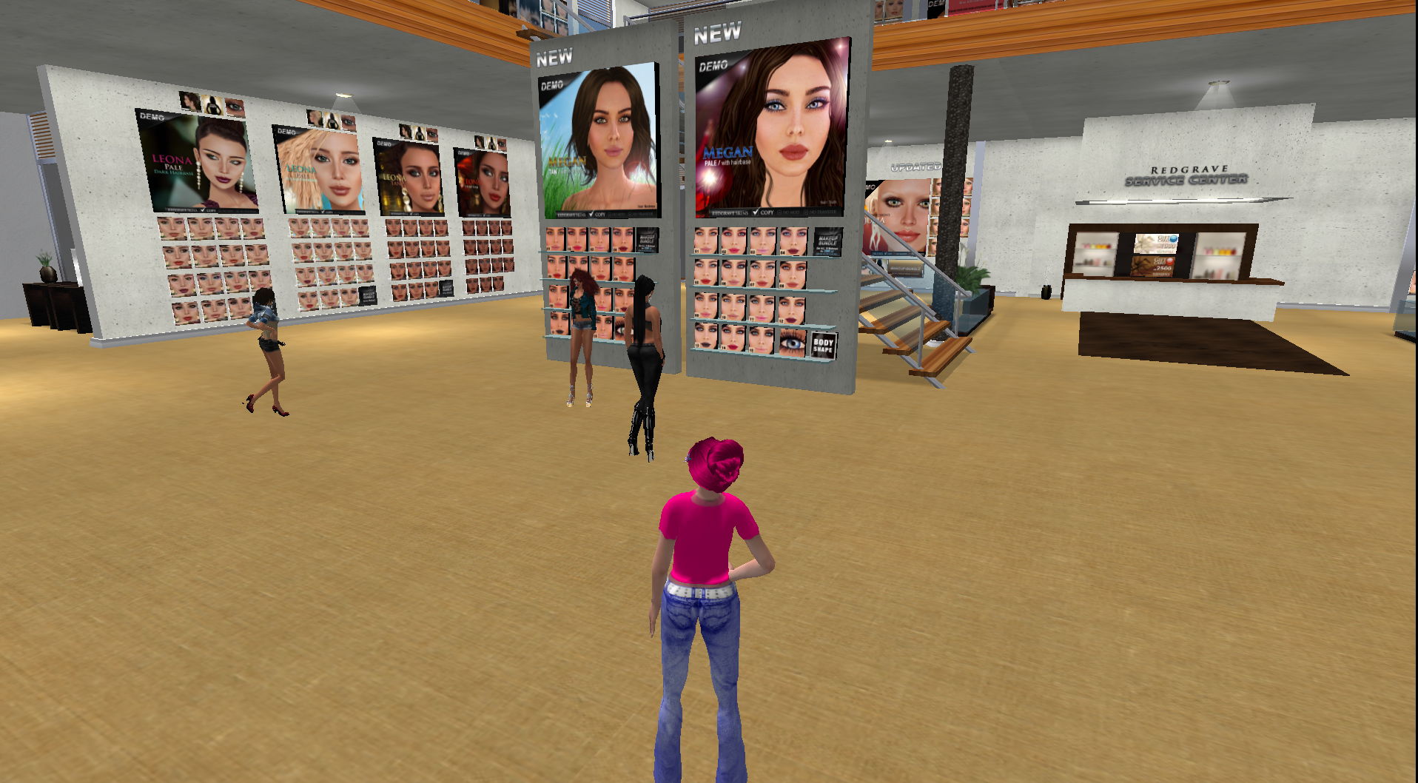
Redgrave

Slide 26
SL’s first millionaire
Started with < USD 10
Buys and develops virtual real-estate in Linden Dollars
Develops communities in SL
Develops 3D copies of real life buildings e.g. Dresden Gallery
Employs almost 80 people in real life
Bank owner in Entropia Universe
http://acs.anshechung.com/index.php
Notes:
Real Name:Ailin Graef
For her portfolio:
http://acs.anshechung.com/portfolios.php
Dresten Museum is One of them
CNN journalist Sloan, Paur referred to her as "Rockefeller of Second Life (December 1, 2005.)
She Started with less then 10 US$.
In 2006 Anshe Chung became the first avatar with a net worth exceeding 1 million US$ in SL.

Slide 27
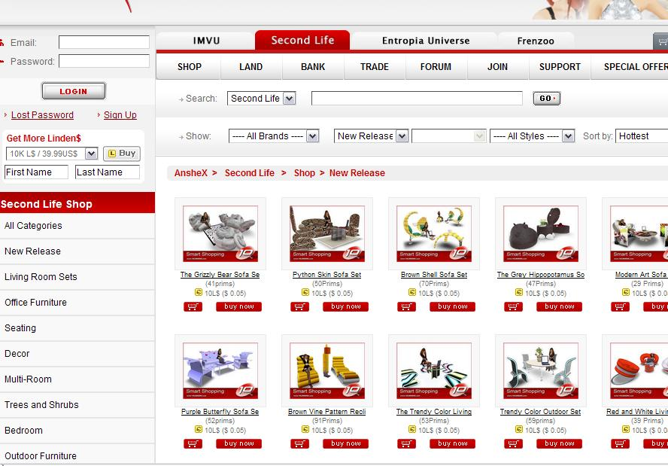
Virtual Things for Real Money
Notes:
Secreenshot is from http://www.anshex.com/sl.php
again Anse Chungs project. Fir different world, you can buy what you need do. Decoration, Jevellery etc.
if she is the only reseller...
check it...

Slide 28
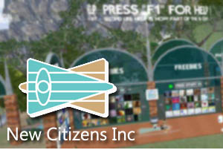
New Citizens Inc – A successful non-profit
Provides services for SL residents
Est. 2005
Staff of 150
Raises more than USD 13,000 / year to cover costs
Its instructors and event hosts paid
Notes:
http://www.metaversejournal.com/2009/05/13/a-second-life-success-story-nci/

Slide 29
Today’s Discussion
Some facts and figures on virtual worlds
A look at virtual entrepreneurship
Some real life benefits of virtual worlds
Break
A look at some of my virtual world activities
A tour of Second Life

Slide 30
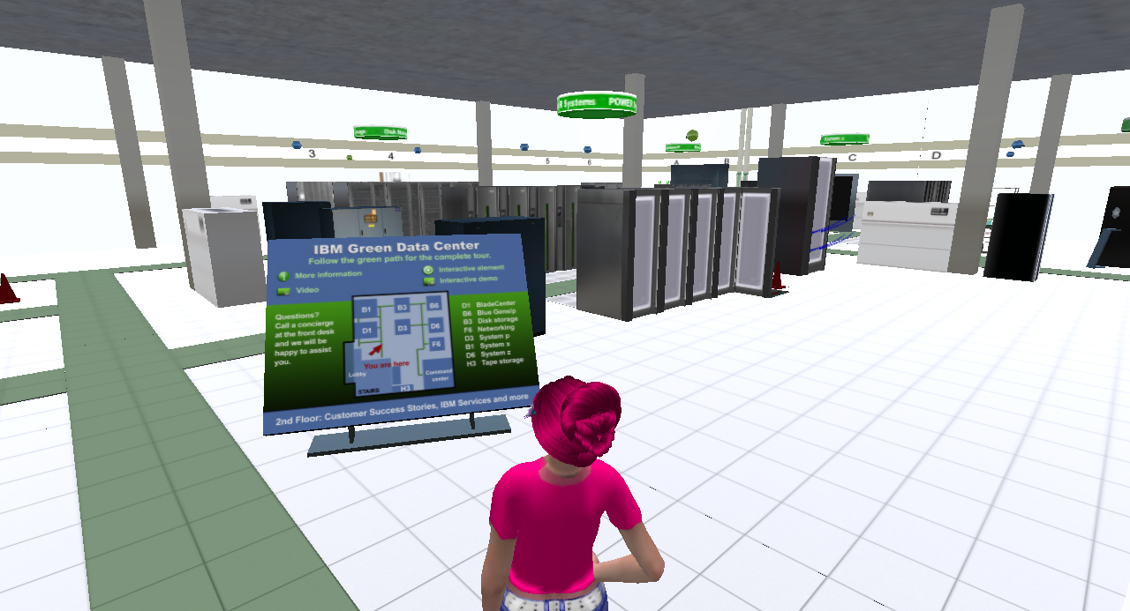
Showcasing current products
IBM’s Green Data Center

Slide 31
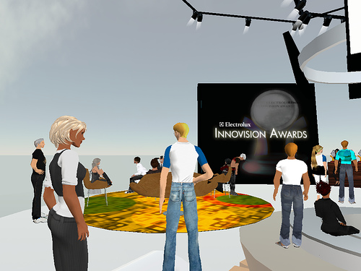
Developing new products
The Innovision Awards by Electrolux
Notes:
We also got to meet the design gurus for a panel discussion about the challenges of gadget making and the process of innovation in Second Life. The meeting turned to a fast and furious chat conversation about how to provide customer service of new innovations and how to integrate web sites and email into Second Life.
That’s the kind of innovations Electrolux is all about, products that are thoughtfully designed to meet real user needs.

Slide 32
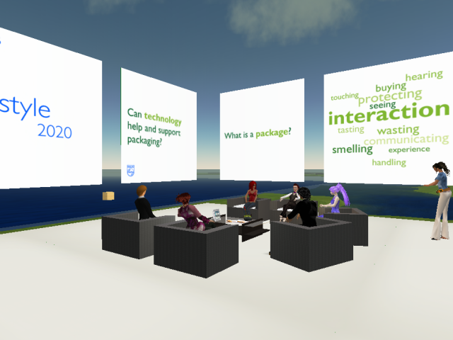
Co-creating solutions
Philips Design Group
Lead-user innovation workshops
Notes:
Several companies are now taking the ideas related to open innovation into SecondLife. For example, Philips Design has created several open air meeting areas on Second Life with the purpose of testing virtual concepts and allowing SL residents to participate in co-design projects. During one event a group of approximately 20 avatars comprising educators, computer specialists, and marketers, discussed the subjects of packaging, clothing, and future of self-expression in smaller groups led by moderators[1] (Figure x). Recently the company opened the Co-creation Experience[2], which helps the company develop a personal connection with members of its ‘Philips Design Friends Group’, now comprising more than 200 people who proactively offer insights and ideas including ongoing dialogue concerning their habits and behaviors in this virtual space.
[1] www.lostinthemagicforest.com/blog/?p=28
[2] http://www.design.philips.com/about/design/designnewscenter/news/article-15083.page

Slide 33
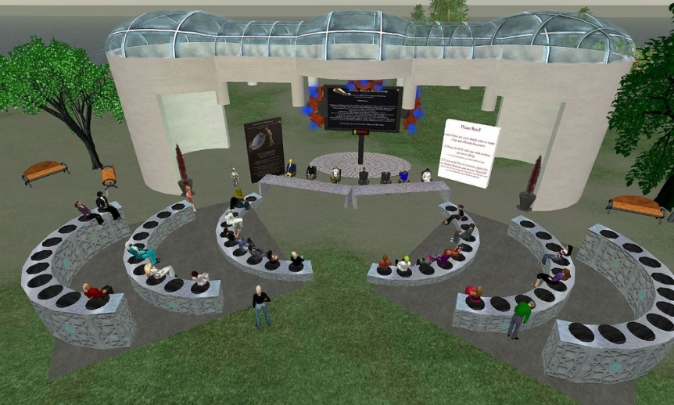
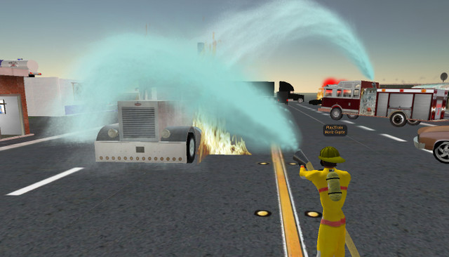
Developing training & education programs
Play2train
New employee training, eg policies, organizational culture
Skills training, eg sales
Virtual teaming
Notes:
http://www.social-marketing.com/blog/2006/11/real-disaster-preparedness-in-virtual.html
http://muveforward.blogspot.com/2007/12/nursing-education-simulator-in-second.html

Slide 34
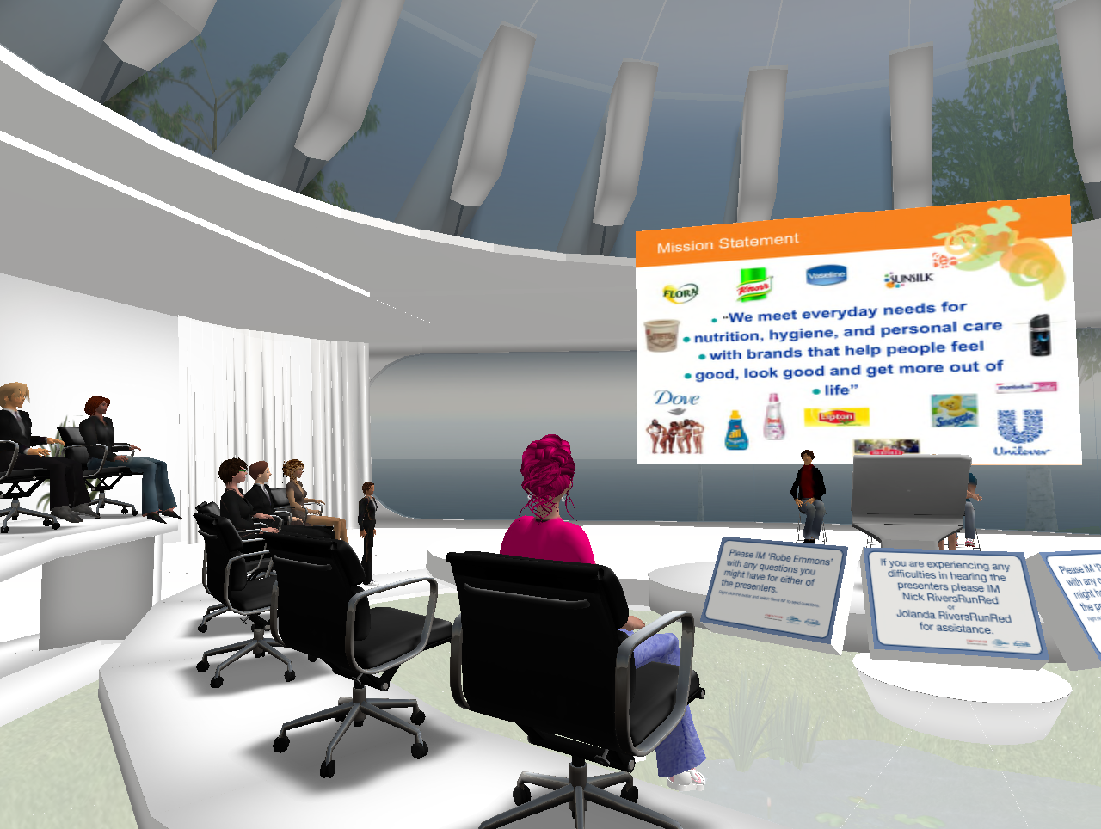
Facilitating the virtual workforce
Completely private virtual business worlds offering tools to conduct business and collaborate
Fortune 500: IBM, Intel, Johnson & Johnson, Motorola, Novartis, Unilever
Notes:
http://www.protonmedia.com/
www.qwaq.com
VOIP
Chatrooms
Wikis, blogs
Social networking
avatars

Slide 35
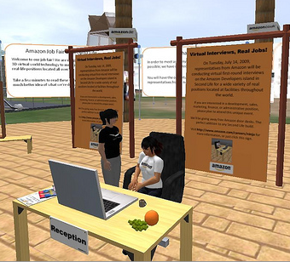
Finding and recruiting talent globally
Amazon.com job fair
Benelux job fair
Accenture island
IBM island
Entrepreneurs
Microemployees

Slide 36
Today’s Discussion
Some facts and figures on virtual worlds
A look at virtual entrepreneurship
Some real life benefits of virtual worlds
Break
A look at some of my virtual world activities
A tour of Second Life

Slide 37
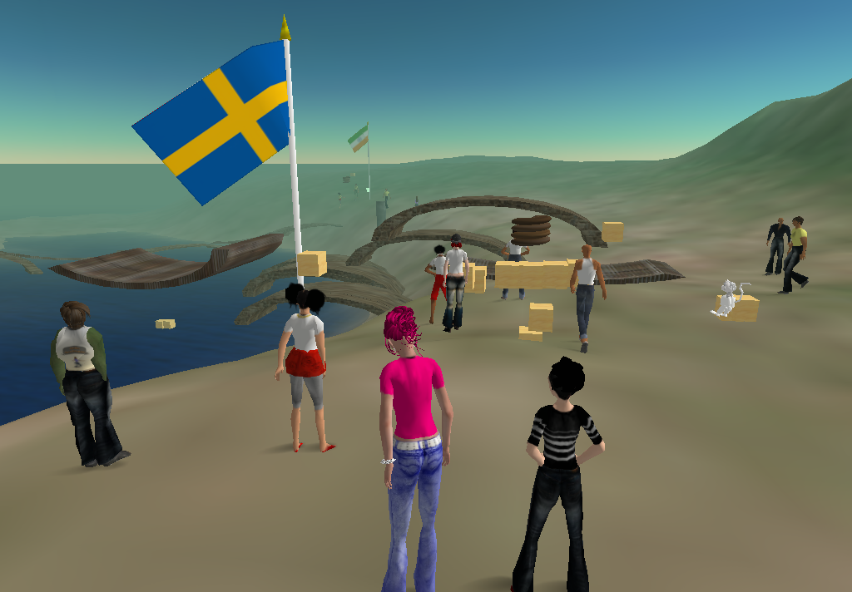
In-house training and education
IFL at SSE and Duke Corporate Education
Co-developing and running a virtual team building exercise

Slide 38
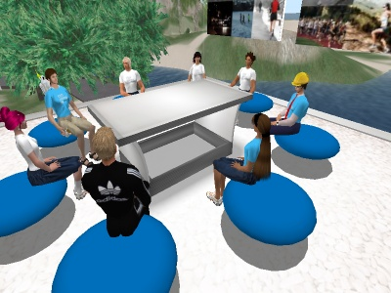
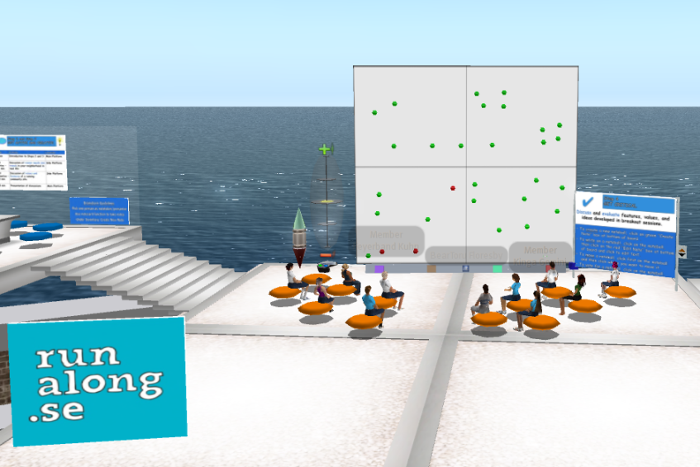
Our innovation workshops bring together users from across the globe
Partners
Utrecht University
University of Innsbruck
Notes:
http://flickr.com/photos/secondsweden/2110677418/

Slide 39
Creating a new fashion brand
With Florida State University fashion design
New brand designed and showcased on catwalk during annual pageant on Planet Calypso
Users / players vote on designs
Potentially produced in real life

Slide 40
Pros & Cons
Low entry barriers, software often free
VWs humanize technology
Young generation already there, “grown virtual”
Microtransactions
Microemployees
International reach
Some hardware requirements
“User friendliness”
Not regulated
Real world skepticism
Creating attraction
Which world?
Notes:
internet bandwith not regulated platform,. vws humanizes the technology..gives better feeling than having conversations at msn. convergence of latest technologies. young generation is already there, they are " grown virtual" disable people enjoys freedom of activities even it is in virtual world. micro transaction ability real case scenarios

Slide 41
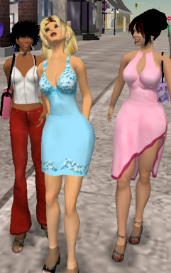
Increasing effectiveness in traditional industries
“Soon all fashion designers will be originating their designs and managing the production in virtual worlds….Why such a dramatic change? Economics, pure and simple.”
Shenlei Winkler,
Director Fashion Research Institute
Learn how to become an SL Fashion Designer at Fashiontech.wordpress.com/
Notes:
NYC, NY, November 27 2007: Virtual world-based fashion design is now a reality. “Soon all fashion designers will be originating their designs and managing the production in virtual worlds.” says Shenlei Winkler, director of the Fashion Research Institute. “Why such a dramatic change? Economics, pure and simple.”
The Fashion Research Institute (FRI) in conjunction with IBM is developing a product lifecycle management solution for the fashion industry that specifically addresses the industry’s unique needs. The FRI-IBM solution will sweepingly alter how fashion does business. The solution cuts time to market. It provides real time information to fashion executives and allows better management of human and material resources. It is a greener solution, as well, as it reduces the carbon footprint of traditionally wasteful fashion industry practices.
“We’ve moved beyond the marketing hype of virtual worlds. With our solution we have answered the question ‘How can you use virtual worlds for big business?’” Winkler said. “Quite apart from virtual fashion for avatars which remain in virtual worlds, FRI has created a new process that encapsulates the real life fashion designer and her workflow in a virtual world. Designers and other fashion industry personnel work together in a virtual world to expedite real life production, using an IBM-backed solution that seamlessly manages the process.
FRI’s virtual world-based product design solution allows collaborators to design, modify and perfect their products in real time. Product design-centered conversations occur with a real time presence of all concerned parties regardless of geographical location, time zone differences, or language barriers. Fashion businesses that use virtual worlds for product design will deliver huge savings of time, money, and energy.
Fashion Research Institute (FRI) conducts research into technology-based initiatives and develops emerging technologies to sweepingly overhaul traditional fashion industry practices and methodologies. FRI’s mission is to reduce the carbon footprint and change the environmental impact of the industry in ways that are sustainable, replicable, respectful of the practitioners, and meaningful for all stakeholders. Some of FRI’s projects include inventing new, improved forms of lyocell textiles from waste biomass generated from biofuels production; inventing a virtual world-based design methodology; and inventing a new anti-counterfeiting methodology for luxury fashion products.
41

Slide 42
Revolutionizing professions

Slide 43
Four scenarios for 2015
Integrated
worlds
One Converged Universe
High penetration
Easy avatar & asset mobility
High scalability & security
Business transformation
Digital Divide
Ease of mobility
Self-governance
Dominance by gaming generation
Traditional vs virtual business
Less-
advanced
usage
Advanced
usage
Virtual Silos
Many competing, limited worlds
Difficult avatar & asset mobility
Limited scalability
High security
New business models
Wild Wests
Individual “MMOGs” dominant
Virtual vandalism
Security problems
Retreat
Fragmentated
worlds
Notes:
Australian government
The process of developing scenarios builds and enhances participant strategic thinking and
decision-making skills under uncertainty, and provides the opportunity to discuss longer-term
issues and:
• challenge current assumptions about the future
• develop new insights about the future in terms of the industry’s strategic environment
• explore options
• identify likely future skills base and resource needs for the regulatory environment
and
• provide leadership in thinking about the future.
Gartner Group 2007 There is significant probability that, over time, market pressures will lead to a merging of current virtual worlds into a smaller number of open-sourced environments that support the free transfer of assets and avatars from one to another with the use of a single, universal client
Business Week 2007 Even the earliest adopters of Second Life are turning elsewhere. In September, 2005, Wells Fargo was ahead of the corporate stampede into Second Life when it launched a 3D virtual environment, "Stagecoach Island," in Second Life to attract youthful, tech-savvy customers and teach them about banking. Now nearly 50 corporations use Second Life, with Royal Philips Electronics, Coca-Cola, and News Corp. among the latest. But Wells Fargo is gone. It pulled its Stagecoach Island out and opted to create its own world, a larger, stand-alone online universe that it can monitor more closely and customize.

Slide 44
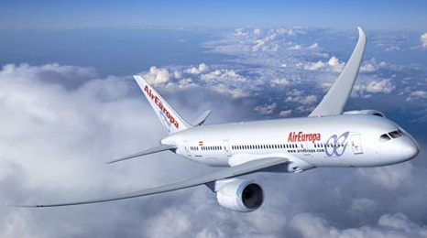
The future of 3D internet
Before the first plate of aluminum is even bent for production, the passengers will have flown the plane, the crew will have serviced the plane, and the pilots will have flown the plane.
CEO of Boeing supplier
Notes:
Carl vast – autodesk – ceo – 2005 -2006 before you bend the first plate of steel for a plane, you should be able to fly, service, and pilot virtually

Slide 45
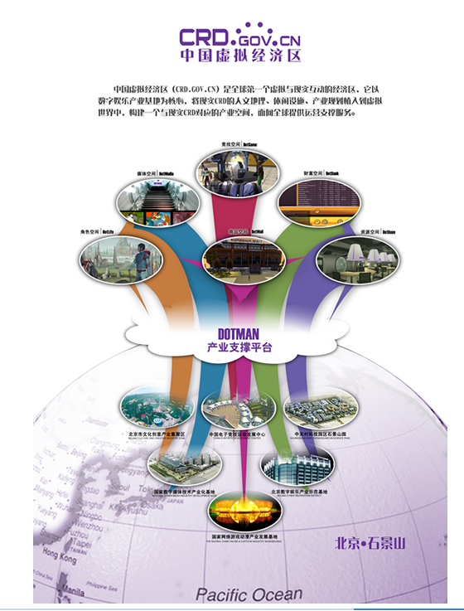
China is making efforts in virtual worlds
“The real China is only a piece of land. We believe that there must be a China in the virtual world and the real world.”
Robert Lai, Chief Scientist, CRD
“Here in China the value of such items is taking off as teens can’t afford the real world items and are compensating by getting a virtual item that has more ‘online’ status.” -KZERO blogger
Notes:
Speaker note
I also like to take this opportunity to show you about how some countries are even leveraging these new internet-based media and networks. One example is China that is putting big efforts into virtual worlds. In May 2007, the Cyber Recreation Department of Beijing signed a partnership agreement with MindArk, a company in Gothenburg, to develop the largest virtual world ever. The idea is to create a virtual world in which 7 mln people can be inworld at the same time – both for entertainment and for business opportunities. MindArk has auctioned off five banking licenses to create real banks where virtual money can be borrowed and invested – there is a real cash economy in which money can be invested and taken out. Why is China doing this??? Think it is very much in the quotation above – the real china….. And through this virtal world, they can reach out to the 150 mln overseas Chinese – build networks to these people to gain access to resources that these people have – financial resources, access to markets, technologies, etc. This world will be launched something in early 2009 and it will be very exciting to see how this develops.
Next slide
Other notes
Discussion with Frank Campbell - MindArk
The banks were separate from the Chinese deal – they were for entropia universe In general – banking licenses – they are up and working now – 2 years since released now, competitive branch like any others, some banks have gone ahead and some falling behind – market competition like in any other market
As for China, the partnership deal would allow them to regulate the banks and anything else on their planet – dotman
As for the project, they are very good in the development along the way…not sure when to be released but well on their way. The press release was for when the agreement was signed in Nov 2007.
As for the 10,000 people hired, they have a large number of people, but not sure if it is of that large volume.
They chose our platform because they recognize our platform that we have to be of use – combines entertainment with cash economy – provide both business opportunities and entertainment
We have state of art graphic engines that will keep going for several years - Platform – make an effort to make topnotch Cry engine (now in final round with NASA for educational platform)
As for financial crisis – people will have less money – will not spend more time at home and look for entertainment – this is a real cash economy so we are feeling it like anyone else –
Dotman is what it is called – this very Chinese – have dotcoffee, dotman – sign of new era
Robert Lai is the one who died and now been taken over by others.
Wikipedia.org
Entropia Universe is an online virtual universe designed by Swedish software company MindArk. It advertises a unique "Real Cash Economy (RCE)" in which Entropia Universe currency (PED - Project Entropia Dollars) can be redeemed back into real world funds at a fixed exchange rate with the US dollar, where 10 PED = $1 USD.[1][2] This means that virtual items acquired inside Entropia Universe have a real cash value, and a participant may, at any time, withdraw their accumulated PEDs back into real world currencies according to the fixed exchange rate.[3]
On 30 May 2007, it was announced that Entropia Universe had been chosen by the Beijing Municipal People's Government supported online entertainment company Cyber Recreation Development Corp. (CRD) to create a cash-based virtual economy for China, creating the largest virtual world ever.
Financial Times
BEIJING, June 06, SinoCast -- China is to build the first homegrown virtual world supported by real currency, reveals Sweden- based Entropia. Millions of people will work, communicate with each other and be in love in the virtual world.
CRD, under the control of Beijing Municipal People's Government, has been in talks with Entropia and has chosen it as the builder of the virtual world from many competitors including Second Life. Entropia beat down its rivals, owing to its safety, stability and capacity to control a Real Cash Economy, says its spokesman.
The server to support the virtual world will be located in China Mainland, under the inspection and management of CRD and Sweden- based MindArk.
Entropia's spokesman remarks the building of the virtual world will create 10,000 jobs for the Chinese market. Upon its completion, 7 million homegrown users and 150 billion overseas users will join to communicate with each other and do business in the virtual world.
The annual benefit from China's virtual economy will top USD 1 billion, according to evaluation. Entropia's virtual world supports trade of dummy goods and users can meet in reality to make deals.
Market Wire
Virtual World Entropia Universe Issues First Ever Virtual Banking Licenses for $400,000
MindArk Announces the Five Winners of the World's First Virtual Banking License; Real World Banks and Celebrities Among the Buyers
Highlighted Links Entropia UniverseGOTHENBURG, SWEDEN -- (MARKET WIRE) -- May 8, 2007 -- In yet another first for both the virtual world and the real world, Entropia Universe creators MindArk PE AB today announced the long-awaited results of the very first virtual banking license auction after months of active bidding. The five licenses sold for an astounding total of $404,000 to a mix of real world banks, Entropia celebrities, and entrepreneurs, all seeking to invest in the virtual realm. Up for sale since January, these two-year exclusive licenses will integrate real world banking systems into Entropia Universe.

Slide 46
We digitized audio and video, why can’t we just digitize,
you know, Earth”
Philip Rosedale, Chairman
Linden Lab

Slide 47
Thanks and
see you in world!
Karinda Rhode
aka Robin Teigland
robin.teigland@hhs.se
www.knowledgenetworking.org
www.slideshare.net/eteigland
Notes:
New Generation is Grown in Virtual Worlds
--no need to wait oldies to learn VWs. New generation is already in.Are we ready when they grow up?
ex:
Toy manufacturer Spin Master today said it would launch Liv World, an online site designed to compliment its new Liv line of dolls targeted at girls 5+. Similar to a Webkinz or Ty Beanie Babies 2.0 plush, buyers of the Liv dolls get a unique code which permits entrée to an online world. Spin Master calls Liv World "the first website of its kind to deliver an engaging daily narrative of each doll's life" and one that "opens an online world and invites girls to connect at a deeper level with each Liv teen's story." Spin Master promises daily diary updates, the ability for visitors to collect fashions in a "virtual closet," regularly updated webisodes and mini-games.

Slide 48
LPSO.com
Littlest Pet Shop Online
http://www.youtube.com/watch?v=1DwL1JIvGhc
Notes:
You can show this video to the audience.
http://www.youtube.com/watch?v=1DwL1JIvGhc
seach:
one--use existing virtual world and be entrepreneurs..
use
company: show case in sl selling in real life goods..
create your own virtual world to create brand awareness...

Slide 49
Connect the World Through Games
Company makes money by Selling Virtual Goods
FarmVille:"Grow delicious fruits and vegetables and raise adorable animals on your very own farm!"
If you don't visit your farm, your vegetables, animals will die.
Relased in July 2009 and till the end of August 2009:(In 2 months)33 million people played it.
Notes:
youtube video for you: from Zynga team
http://www.youtube.com/watch?v=MeRfnXbKbko&feature=player_embedded#t=207
reference: http://www.gamesbrief.com/2009/09/six-secrets-of-farmvilles-success-and-33-million-people-agree/

Slide 50
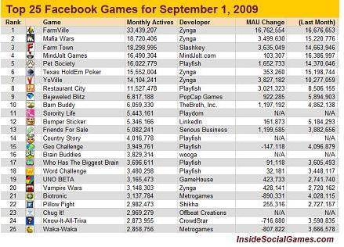
Success of Zynga
Notes:
You would see Zynga is market leader in Facebook Games industry with its 3D games.

