Slide 1





Digitalization and its Future Impact on Welfare Services and Labor
10th December 2019
Stockholm School of Economics & ESBRI

Slide 2
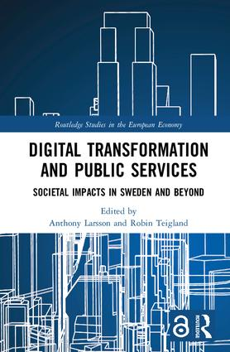
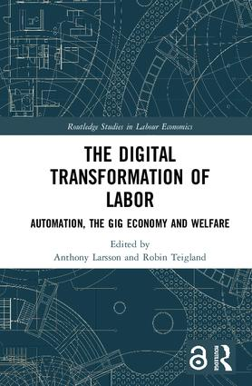






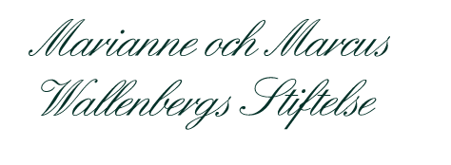
Sponsors

Slide 3


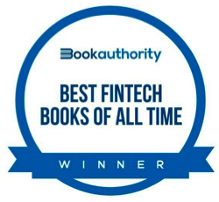
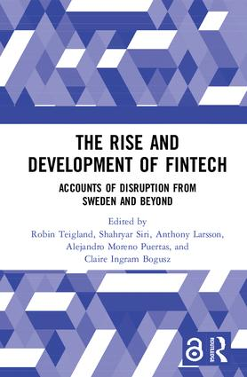
Free download at https://www.routledge.com/
Notes:
Amazon category rankings (Open Access titles)
The Rise and Development of FinTech
#1 in Corporate Finance
#1 in Crowdfunding
Digital Transformation of Labor
#1 in Economic Conditions

Slide 4
Some Figures:
*52 authors from 12 different countries, with an age-span ranging between 24-74
*698 pages in total, with 28 illustrations
*Digital copy is free to download (Open Access)
Notes:
Digital Transformation and Public Services:
354 pages | 14 B/W Illus.
30 Authors.
The Digital Transformation of Labor:
344 pages | 14 B/W Illus.
27 Authors
Author countries of origin:
Sweden
Netherlands
United States
United Kingdom
Denmark
France
Australia
Spain
South Africa
Slovakia
Germany
Portugal
52 Authors (30 male, 22 female)

Slide 5
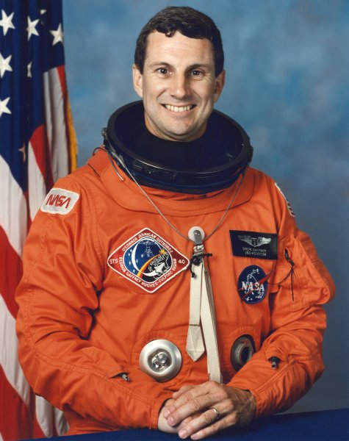
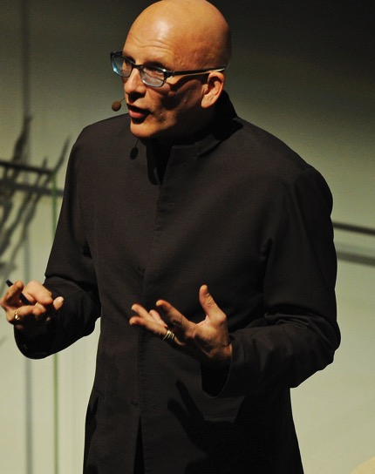
Foreword Contributors
F. Drew Gaffney
-Astronaut, NASA (Retired)
-Professor of Medicine (Emeritus),
Vanderbilt University School of Medicine
Kjell A. Nordström
-Economist
-Writer
-Public speaker
Notes:
Images recreated with Creative Commons license:
https://flickr.com/photos/upsales/6236564931/in/photostream
https://upload.wikimedia.org/wikipedia/commons/thumb/c/c0/Drew_Gaffney.jpg/220px-Drew_Gaffney.jpg

Slide 6

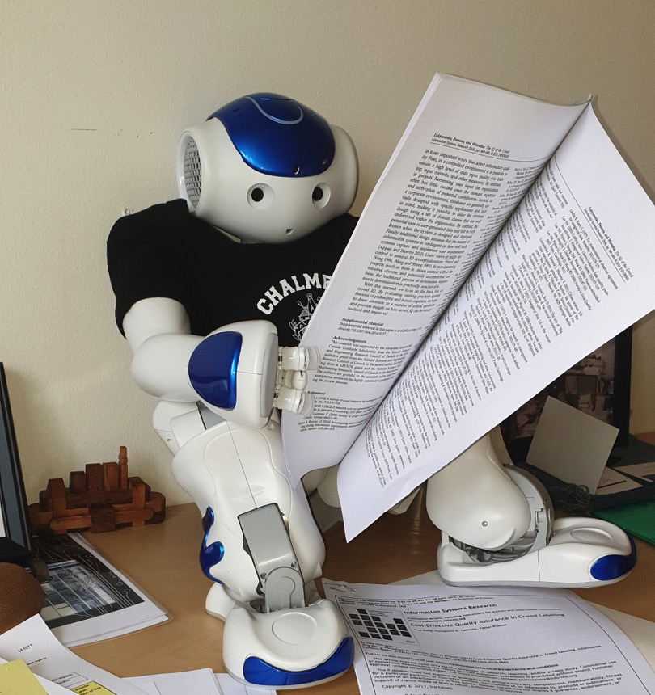
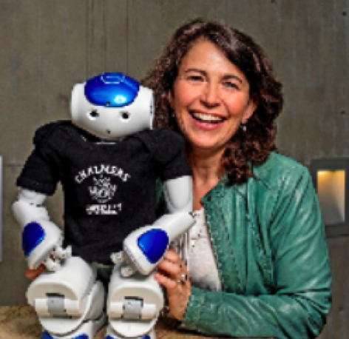
Hello !
My name is Sparky !
I am Professor Robin Teigland’s Humanoid Research Assistant at Chalmers University of Technology.
Follow me on Instagram
https://www.instagram.com/sparky_chalmers/

Slide 7

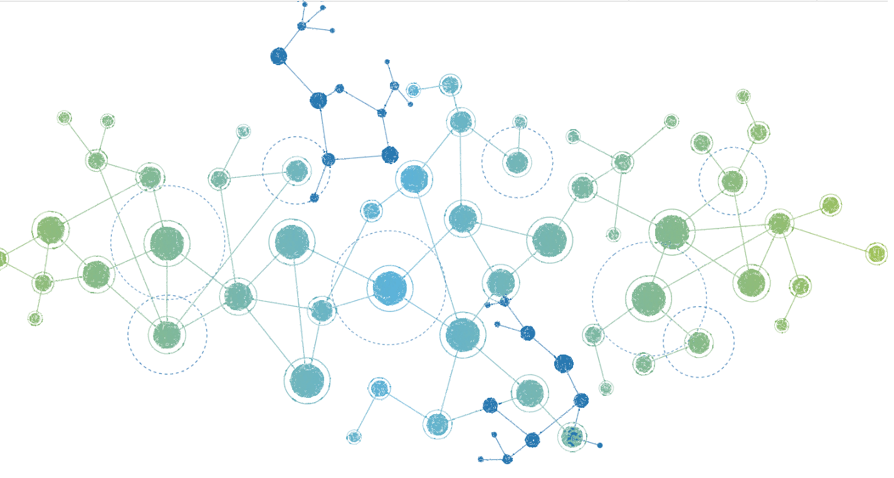
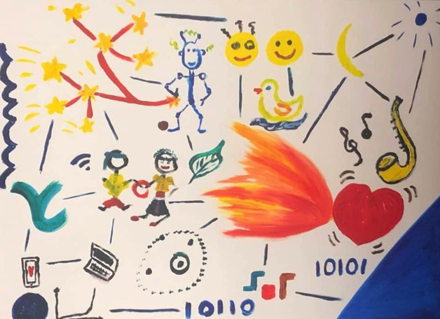
Along with my Professor and my friends I am looking to help you embrace the journey of digitalisation with togetherness !
You will see me in the near future in your workspaces apart from just research labs !
Collaborative social robotic requires active learning for robots like me !
So will you help me learn ?

Slide 8

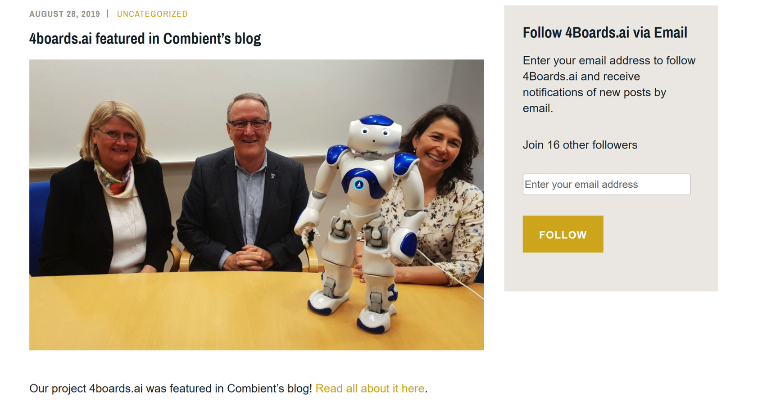

Slide 9

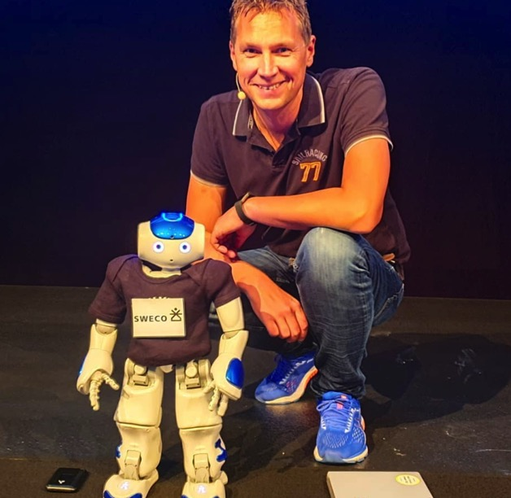
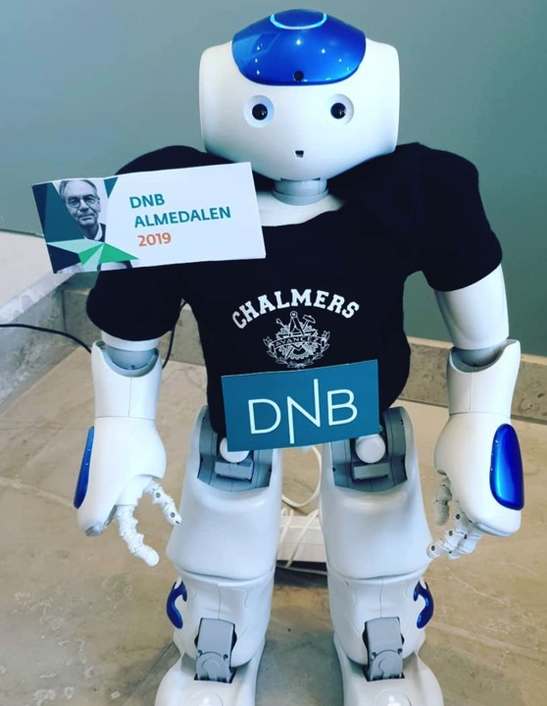
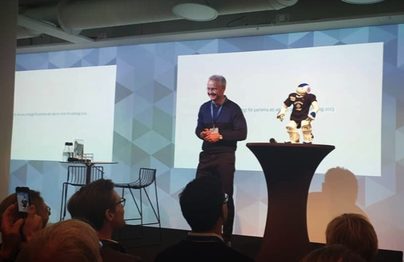

Slide 10
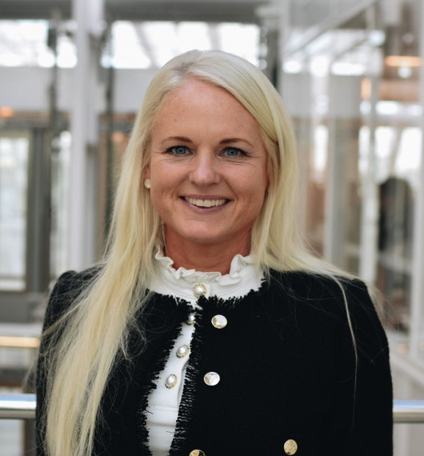

Presentation 1 - Commercialization of Welfare Services
Charlotte Mattfolk

Slide 11
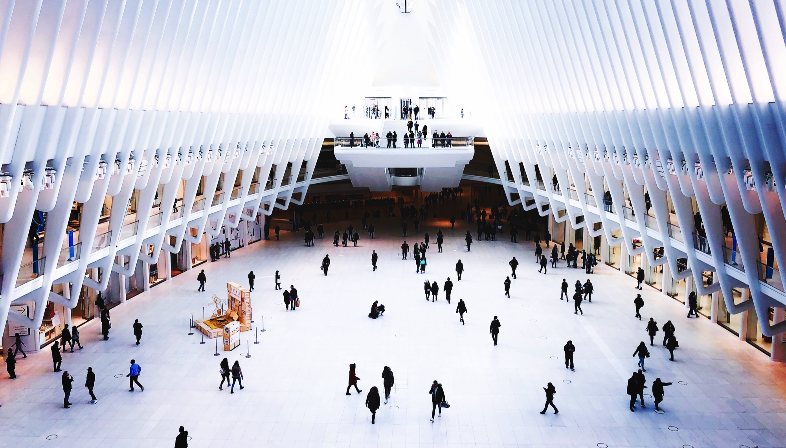
FUTURE CONSUMPTION OF
WELFARE SERVICES 2030

Slide 12

Integrated services, partnerships and new business models
The new informed citizen
Blurring borders between public and private sectors
Increased confidence in digital services
The battle of the citizen - who owns the relationship?
Expectation of a seamless experience
Notes:
Teacher Scarcity and Lack of Control Over Student Data
When it comes to education, the system of today faces great challenges. We will see a scarcity of teachers in the coming years and that will propel digitalization and push for increased efficiency in education according to Helen Melander, Associate Professor in Education at Uppsala University. Teachers must be able to educate more students in the same amount of time. We need to evaluate the role of teachers and how they interact with, and enhance the adaptation of, new technology in education.
When it comes to individualized support and managing student data we need to solve how data can be shared between different parties, according to Peyman Vahedi, Principal at the senior high school Ådalsskolan in the urban area of Kramfors. He regards this as the biggest challenge of today - that student data is owned and managed by two private actors in Sweden. Hence, the state is paying a lot of money to get access to relevant data such as name, address, guardians etc. He describes this as a major obstacle, since we cannot work with data until this information is owned and handled by the state. This implies we do not have full access to the infrastructure needed to develop relevant services to teachers, students and parents. The school needs to be digitalized but the limited access to data stands in the way.
Tommy Jarnemark, Chief Operational Officer at AcadeMedia, Northern Europe's largest education company, also brings up the importance of getting the right technology infrastructure in place for schools to become more digitalized and data driven. He believes teachers will still be a core component of a school, but they will work differently from today. We will not digitalize away teachers, but we may decrease the need for the physical location. Learning will be more real time-based and we will need to continue learning through our whole life. According to Jarnemark, this must be enabled by private actors and the public sector can handle the foundation for everyone to get the same start. His opinion is that it is old fashioned to spend 12-16 years in school before we go to work for the rest of our lives. Instead we will switch between education and work several times during our lifetime.
The Swedish rally navigator and Founder of School4you (global education tools), Tina Thörner, describes the challenge in school today from the student’s perspective – “children today are demotivated since we have an ancient school, far from the world they live in”. The rewarding system does not meet their expectations of instant feedback and they get bored and lose interest, instead of being motivated and inspired. She has a strong belief that schools must adapt to children and technology – and not the other way around.
Actors?

Slide 13


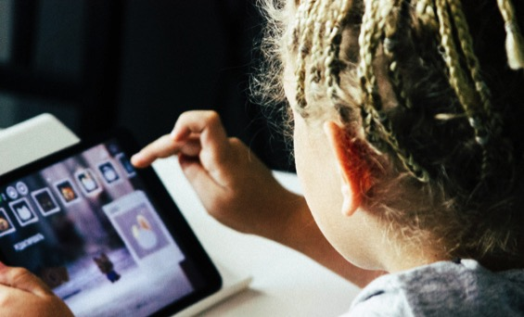



Four Future Scenarios Developed for 2030
CUSTOMIZED SOLUTIONS
Data-Driven State
The state protects citizens from data misuse
Protection of data among citizens
Government body with focus on data intelligence
Data-driven modern welfare
Commercialized Welfare
Freedom drives the gig economy
The gig economy flourishes
High customization – preferably at home
AI is a core competitive edge
I DO IT MYSELF
DO IT FOR ME
Global Choice
Forced to take on a global perspective
Global agreement to solve global issues
Transformed tax legislation
Consumers chose business-minded philanthropists
Efficiency Game
Time is a scarce resource
Automated welfare services
Global commercial actors within welfare
Efficiency over customization
STANDARDIZED SOLUTIONS

Slide 14
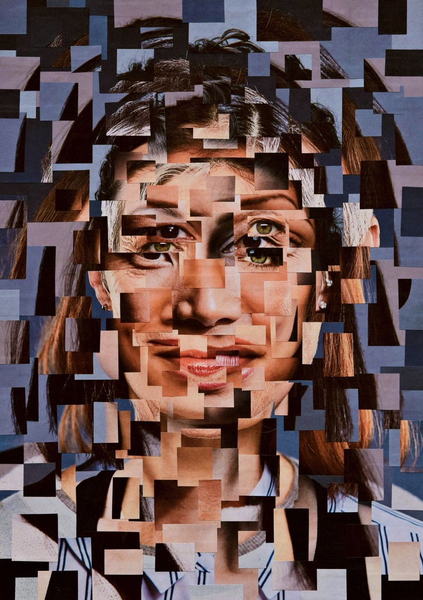

Cyber security demands a global approach
The global school is a highly integrated learning community, supported by modern technology
Patient-centered health intelligence company
1554 students
361 staff
Schadt at Mount Sinai Hospital amassed o pool of genetic data from 600,000 people – and estimates he would need at least 10 million to detect disease-causing mutations
The government and private sector collaborates to make UK the safest place to live and work online
Interdisciplinary team of scientists, data engineers, and clinicians
Notes:
NCSC
Helping to make the UK the safest place to live and work online.
We support the most critical organisations in the UK, the wider public sector, industry, SMEs as well as the general public. When incidents do occur, we provide effective incident response to minimise harm to the UK, help with recovery, and learn lessons for the future.
More specifically, the NCSC:
understands cyber security, and distils this knowledge into practical guidance that we make available to all
responds to cyber security incidents to reduce the harm they cause to organisations and the wider UK
uses industry and academic expertise to nurture the UK's cyber security capability
reduces risks to the UK by securing public and private sector networks
History of the NCSC
Launched in October 2016, the NCSC has headquarters in London and brought together expertise from CESG (the information assurance arm of GCHQ), the Centre for Cyber Assessment, CERT-UK, and the Centre for Protection of National Infrastructure.
The NCSC provides a single point of contact for SMEs, larger organisations, government agencies, the general public and departments. We also work collaboratively with other law enforcement, defence, the UK’s intelligence and security agencies and international partners.
Globala skolor – exempel Avenues
Skolor är historiskt sätt rotade i städer, men har över tid utvecklats till nationella skolor. Framtiden siar om globala skolor och Aveneus School är ett exempel på en skola med en vision av att vara global.
Skolan är inte samling av 20 olika skolor/campus utan snarare ett Learning Community med en enhetlig syn på lärande och kontinuerligt interaktivt agerande med de andra skolorna med hjälpa av digitala verktyg. Avenues har 1554 studenter och 361 i personalen. Skolan fokuserar på att göra studenter redo för den mer globala världen – bla genom att alla lär sig minst ett andra språk, en gemensam läroplan oavsett land och kontinuerliga utbyten. Skolan fokuserar också på mer ”mjuka” värden – exempelvis att bygga självförtroende och passion – och trycker på att retorik är viktigt.
https://www.avenues.org/en/nyc/the-world-school/
Ai kan göra kurser mer tillgängliga för fler människor – stor utveckling av Massive Open Online Courses
http://mooc.org
”Cross-fields” och metakunskap
AI möjliggör samarbeten mellan olika universitet i forskningsfrågor. Kan också underlätta forskning mellan olika ”fields”. Det blir också allt viktigare att studenter förstår hår olika ämnen hänger ihop istället för att studera llt i ”silos”, här ligger Finland redan i framkant.
https://www.business.uq.edu.au/news/artificial-intelligence-will-transform-universities-here-s-how
Globala samarbeten
Mixed reality and computer vision can provide a high-fidelity, immersive environment to stimulate interest and understanding. Simulations and games technology encourage student engagement and enhance learning in ways that are more intuitive and adaptive. They can also engage students in co-developing knowledge, involving them more in university research activities. The technologies also allow people outside of the university and from across the globe to participate in scientific discovery through global classrooms
https://www.business.uq.edu.au/news/artificial-intelligence-will-transform-universities-here-s-how
Möjligheter till prediktiv analys av elever
AI allows the tracking of individual student performance, and universities such as Georgia State and Arizona State are using it to predict marks and indicate when interventions are needed to allow students to reach their full potential and prevent them from dropping out.
https://www.weforum.org/agenda/2017/08/artificial-intelligence-will-transform-universities-here-s-how

Slide 15
Thank you!

Slide 16
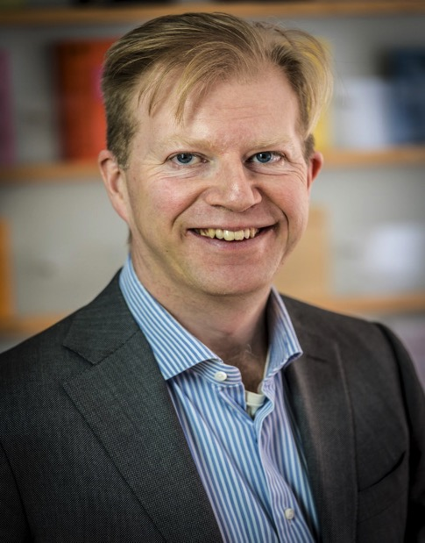

Presentation 2 - Telemedicine and the Welfare State
Mårten Blix

Slide 17
Telemedicine and the Welfare State
Mårten Blix
Research Institute of Industrial Economics, Stockholm
Presentation at ESTRAD - ESBRI/Stockholm School of Economics
10 December 2019
E-mail: marten.blix@ifn.se; twitter @mpblix
www.martenblix.com

Slide 18
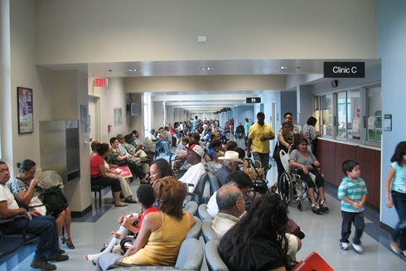
Primary Care Under Pressure
This Photo by Unknown Author is licensed under CC BY-SA-NC

Slide 19

Nation-wide Digital Health Care in a System with Autonomous Regions?
Out-of-county remuneration system
Freedom-of-choice model 2009 (”LOV”)
Publicly funded nation-wide telemedicine in a regional system
Photo credit: Proxima Studio, Colourbox

Slide 20
Rapid increase in telemedicine visits
Stockholm region big consumer
Age

Slide 21

Vitriolic Reaction against Telemedicine
“Simple” care at expense of those with heavy needs
Induces overconsumption
Harder to make diagnosis
Photo credit: Aleksandr/Colourbox

Slide 22

Benefits of Telemedicine
Avoid travel
No risk of contagion
More efficient use of time, better matching doctor/patient
Allow e-triage and AI diagnosis
This Photo by Unknown Author is licensed under CC BY-SA-NC

Slide 23
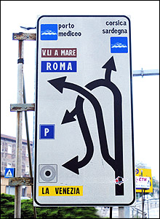
Digital Health Care at a Cross-roads
Two systems – no solution
Clash in funding - ”man-made” problem
Generational contract under threat
Contours of a change: digital pivot

Slide 24
Thank you!

Slide 25


Presentation 3 - Circular Economy, Digitalization and What It Means for Future Labor
Linn Lindfred

Slide 26
“What does prosperity mean in a world of 9 billion people living under the threat of climate change and resource scarcity? One thing is absolutely clear. It cannot mean business as usual. It cannot mean more of the same.”
- Jackson, 2009, p. xvi

Slide 27

Linear Economy – Maximizing Throughput

Slide 28
30% of all clothes are never sold
80% of all consumer products and their material go to landfill
31% of all food goes to waste during its value chain

Slide 29
Now is the Time
“This generation has the opportunity to shape the future profoundly.”
- Carlota Perez, Professor of Technology and Socio-economic Development
Each brings a techno-economic and socio-institutional shift
1771
1875
1971
NOW
Industrial revolution
Age of steel and heavy engineering
Age of information technology and telecommunications
“We have the most powerful tool
in history right at our fingertips.”
- Stuchtey et.al., 2016 p.31
1829
1908
Age of steam, coal, iron and railways
Age of automobile, oil, plastic and mass production

Slide 30
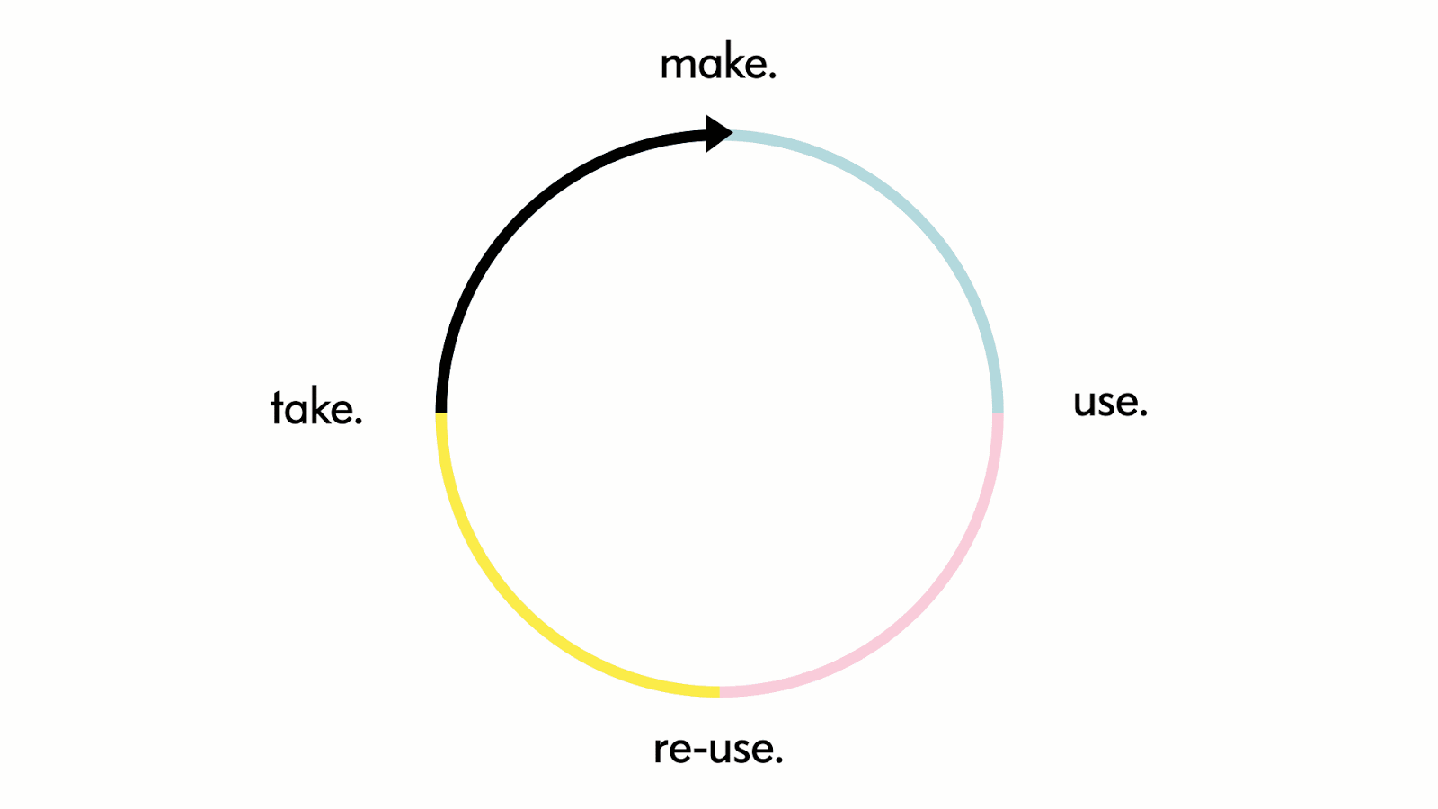
Circular Economy

Slide 31
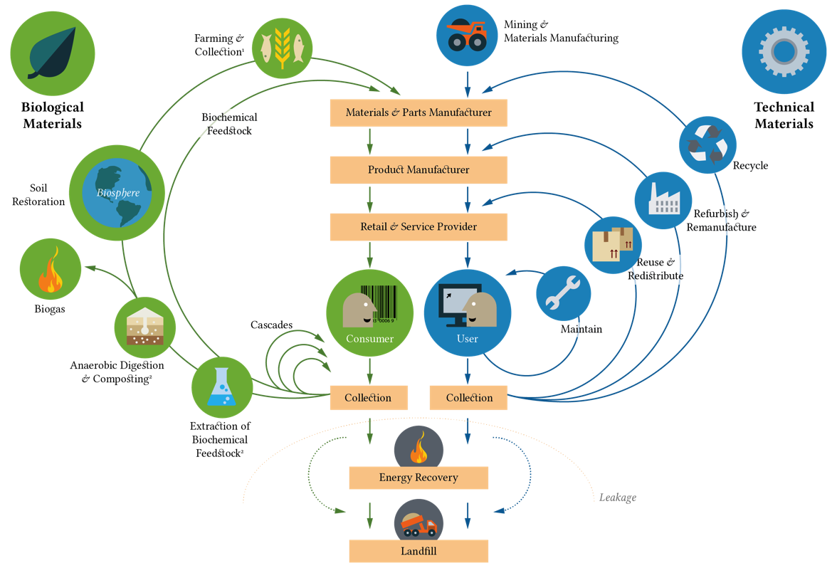

Circular Economy
Personalization
Made-to-order
Closed loop
Reuse
– Waste to value
Access over ownership
Repair
Modular design

Slide 32



Slide 33
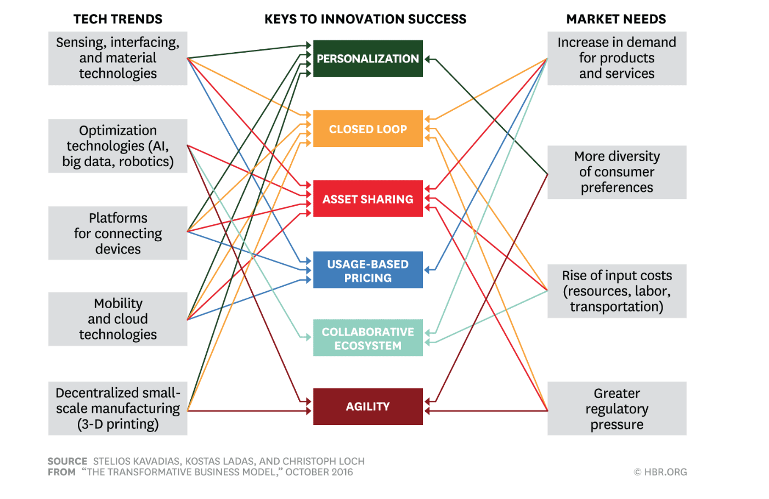
Linking new tech to an emerging market need through an innovative business model

Slide 34
“Circular economy is not an activity for the sustainability department –
It is an innovation, a new mindset and a business strategy for competitiveness and survival.”
- Linn Lindfred

Slide 35
Circular economy changes the labor market
Collection and reverse logistics firms that support
products being reintroduced into the system.
Parts and component remanufacturing and product refurbishment offering specialized knowledge.
If we use digitalization as an enabler, the circular economy could increase the resource productivity up to 3% annually in Europe.
Ellen MacArthur Foundation, 2015
More labor and fewer resources to repair and refurbish than to create new.

Slide 36

There are no jobs on a dead planet - sustainability should be a pre-requisite for innovation and digital transformation.

Slide 37


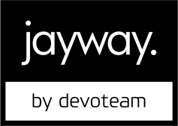
Thank you!
Linn Lindfred
Entrepreneur, Consultant in Circular Economy and Sustainable Innovation at Jayway by Devoteam
linn.lindfred@jayway.com
+46739466537
@circularista

Slide 38
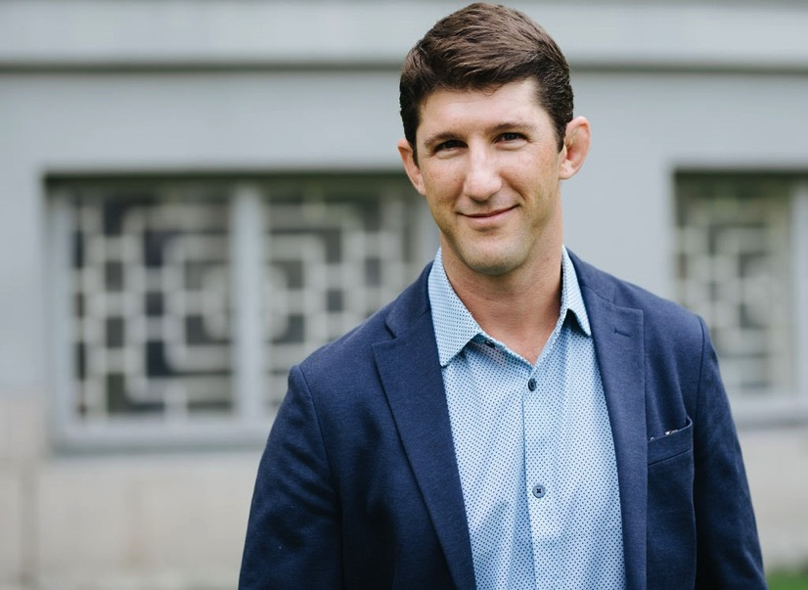

Presentation 4 - Citizen Protection: Does the State Still Have the Capability and Intention to Protect Us?
Mark A. Conley

Slide 39
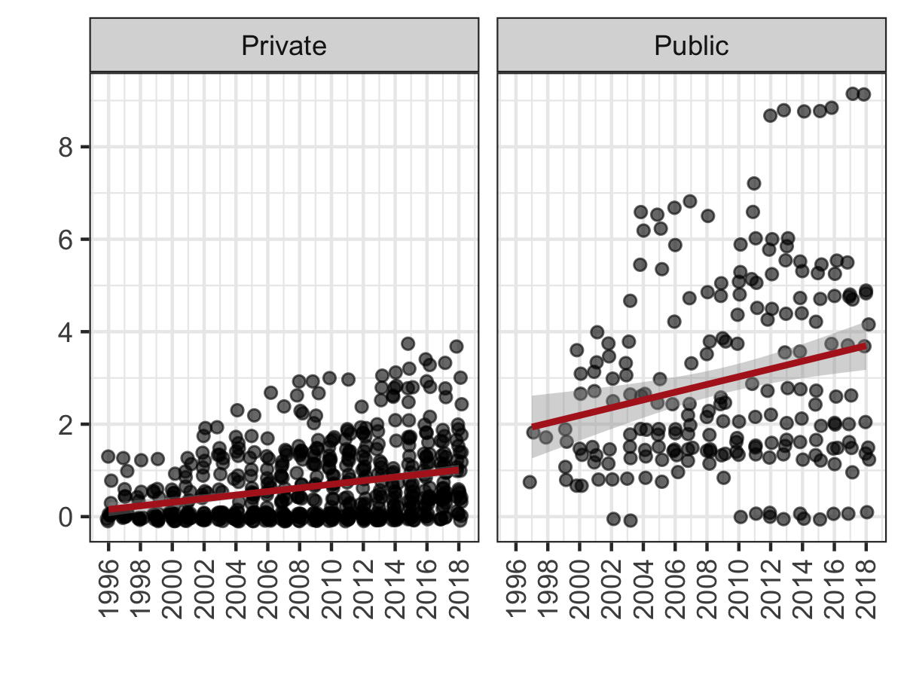
Citizen Protection: Concern for Threats and Defense
Private and public organizations show increasing concerns for threats and protection over time; both sectors have become more concerned with threats and protection.
Public entities continue to outpace private organizations.

Slide 40
Thank you!

Slide 41
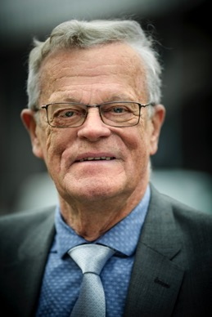
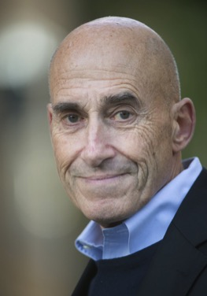
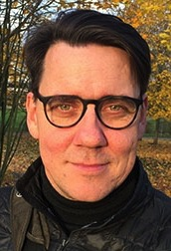
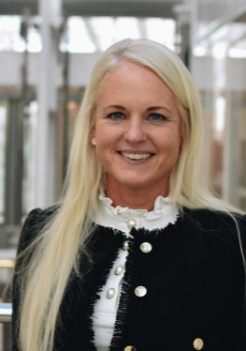
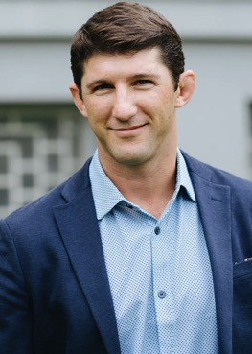

Panel 1 - Digital Transformation and Public Services
Björn Eriksson
Olle Wästberg
Cormac
Mc Grath
Charlotte Mattfolk
Mark A. Conley

Slide 42
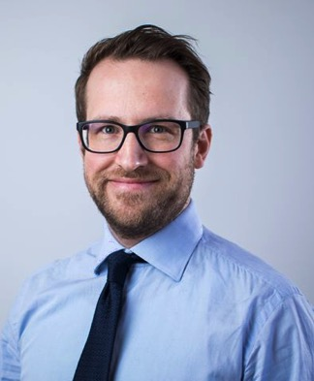
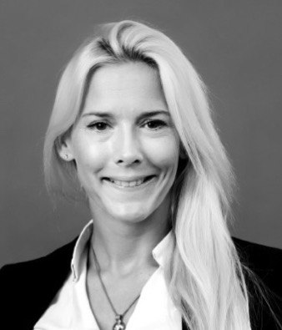
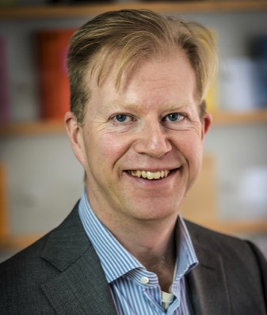
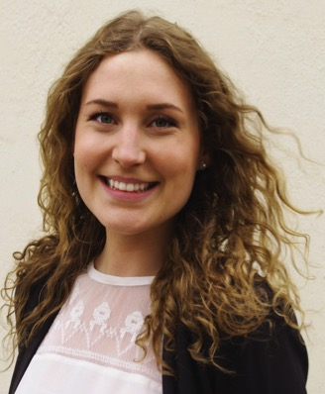

Panel 2 - The Digital Transformation of Labor
Jan Söderqvist
Peter Markowski
Pernilla Lilja
Mårten Blix
Linn Lindfred

Slide 43

Concluding Remarks
4 Key Takeaways:
*The public sector will continue to be important but may shift its priorities in providing welfare (e.g. health care)
*Non-state actors may provide welfare to a greater extent in the future
*Digitalization will change the way we work but does not necessarily entail the substitution of labor
*Digitalization can either increase job availability (Productivity effect) or decrease number of jobs (Displacement effect).

Slide 44

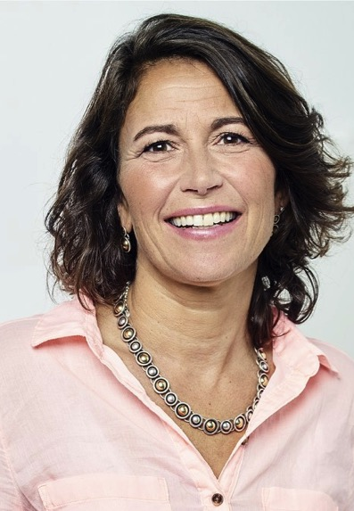
Editor Contact
Anthony Larsson, Ph.D.
Stockholm School of Economics Institute for Research
E-mail: dr.anthony.larsson@gmail.com
WWW: http://www.routledge.com/authors/i18347-anthony-larsson
Professor Robin Teigland
Chalmers University of Technology
E-mail: robin.teigland@chalmers.se
WWW: http://www.robinteigland.com

Slide 45

Thank you!
Free download via Open Access at:
https://www.routledge.com/Digital-Transformation-and-Public-Services-Open-Access-Societal-Impacts/Larsson-Teigland/p/book/9780367333430
Free download via Open Access at:
https://www.routledge.com/The-Digital-Transformation-of-Labor-Open-Access-Automation-the-Gig/Larsson-Teigland/p/book/9780367330705

