Slide 1
Knowledge-intensive Innovative Entrepreneurship in a Digital and Creative Economy
Professor Maureen McKelvey
Swedish Research Council Distinguished Professor Programme on Knowledge-intensive Entrepreneurial Ecosystems
Estrad West
Esbri and Institute of Innovation & Entrepreneurship, GU
Gothenburg, Sweden, November 11, 2019

Slide 2
We teach about 140 MSc students+ 45 Bachelor students
annually

Slide 3
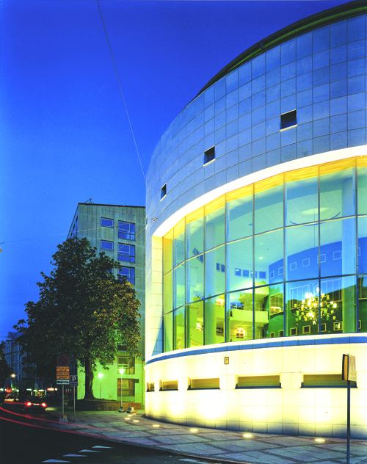
More extreme, faster system dynamics More than high tech or academic spin-offs More dependent upon innovation systems Impact all sectors and industries
1. Knowledge-intensive Innovative Entrepreneurship differs from other types of entrepreneurship

Slide 4
KIE firms are:
New learning organizations that generate new knowledge or use, transform or recombine existing knowledge and are problem solvers through innovation systems and knowledge networks

Slide 5
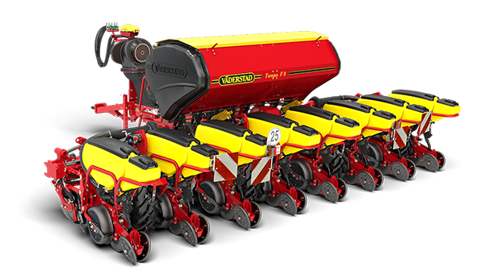
. https://cellink.com/global/ https://www.vaderstad.com/se/ https://www.qamcom.se
Qamcom – unity of technology experts

Slide 6
KIE encompass the circle
Manufacturing / goods
New tech based firms
Academic entrepreneurship
Gazelles
KIBS (knowledge intensive business services)
High tech industry /
University spin-offs
Low tech /
Traditional industries
Services

Slide 7
Based on survey of 4004 KIE firms: Contrasting KIE in creative and manufacturing
1/2
KIE in creative industries are even more dependent upon internal knowledge and services, but tend not to grow
Highly dependent upon educated people
More female founders
Innovate in services but not scale up

Slide 8
But what about special conditions for KIE in creative and digital economy?
Not only technology

Slide 9
Contrasting KIE in creative and manufacturing
2/2
KIE in manufacturing industries are more dependent upon financing, technology, and products
If they are without innovation system linkages, they have difficulties to scale up
They are more likely to do products & radical innovations, but these require global market

Slide 10
Using KIE thinking to help nuance innovation policy
Not the entrepreneur only – but also their ecosystem:
KIE firms are highly dependent upon their education – and other specialists – in the ecosystems
KIEs have very strong links to specific knowledge networks in innovation systems, including large companies, institutions
Scientific, design, creative & technology knowledge link together:
Not only digital or technology!
All industries can use new types of knowledge to innovate
Universities play key role in knowledge networks (> important than direct to start-ups or research per se)
Other sources of knowledge also vital - collaboration

Slide 11
So: KIE in a digital and creative economy
Knowledge-intensive Innovative Entrepreneurship differs from other types of entrepreneurship
KIE firms in a digital and creative economy are a vital organizational entity in a KIE innovation ecosystem

Slide 12
> 30 scientific publications to date “Knowledge-intensive entrepreneurship” Malerba and McKelvey 2019, Trends and Foundations in Entrepreneurship

